Slide 1
Questions on the fundamentals: whom and where to protect?
Reflections on the Geneva Convention and on the future
Presentation of Boldizsár Nagy
on the World Refugee Day celebration
UNHCR – ELTE TÁTK,
25 June 2026
Budapest

Slide 2
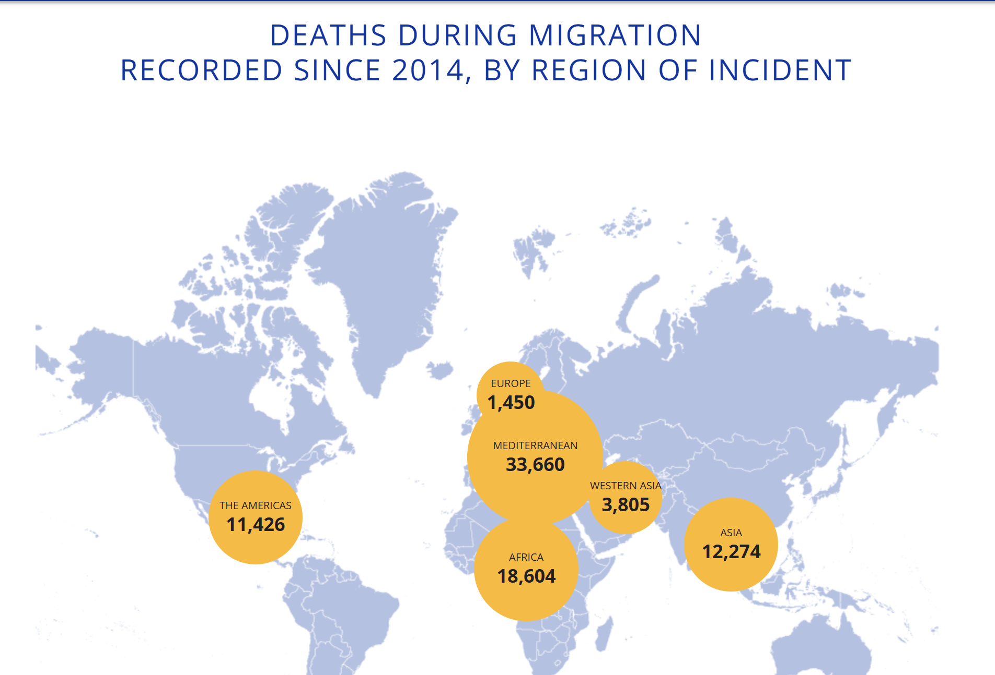
    Warsan Shire: Home
    (Excerpts)
    no one leaves home unless
    home is the mouth of a shark
    you only run for the border
    when you see the whole city running as well
    your neighbors running faster than you
    …
    you have to understand,
    that no one puts their children in a boat
    unless the water is safer than the land
    …
    no one leaves home until home is a sweaty voice in your ear
    saying-
    leave,
    run away from me now
    i dont know what i’ve become
    but i know that anywhere
    is safer than here
82,611
MISSING MIGRANTS since 2014
Notes:
Home
no one leaves home unless
home is the mouth of a shark
you only run for the border
when you see the whole city running as well
your neighbors running faster than you
breath bloody in their throats
the boy you went to school with
who kissed you dizzy behind the old tin factory
is holding a gun bigger than his body
you only leave home
when home won’t let you stay.
no one leaves home unless home chases you
fire under feet
hot blood in your belly
it’s not something you ever thought of doing
until the blade burnt threats into
your neck
and even then you carried the anthem under
your breath
only tearing up your passport in an airport toilet
sobbing as each mouthful of paper
made it clear that you wouldn’t be going back.
you have to understand,
that no one puts their children in a boat
unless the water is safer than the land
no one burns their palms
under trains
beneath carriages
no one spends days and nights in the stomach of a truck
feeding on newspaper unless the miles travelled
means something more than journey.
no one crawls under fences
no one wants to be beaten
pitied
no one chooses refugee camps
or strip searches where your
body is left aching
or prison,
because prison is safer
than a city of fire
and one prison guard
in the night
is better than a truckload
of men who look like your father
no one could take it
no one could stomach it
no one skin would be tough enough
the
go home blacks
refugees
dirty immigrants
asylum seekers
sucking our country dry
niggers with their hands out
they smell strange
savage
messed up their country and now they want
to mess ours up
how do the words
the dirty looks
roll off your backs
maybe because the blow is softer
than a limb torn off
or the words are more tender
than fourteen men between
your legs
or the insults are easier
to swallow
than rubble
than bone
than your child body
in pieces.
i want to go home,
but home is the mouth of a shark
home is the barrel of the gun
and no one would leave home
unless home chased you to the shore
unless home told you
to quicken your legs
leave your clothes behind
crawl through the desert
wade through the oceans
drown
save
be hunger
beg
forget pride
your survival is more important
no one leaves home until home is a sweaty voice in your ear
saying-
leave,
run away from me now
i dont know what i’ve become
but i know that anywhere
is safer than here
Home
no one leaves home unless
home is the mouth of a shark
you only run for the border
when you see the whole city running as well
your neighbors running faster than you
breath bloody in their throats
the boy you went to school with
who kissed you dizzy behind the old tin factory
is holding a gun bigger than his body
you only leave home
when home won’t let you stay.
no one leaves home unless home chases you
fire under feet
hot blood in your belly
it’s not something you ever thought of doing
until the blade burnt threats into
your neck
and even then you carried the anthem under
your breath
only tearing up your passport in an airport toilet
sobbing as each mouthful of paper
made it clear that you wouldn’t be going back.
you have to understand,
that no one puts their children in a boat
unless the water is safer than the land
no one burns their palms
under trains
beneath carriages
no one spends days and nights in the stomach of a truck
feeding on newspaper unless the miles travelled
means something more than journey.
no one crawls under fences
no one wants to be beaten
pitied
no one chooses refugee camps
or strip searches where your
body is left aching
or prison,
because prison is safer
than a city of fire
and one prison guard
in the night
is better than a truckload
of men who look like your father
no one could take it
no one could stomach it
no one skin would be tough enough
the
go home blacks
refugees
dirty immigrants
asylum seekers
sucking our country dry
niggers with their hands out
they smell strange
savage
messed up their country and now they want
to mess ours up
how do the words
the dirty looks
roll off your backs
maybe because the blow is softer
than a limb torn off
or the words are more tender
than fourteen men between
your legs
or the insults are easier
to swallow
than rubble
than bone
than your child body
in pieces.
i want to go home,
but home is the mouth of a shark
home is the barrel of the gun
and no one would leave home
unless home chased you to the shore
unless home told you
to quicken your legs
leave your clothes behind
crawl through the desert
wade through the oceans
drown
save
be hunger
beg
forget pride
your survival is more important
no one leaves home until home is a sweaty voice in your ear
saying-
leave,
run away from me now
i dont know what i’ve become
but i know that anywhere
is safer than here

Slide 3
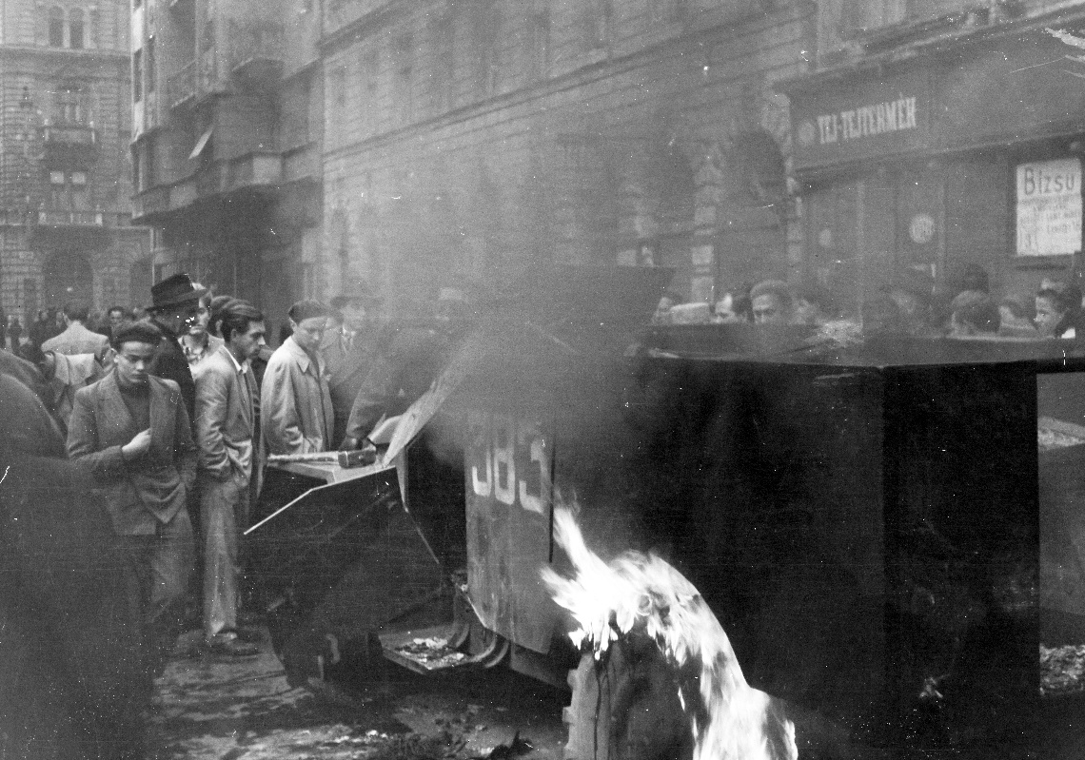
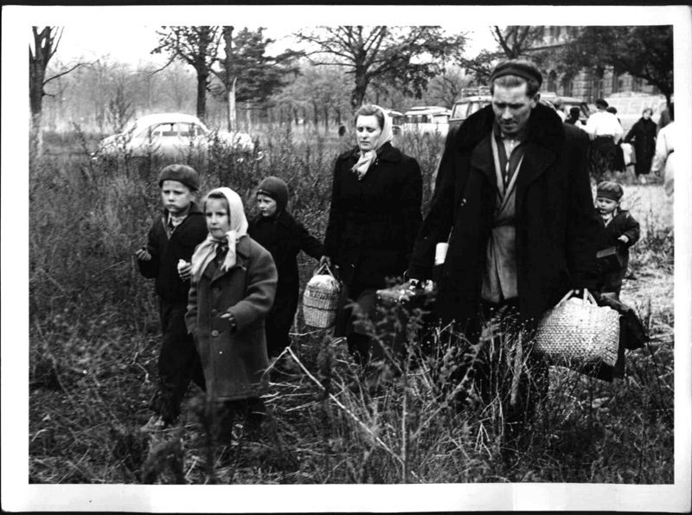
1956
1956
Akácfa street, burnt out Soviet BTR-40
Fortepan / Fóti István heirs
1956
Hungarian family arriving in Traiskirchen
ÖNB Photo archive
Reproduced: https://www.derstandard.at/story/2000022018004/ungarn-1956-von-armen-fluechtlingen-zu-parasiten-des-wohlstands
Notes:
„Den Anstoß zur Verschärfung der öffentlichen Diskussion lieferte dann Innenminister Helmer selbst, als er Anfang Jänner 1957 skandierte, dass Flüchtlinge auch Pflichten hätten.375 Dem Bild der heroischen Kämpfer:innen für die Freiheit wurde nun die Vorstellung von faulen und undankbaren Flüchtlingen gegenübergestellt.” 376
Sarah Knoll ZWISCHEN AUFNAHME UND TRANSIT Österreichische Asyl- und Flüchtlingspolitik im Kalten Krieg, p. 90

Slide 4
Nothing new – solidarity request in 1956
„Vienna has on 5 November [1956, the day after the crashing of the revolution – BN] formally addressed the UNHCR and the ICEM [Intergovernmental Committee for European Migration, predecessor of IOM] to request immediate assistance: [other states should] offer temporary admission to as many refugees as possible and provide financial assistance to Austria”
Kecskés (2025) p. 56

Slide 5
Two fundamental questions
Why to protect refugees and not others in need?
Who (which state/society) should offer that protection?

Slide 6
Constructing the self by way of construction the refugee and the duties towards them
The essential claim of this talk is simple: by extending or withholding protection to the refugee, by undertaking responsibility or shifting it to other states we construct (identify and understand) ourselves, our roles, our values.

Slide 7
WHY DO REFUGEES DESERVE PREFERENTIAL TREATMENT OVER OTHER FOREIGNERS AND WHY IS PREFERENCE OF FELLOW NATIONALS (PARTIALISM) NOT UNCONDITIONAL?

Slide 8
Why protect and assist refugees and not others?
Who is the refugee, whom to protect?
Refugee definitions (definitions of those entitled to international protection) are arbitrary (politically determined) – compare Geneva 51 and the AU convention + Qualification regulation of the EU
It is an indeterminate and historically changing group
Debates about the use of the term(s): Shacknove, Betts, Crawley-Skleparis
Human action
Persecution – inactive (failed) state
Political freedoms Basic needs
Forces of nature
GC51
Climate refugees?
Notes:
Andrew E. Shacknove: Who is a refugee?
Ethics, col. 95, January 1985, quote from p. 278
Alexander Betts: Survival Migration: A New Protection Framework
16 Global Governance 361 2010
Heaven Crawley & Dimitris Skleparis (2018) Refugees, migrants, neither, both: categorical fetishism and the politics of bounding in Europe’s ‘migration crisis’, Journal of Ethnic and Migration Studies, 44:1, 48-64, DOI: 10.1080/1369183X.2017.1348224
To link to this article: https://doi.org/10.1080/1369183X.2017.1348224
„It is clear therefore that there is nothing ‘natural’ or ‘fixed’ about the legal and policy categories associated with international migration: rather these categories are in a constant state of change, renegotiation and redefinition. The categories ‘refugee’ and ‘migrant’ do not simply exist but rather are made. Choosing to label – or equally not label – someone as a ‘refugee’ is a powerful, and deeply political, process, one by which policy agendas are established and which position people as objects of policy in a particular way (Zetter 2007; Becker 2014).” Crawley – Skleparis, p. 52

Slide 9
Why protect and assist refugees and not others?
Specificities of international protection
Historic: political struggle of the liberal states with the regimes committing horrific acts of persecution (Bolshevik Russia, Turkey after WWI, then Germany and other fascist powers and after 1945 Stalin’s Soviet Union and the Communist states)
Structural: the need for a specific entry right is necessitated by the exclusion regime based on borders and sovereignty. Sovereign control over migration creates the need for refugee law. Admission is the only remedy against locking in the person to a persecutory environment (state, society, geographic area)
Notes:
Gibney, 2004: he acknowledges that states may limit entry places in order to maintain a welfare state and to protect the values of a liberal democratic state.
If there are limited places then choce must be made.
Refugees can not be assisted at homes, others, who would also come, can. So prefer refugees over the other neeedy (2004, p. 83 -4)

Slide 10
Why protect and assist refugees and not others?
The moral-political duty to assist extends beyond refugees
Alleviation of poverty and other vulnerabilities is the political duty of the international community – see e.g. 2030 UN Sustainable development goals, and the human security approach.
It is widely debated to what extent there is a legal duty derived from ICESCR or from the colonial past to assist.
See Pribytkova, (2022) and Anghie (2025)
for illuminating overviews
Notes:
Gibney, 2004: he acknowledges that states may limit entry places in order to maintain a welfare state and to protect the values of a liberal democratic state.
If there are limited places then choce must be made.
Refugees can not be assisted at homes, others, who would also come, can. So prefer refugees over the other neeedy (2004, p. 83 -4)

Slide 11
Environment. Climate – non-refoulement
Environmental-change induced migration
„[T]he idea that disasters are ‘natural’ and thus beyond the scope of the 1951 Refugee Convention has plagued refugee law for much of the past 75 years, constraining its inherent ability to respond. In 1993, for instance, the Supreme Court of Canada said that ‘victims of natural disasters’ could not be refugees ‘even when the home state is unable to provide assistance’.” McAdam-Gilbert, (2026), p. 2.
Hazard – natural (neutral) disaster: hazard + demographic, political, social, economic and other factors
„The basic legal premise that the principle of non-refoulement is applicable to the disaster and climate context is now firmly established.” Bruce Burson (New Zeeland Judge) 2026

Slide 12
Four counterarguments against (automatically) preferring citizens over others
The relationship of preference ought to be of moral value (No duty to prefer a fellow national fascist over a foreign social democrat!)
Loyalty: not necessarily concentric circles where nation comes after locality. Think of ethnic/national minorities who prefer their ethné over the fellow nationals
Preferring nationals taking the form of welfare chauvinism may run counter to the overall duty to alleviate poverty.
The community of (only) citizens is a fiction. The society consists of nationals and (resident) foreigners. The state must serve both groups forming the society. Resident foreigners ought to be preferred (in respect of social services) over own nationals living abroad.
Notes:
„It is important to bear in mind that in its jurisprudence the Court has interpreted the inclusion of “other status” among the grounds of prohibited discrimination as including discrimination on the basis of nationality: According to the Court’s case-law, a difference of treatment is discriminatory, for the purposes of Article 14 (art. 14), if it ‘has no objective and reasonable justification’, that is, if it does not pursue a ‘legitimate aim’ or if there is not a ‘reasonable relationship of proportionality between the means employed and the aim sought to be realised’. Moreover the Contracting States enjoy a certain margin of appreciation in assessing whether and to what extent differences in otherwise similar situations justify a different treatment. However, very weighty reasons would have to be put forward before the Court could regard a difference of treatment based exclusively on the ground of nationality as compatible with the Convention (paragraph 42)53”
53. Gaygusuz v. Austria, 16 September 1996, application number 17371/90.
The right to leave a country
Issue Paper by the Council of Europe Commissioner for Human Rights
Council of Europe, p. 38

Slide 13
THE MORAL IRRELEVANCE OF GEOGRAPHIC PROXIMITY/DISTANCE

Slide 14
Distance/proximity in itself is morally irrelevant – general theses
Proximity does not create a moral ground justifying larger/more intensive obligation.
It is only relevant if proximity is a precondition for the performance of a moral duty („rescuing the drowning person”).
All other spatially determined communities („our town”, „our region”) are cognitive creations, mental constructions within which physical distance usually is irrelevant when moral duties are defined. (The remote rich must help the local poor through taxation, men and women from the center have to protect the border)
Membership in spatially imagined communities (e.g. citizenship in a country) usually assumes equality in respect of that community. Differentiation in morally relevant duties is not based on geographic distance.

Slide 15
Proximity, distance and states
Humanitarian intervention, R2P – distance is not an issue
Refugee protection - surrogate protection instead of the state of origin. Same logic as in R2P: the state is unable or unwilling to exercise its sovereign functions → protection offered is
- a global public good
- offered to the „world’s refugees” (New York Declaration)
Hathaway and Neve, 1997
„In an ideal world a system to share the burdens and responsibilities of refugee protection would operate at a global level. A universal system could spread the costs of providing asylum among the largest number of states, thereby minimizing the risk of an unacceptably high cost being imposed on any particular government. It is also morally attractive” (p. 187) But impossible for Realpolitik reasons (ibid)
Propose regionalised solution „interest-convergence groups”

Slide 16
Proximity - further reasons for its irrelevance
Hathaway and Neve: (1997) 4 factors influencing the place of asylum
„it makes most sense to protect refugees where they are safest, most self-sufficient, least likely to experience social conflict and ultimately in the best position to repatriate if and when safety is restored in their country of origin” (p.204)
„… geographical proximity between the state of asylum and the country of origin is desirable to allow for ongoing contact between refugee and stayee communities, and ultimately to facilitate repatriation” (p. 204)
_______________
Ad 1 and 2) Safety and self–sufficiency more likely in remote (developed) countries
Ad 3) Threat of social conflict: context dependent, both nearby and remote country may be threatening
1 safe
2 self sufficient
3 no social conflict
4 proximity
= contact
= easy repat-riation

Slide 17
Proximity justification - challenged
Ad 4) Proximity 2 reasons
Contact with stayee community Ease of repatriation
1996 2019
Internet, mobile phone, unlimited air capacity
(DHL – 500 flights/day!)
There is no morally relevant justification of preferring an asylum country close to the site of persecution if that is not the choice of the refugee
Even, from a practical point of view 2,5 of the 4 requirements probably are better met in more remote (developed) states
Proximity may be relevant as the refugee’s choice, and, indeed in some instances cultural closeness may mitigate trauma.
Notes:
DHL 500 flights per day from 250 dedicated aircraft
500 flights 150 000 humans in an aircraft with 300 capacity

Slide 18
HUNGARY,
MEMBER OF THE EU,
BOUND BY THE NEW MIGRATION AND ASYLUM PACT
2026

Slide 19
EU, PACT, HUNGARY,
The Pact:
Broad definition of persons in need of protection
but
efforts to prevent arrival
reification of the applicant, drastically limiting their agency
Implied presumption of not being in need of protection – limiting freedom of movement, fiction of non-entry
Efforts to shift responsibility to third states
Hungary,
June 2026
- Mostly fair treatment of the persons feeing Ukraine.
Inarticulate refusal of the Pact.
Maintaining the lie of an existing „crisis caused by mass immigration” as pretext for non-applying the ordinary refugee law.
Abuse of Serbia with informal returns
Denying the similarity of „our heroes” of Budapest, 1956 and the present day heroes of Tehran, Kabul, Damascus, Tbilisi, Moscow, etc.
Maintaining an attitude (and identity) our successors will be ashamed of. (And many of us already are)

Slide 20
Referenced works
Anghie Anthony. (2025) The Injustices of Reparations. 119 (3) American Journal of International Law. 423-451.
Betts, Alexander (2010) Survival Migration: A New Protection Framework 16 Global Governance 361
Betts, Alexander – Collier, Paul (2017)Refuge –Rethinking refugee policy in a changing world, OUP, 2017
Burson, Bruce (2026) ‘Enhancing Legal Preparedness for Climate Displacement: Judicial Engagement with the Non-Refoulement Principle in the Decade since the Nansen Initiative Protection Agenda’ (Nansen Initiative +10 Blog, 2 February 2026) <https://climatemobility.unsw.edu.au/blog/bruce-burson/index.html> (accessed 23 June 2026).
Carens, Joseph (2013) The Ethics of Immigration OUP
Crawley, Heaven - Skleparis, Dimitris (2018) Refugees, migrants, neither, both: categorical fetishism and the politics of bounding in Europe’s ‘migration crisis’, Journal of Ethnic and Migration Studies, 44:1, 48-64
Hathaway, James A - Neve, Alexandre R (1997) : Making International refugee Law relevant Again: A proposal for Collectivized and Solution-oriented Protection Harvard Human Rights Journal, vol. 10, Spring, 115 – 211.
Kecskés D Gusztáv (2025) : Globális humanitárius akció a hidegháború idején. Az 1956-os magyar menekültek nemzetközi befogadása, Hun-Ren, Budapest, 2025,
Knoll, Sarah (2024) Zwischen Aufnahme und Transit Österreichische Asyl- und Flüchtlingspolitik im Kalten Krieg, Transit, Bielefeld
McAdam, Jane & Gilbert, Geoff: (2026) Après le déluge: Evolving approaches to international protection in the context of climate change and disasters, International Journal of Refugee Law, https://doi.org/10.1093/ijrl/eeag011
Pribytkova, Elena (2022) Are there global obligations to assist in the realization of socio-economic rights? 54 N.Y.U. Journal of International Law & Politics 379-484
Shacknove, Andrew E. (1985) Who is a refugee? Ethics, col. 95, January 1985

Slide 21
THANKS!
BOLDIZSÁR NAGY
Professor Emeritus
CEU IR and ELTE
Vienna Budapest
E-mail: nagyboldi100 at gmail.com
www.nagyboldizsar.hu

