Slide 1
STATES, INSTITUTIONS, MOBILITY
THE EU AND THE THIRD COUNTRY NATIONALS
Presentation by
Boldizsár Nagy at the CEU summer school course:
The National and the Transnational
5 July 2018

Slide 2
The scheme of the talk
Setting the scene: statistics
An Area of Freedom, Security and Justice - conceptual frame
Schengen
Migration and the EU acquis – an overview
Visas, borders, Schengen rules within the EU
Intra-EU mogration (mobility), citizenship
Third country nationals in the EU
- regular migration
- no right to enter/stay („illegal migration”)
- asylum seekers, refugees
Solidarity within the EU
Solidarity (or not) with third states

Slide 3
How many?
Basic statistics

Slide 4
Basic Statistics
EU, total population on 1 January 2017: 511 million of which the UK: 65 million
 | In/of another EU member state | In /of a third country | Total
Foreign-born | 20,4 | 36,9 | 57,3
Foreign citizen | 16,9 | 21,6 | 38,5
Notes:
„There were 33.5 million people born outside of the EU-28 living in an EU Member State on 1 January 2014, while there were 17.9 million persons who had been born in a different EU Member State from the one where they were resident. Only in Ireland, Hungary, Slovakia, Luxembourg and Cyprus was the number of persons born in other EU Member States higher than the number born outside of the EU-28.” p. 6
Source: Eurostat, Migration and migrant population statistics, 2015
http://ec.europa.eu/eurostat/statistics-explained/index.php?title=Migration_and_migrant_population_statistics&oldid=216019

Slide 5
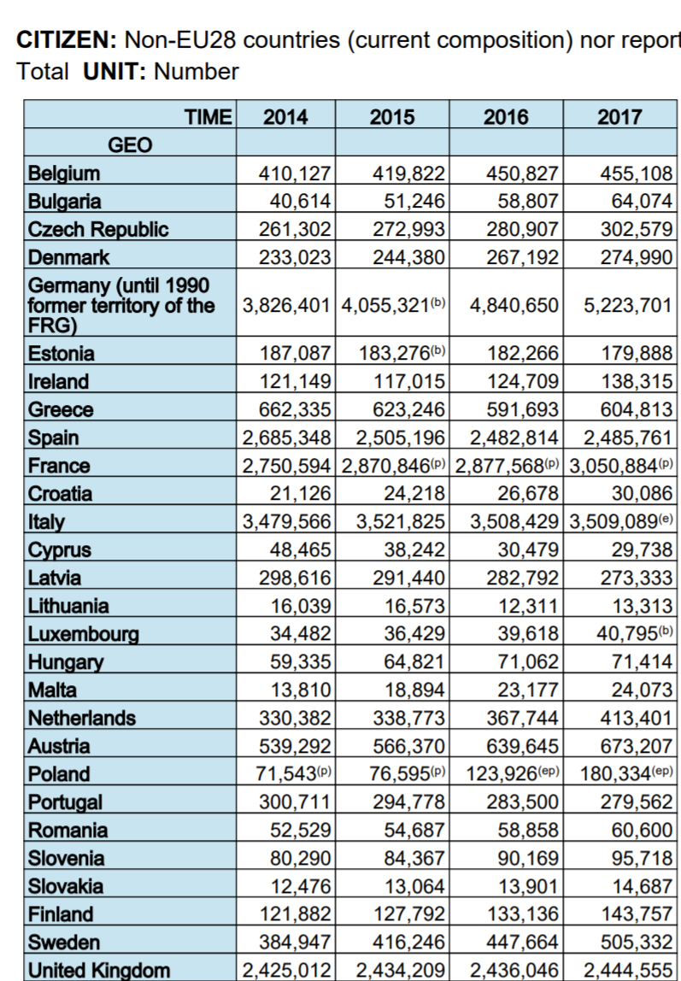
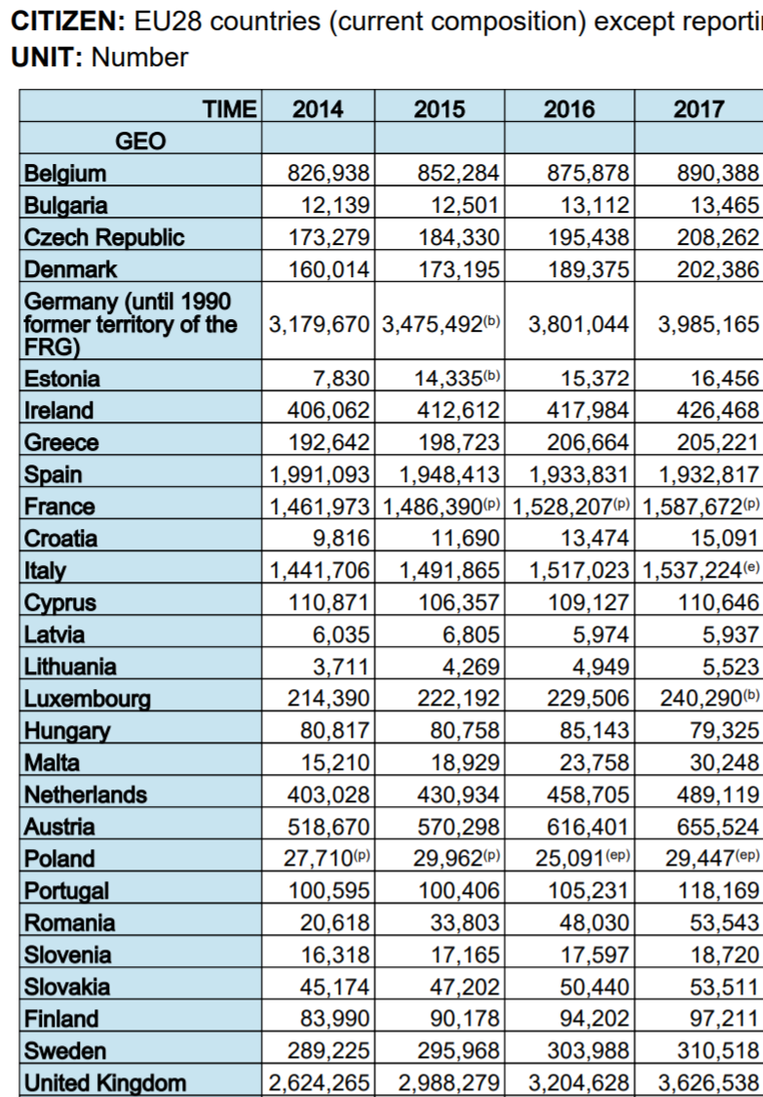
Non-EU and EU citizens in EU 28
Source: Eurostat: Population on 1 January by age, sex and broad group of citizenship (migr_pop2ctz) (20180702)

Slide 6
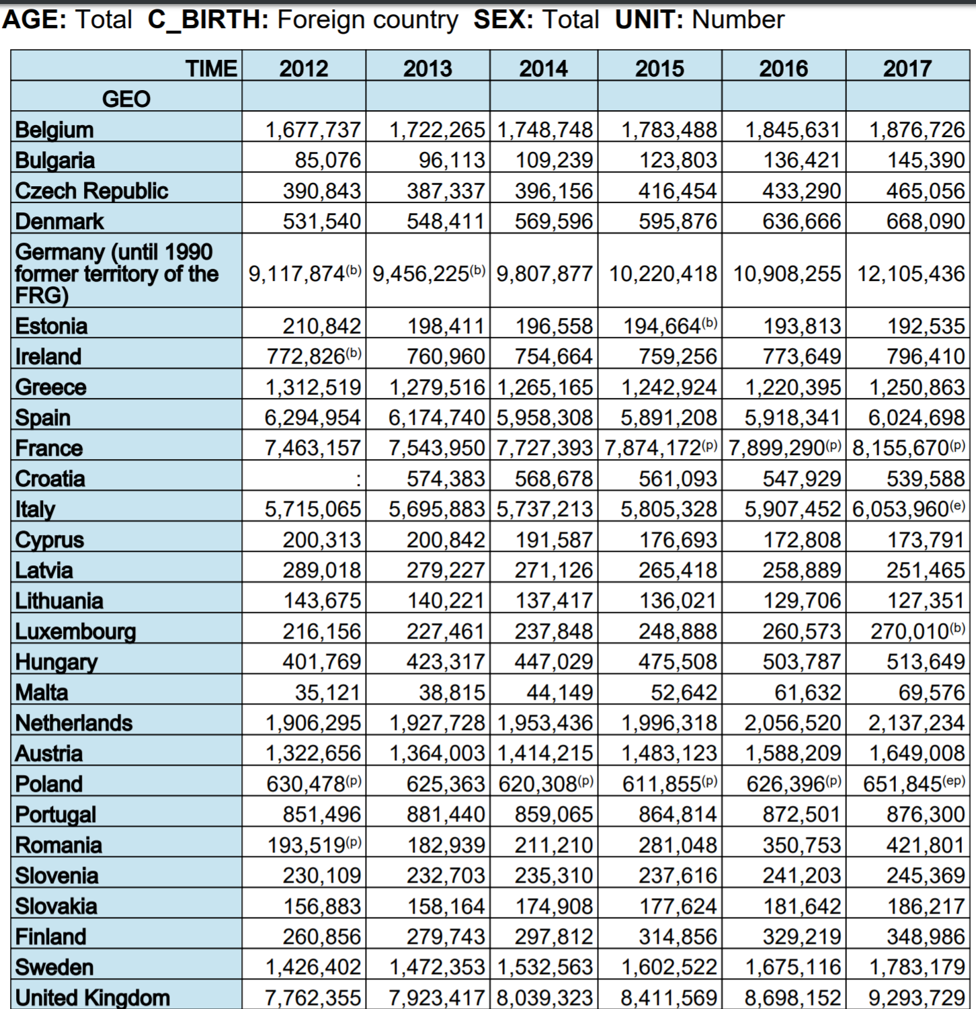
Foreign born population in the EU 28
B = break in time series
P = provisional
Source: Eurostat:Population on 1 January by age, sex and broad group of country of birth [migr_pop4ctb]
Last update: 28-06-2018 (20180702)

Slide 7
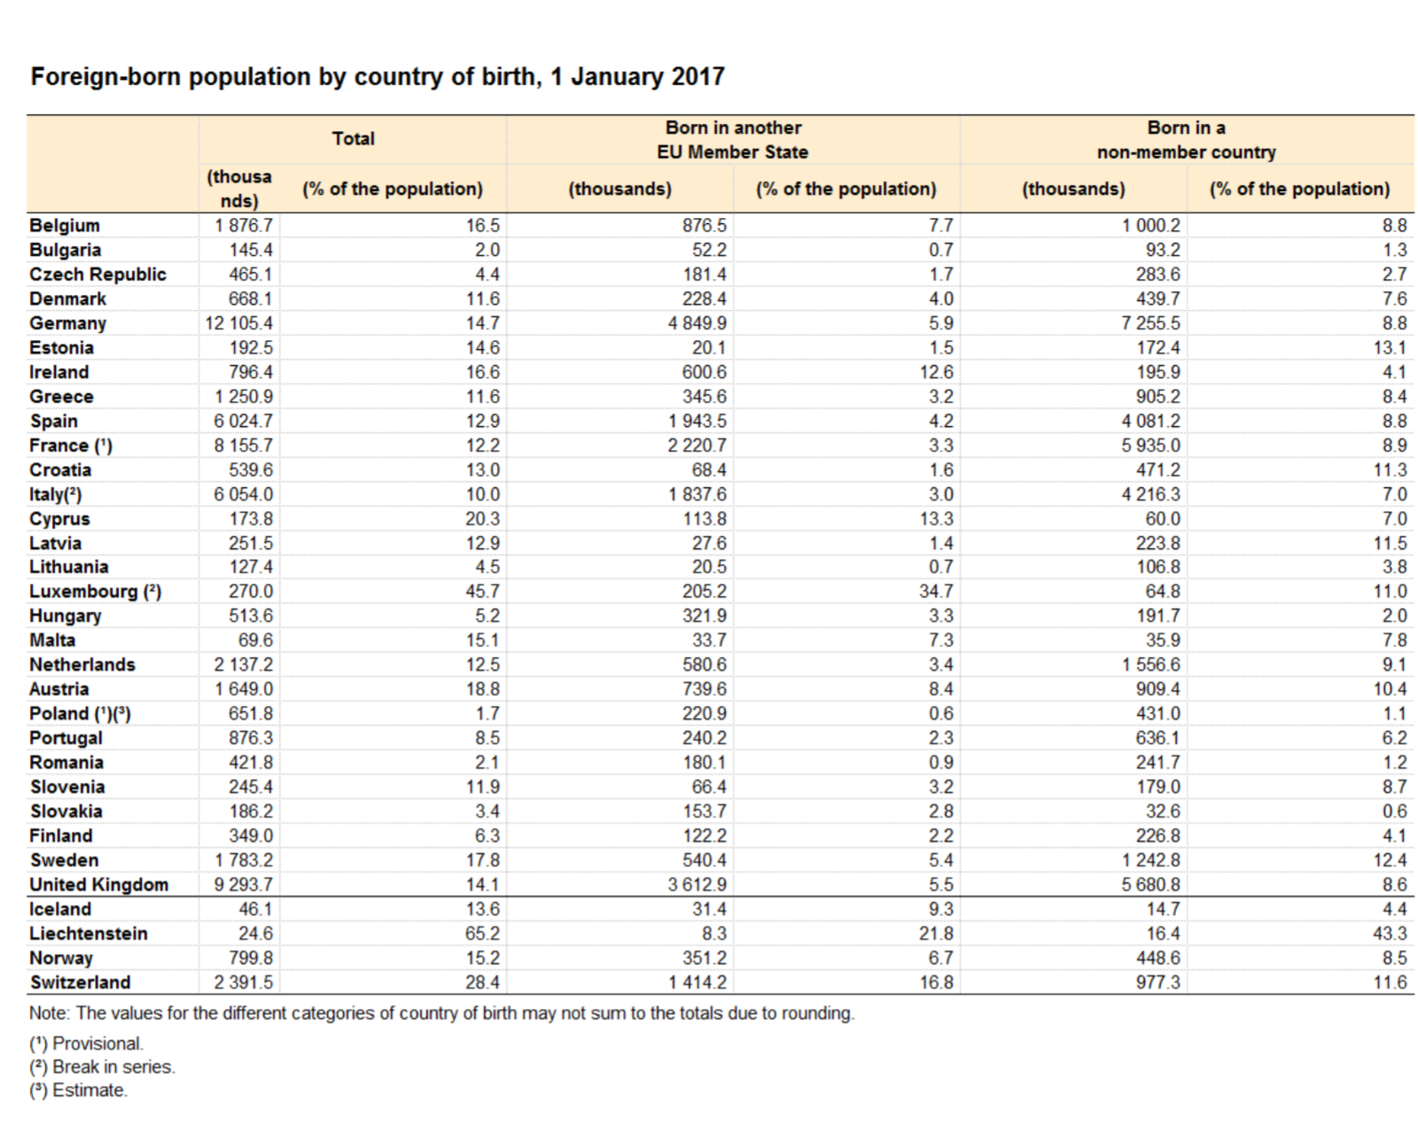
Foreign born population in the EU

Slide 8
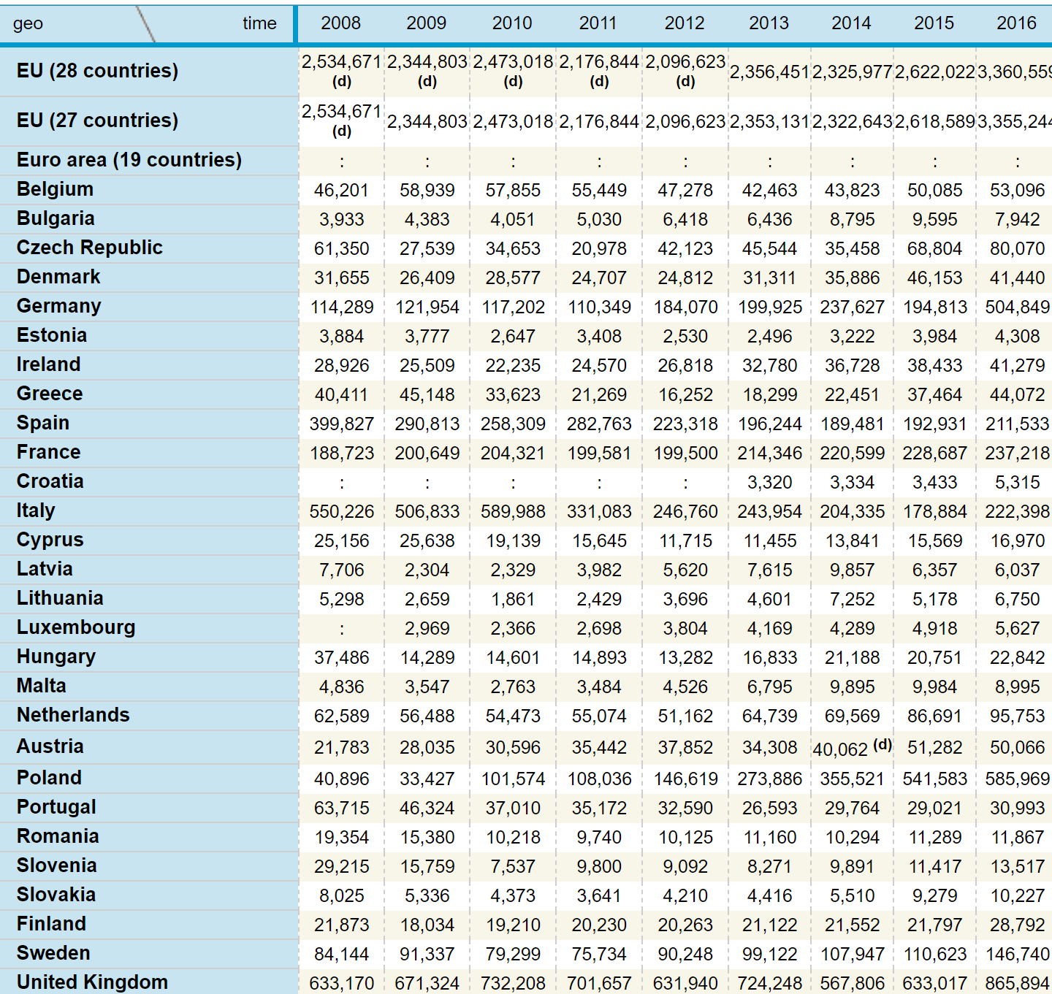

Longer than 3 months first residence permits issued to third country nationals
2008
2009
2010
2011
2012
2013
2014
Source: Eurostat, http://ec.europa.eu/eurostat/web/asylum-and-managed-migration/data/main-tables (20180702)

Slide 9
FROM JUSTICE AND HOME AFFAIRS TO AN AREA OF FREEDOM, SECURITY AND JUSTICE

Slide 10
The area of freedom, security and justice
The metamorphosis of concepts
1958 - 1993 = Up to Maastricht: intergovernmental cooperation
  Schengen Agreement (1985) and Convention implementing the Sch. A. (1990)
  The Dublin Convention on determining the state responsible for the asylum procedure (1990)
1993 – 1999 = Between Maastricht (1 November 1993) and Amsterdam (1 May 1999) = Justice and home affairs = III pillar = 9 matters of common interest as in Article K (Title IV) of the TEU (Maastricht treaty)
1999 - 2009 = From entry into force of the A.T. till entry into force of the Lisbon Treaty (1 December 2009) = Justice and home affairs = Area of freedom, security and justice =
    I pillar = Title IV. of TEC (Visas, asylum, immigration and other policies related to free movement of persons + civil law cooperation)
    +
    III pillar =Title VI. of TEU (Provisions on police and judicial cooperation in criminal matters)
2009 December 1 - = Area of freedom, security and justice reunited in Title V of the Treaty on the Functioning of the European Union = Border checks, asylum, immigration; civil law cooperation; criminal law cooperation; police cooperation = no pillar structure but CFSP is outside of the „normal” EU regime
Notes:
Freedom = freedom of movement + immigration and asylum+ non-discrimination+ data protection+ fundamental human rights+citizenship
Security = fight against organized crime (including terrorism) and drugs + police cooperation (Europol, Eurojust, External Border Agency)
Justice („Recht”) = cooperation among civil and criminal courts, approximation of procedures, mutual recognition of decisions, simplification of transborder actions (litigation in another member state)

Slide 11
The area of freedom, security and justice
Freedom = freedom of movement + immigration and asylum+ non-discrimination+ data protection
Security = fight against organized crime (including terrorism) and drugs + police cooperation (Europol, Eurojust, Frontex)
Justice („Recht”) = cooperation among civil and criminal courts, approximation of procedures, mutual recognition of decisions, simplification of transborder actions (litigation in another member state)
Notes:
European Agency for the Management of Operational Cooperation at the External Borders of the Member States of the European Union

Slide 12
The rationale behind developing an EU acquis:
Schengen

Slide 13
SCHENGEN
I. The creation of the Agreement (1985) and the Convention, implementing it (1990)
    C O N V E N T I O N IMPLEMENTING THE SCHENGEN AGREEMENT OF 14 JUNE 1985 BETWEEN THE GOVERNMENTS OF THE STATES OF THE BENELUX ECONOMIC UNION, THE FEDERAL REPUBLIC OF GERMANY AND THE FRENCH REPUBLIC, ON THE GRADUAL ABOLITION OF CHECKS AT THEIR COMMON BORDERS
    19 JUNE 1990 (OJ (2000) L 239/19)
II. The essence (see next slides)

Slide 14
Schengen
Purpose:
  Abolition of controls at the internal borders
  Implementation of appropriate flanking measures
    protecting the external borders with the same level of security including checks and surveillance
    intensive co-operation in customs, police and criminal justice matters
    establishing a system to determine which state is responsible for the examination of asylum applications
How to interpret the flow of people from Greece to Macedonia (fYROM), Serbia and then across the external border of the EU to Hungary (and onwards)?!

Slide 15
Schengen
Territorial and personal scope
  Territorial - see map on next slide
  Personal: nationals of member states or “aliens”
  “Internal borders shall mean the common land borders of the Contracting Parties, their airports for internal flights and their sea ports for regular ferry connections exclusively from or to other ports within the territories of the Contracting Parties and not calling at any ports outside those territories;”

Slide 16
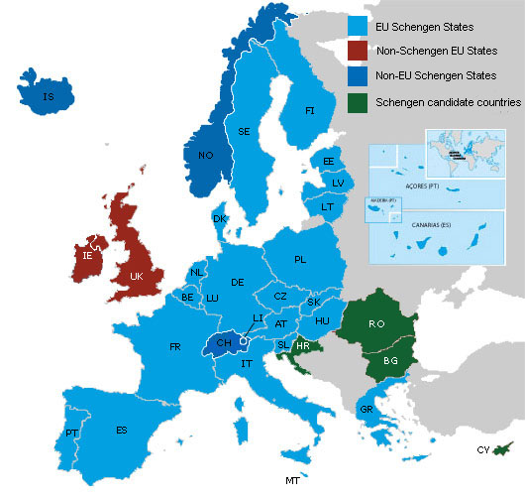
Schengen: area with no internal borders
1985: Signature of the Schengen agreement between FR, BE, NL, DE & LUX
1990 Schengen Implementing Convention
1995: abolition of the checks at the internal borders + one single external border among the 13 EU MS (except for UK IRL)
1997: incorporation of the Schengen cooperation into the EU legal framework
2001 Norway and Iceland
2007 Estonia, Hungary, Latvia, Lithuania, Malta, Poland, Slovenia, Slovakia and the Czech Republic
2008: Switzerland
2011: Liechtenstein
Prospective Members CY, BG, RO,HR
Special status UK, IRL and DK – protocols under the Treaty of Lisbon

Slide 17
MIGRATION
AN OVERVIEW OF THE SITES, LEVELS AND TYPES OF EU RESPONSES

Slide 18
Phases/sites of migration
Methods and helpers of migration
Country of origin
Transit state
Border
Destination country (EU MS)
Elements of the acquis as tools of enforcing the EU strategy

Slide 19
Dimensions of the analysis – main elements of the migration acquis
Methods
and helpers of migration
Transit state
Border
Destination country
(EU MS)
Country of origin
Immigration rules and emigration (their impact on the country of origin’s society); | Human smuggling, Fight against trafficking |  | External border Surveillance conditions of crossing; abolition of internal borders European Border and Coast Guard Eurosur | EU mobility and immigration policy - workers, - service providers - EU citizens - researchers, students, trainees, volunteers - „blue card” – highly skilled - family unification - intra corporate transferees - seasonal workers
 | Carrier sanctions | Transit visa | Visa; Alerts (Schengen) | Integration Fight agains racism, xenophobia and discrimination
Tackling the root causes of asylum seeking | Interception in international waters | Safe third country |  | Asylum acquis Burden and responsibility sharing
Safe country of origin | Document protection (from falsification) | Return agreements |  | Cooperation in removal/return

Slide 20
Dimensions of the analysis – overview of the junctures)
Type of migrant | The position of the migrant from the EU’s point of view | Preferred | Reservations | Pawn in the game |  | Unwanted
Regular |  | National of the EU MS or of the EEA MS or of Switzerland | New MS, Europe Agreements, Associated states (Turkey) | ACP and Maghreb countries; nationals of states with return agrements; Eastern Europe |  |  | Visa rejected
S. Peer’s category: |  | Market citizen | Worker | „Alien”
Refugee Irregular Migrant without the right to stay |  | Resettlement „Quota refugees” „protected entry” | Asylum seeker ariving directly from the territory of persecution | Asylum seeker arriving through third countries | Intercepted outside the EU; Arriving from safe country of origin; Rejected claimant
 |  |  |  | Regularisation Victims of trafficking |  | Those to be removed or already removed
Notes:
Chalmers- Davies – Monti’s categories
Desirable foreigners Worke

Slide 21
Visas, borders, border guards, schengen entry, restoration of internal border controls

Slide 22
External Borders
The virtualisation and delocalisation of the border
- Visa policy
- Liaison persons in third countries, capacity building, info sharing, direct assistance (Libya, e.g.!)
- Carrier sanctions
- Interception on high seas
- Border management
- control at entry points,
- surveillance between them - fences!
- In-country controls for immigration purposes
The dialectic of the restoration of internal border controls under the Schengen Border Core – internal becomes external
Notes:
REGULATION (EC) No 810/2009 OF THE EUROPEAN PARLIAMENT AND OF THE COUNCIL of 13 July 2009 íestablishing a Community Code on Visas
(Visa Code) (OJ L 243, 15.9.2009, p. 1)
As consolidated (last amendment: 2016) https://eur-lex.europa.eu/legal-content/EN/TXT/PDF/?uri=CELEX:02009R0810-20160412&qid=1530612762772&from=EN

Slide 23
Visa policy
COUNCIL REGULATION (EC) No 539/2001 visa list (consolidated in 2017)
Determining thrid country nationals who need a visa to cross the external border.
Immoral - Visas are collective stigmas / prevents asylum seeekrs from arriving
Ineffective – No serious threat may be discovered with the help of a mere questionnaire. (Now, ohoto and fingerprint may be more helpful)
Obstacle – hinders the economy and cheap travel by making voyage cumbersome and expensive
But: one Schengen visa valid in 26 countries
Border control could be used to screen out the unwanted.
Notes:
COUNCIL REGULATION (EC) No 539/2001 of 15 March 2001 listing the third countries whose nationals must be in possession of visas when crossing the external borders and those whose nationals are exempt from that requirement (OJ L 81, 21.3.2001, p. 1) Latest consolidated version: 2017 June

Slide 24
Border management - Schengen Borders Code
Schengen Borders Code (Regulation (EU) 2016/399)
In essence:
Codifies Schengen: abolition of internal border controls (and rules on temporary reinstallation as amended in 2017
(Articles 25 – 35)
Determines conditions for entry of persons
Regulates checks at border crossings, surveillance between border crosing points
  (In harmony with the Visa list regulation, the Visa code and SIS, Interpol, national data bases)
Notes:
Schengen Code (REGULATION (EU) 2016/399 OF THE EUROPEAN PARLIAMENT AND OF THE COUNCIL of 9 March 2016 on a Union Code on the rules governing the movement of persons across borders (Schengen Borders Code) Consolidated text at https://eur-lex.europa.eu/legal-content/EN/TXT/PDF/?uri=CELEX:02016R0399-20170407&qid=1530610080064&from=EN
EBCG (Frontes) regulation:
Regulation (EU) 2016/1624 of the European Parliament and of the Council of 14 September 2016 on the European Border and Coast Guard and amending Regulation (EU) 2016/399 of the European Parliament and of the Council and repealing Regulation (EC) No 863/2007 of the European Parliament and of the Council, Council Regulation (EC) No 2007/2004 and Council Decision 2005/267/EC (OJ L 251, 16.9.2016, p. 1).
Risk analysis - all Frontex activities are risk-analysis driven. Frontex assesses risks to EU border security. It builds up a picture of patterns and trends in irregular migration and cross-border criminal activity at the external borders, including human trafficking. It shares its findings with EU countries and the Commission and used by the agency for planning its activities.
Joint operations - coordinates the deployment of specially trained staff and technical equipment (aircraft, vessels, and border control/surveillance equipment) to external border areas in need of additional assistance.
Rapid response - if an EU country is facing extreme pressure at an external border, especially the arrival of large numbers of non-EU nationals, Frontex coordinates the deployment of European Border Guard Teams.
Research - brings border control experts together with research and industry to make sure new technology meet the needs of border control authorities.
Training - develops common training standards for border authorities, to harmonise border guard education in EU and Schengen associated countries. This harmonisation is intended to ensure that wherever travellers cross an external EU border, they will encounter uniform border-control standards. It also enables border guards from different countries to work together efficiently while deployed to joint operations coordinated by Frontex.
Joint returns - develops best practices for returning migrants and coordinates joint return operations (but individual countries decide who should be returned).
Information-sharing - develops and operates information systems that enable swift exchange of information between border authorities.
(From: https://europa.eu/european-union/about-eu/agencies/frontex_en )

Slide 25
Border mamnegment - EBCG
European Border and Coast Guard regulation (Earlier „Frontex”). Regulation 2016/1624/EU)
Implements the Schengen Border Code
EBCD = EBCD Agency (EU) + National authorities
Risk analysis -Joint operations - Rapid response - Research - Training- Joint returns - Information-sharing
Specific intervention (Arts 13, 19): management board prescribes compulsory measures – if MS does not act: Council decides measures, including deploying border guard teams. MS must cooperate – if not restoration of boder control restored against it at the internal border according to the Schengen Border Code

Slide 26
The cost of „non-Schengen”
„According to the Commission analysis of direct economic cost of non-Schengen i.e. the situation where the border controls have been reintroduced for a longer period of time delays at the borders would have a substantial impact on cross-border transport (notably through road), tourism, public administrations and cross-border workers and travellers. For those categories, the direct costs are estimated to range between €5 and €18 billion per year (or 0.06%-0.13% of GDP), depending on the time spent due to delays. The medium-term indirect costs of non-Schengen may be considerably higher than those direct estimates, as the impacts on intra-community trade, investment and mobility would be unprecedented if rolling-back Schengen puts at risk the economic integration.”
Taking care of 1 million persons with 500 euros / head / month entails 6 billion Euros cost, which is all spent in the national economy
Source: COM (2017) 571 Final Proposal for a REGULATION OF THE EUROPEAN PARLIAMENT AND OF THE COUNCIL amending Regulation (EU) 2016/399 as regards the rules applicable to the temporary reintroduction of border control at internal borders, p. 5, fn 5

Slide 27
National?
Are there tasks, which by definition must be performed by the state concerning borders?
Is „statehood” and „sovereignty separable?”
Is statehood/sovereignty undermined if the rules on entry rights, border checks and surviellance are adopted at EU level?
Where is the „final control” in the scheme created by the Visa regime and the border regime adopted by the EU?

Slide 28
Freedoms within the EU
The preferred group

Slide 29
Migration within the EU („Mobility”)
In the beginning: workers and service providers
„Citizenship”: introduced in the Maastricht treaty, amending the Rome Treaty (TFEU)
Not an unlimited right! (Directive 2004/38/EC)
Only: workers, self employed, persons with sufficient means, students
„Union citizenship is for all Europeans who are not poor or sick” Chalmers- Davies –Monti, 2104, 478
After 5 years: permanent residence
Notes:
TFEU Article 20
1. Citizenship of the Union is hereby established. Every person holding the nationality of a
Member State shall be a citizen of the Union. Citizenship of the Union shall be additional to and not replace national citizenship.
2. Citizens of the Union shall enjoy the rights and be subject to the duties provided for in the
Treaties. They shall have, inter alia:
(a) the right to move and reside freely within the territory of the Member States;
(b) the right to vote and to stand as candidates in elections to the European Parliament and in
municipal elections in their Member State of residence, under the same conditions as nationals of that State;
(c) the right to enjoy, in the territory of a third country in which the Member State of which they are nationals is not represented, the protection of the diplomatic and consular authorities of any Member State on the same conditions as the nationals of that State;
(d) the right to petition the European Parliament, to apply to the European Ombudsman, and to address the institutions and advisory bodies of the Union in any of the Treaty languages and to obtain a reply in the same language.
These rights shall be exercised in accordance with the conditions and limits defined by the Treaties and by the measures adopted thereunder.

Slide 30
Third country nationals, regular (im)migration

Slide 31
Third country nationals – regular migration into the EU
Article 79 TFEU
„1. The Union shall develop a common immigration policy aimed at ensuring, at all stages, the efficient management of migration flows, fair treatment of third-country nationals residing legally in Member States, and the prevention of, and enhanced measures to combat, illegal immigration and trafficking in human beings.”
- Rules on entry and residence conditions, on visas and residence permits
- Defining the rights of legally residing t.c.n. including the right to move to another MS
- Measures on „illegal immigration and unauthorised residence”, including removal and repatriation
- Combating human trafficking
Incentives for integration may be adopted, but no harmonisation of rules
Only the MS have right to determine „volumes” of workers and self-employed to be admitted
Notes:
Article 79
(ex Article 63, points 3 and 4, TEC)
1. The Union shall develop a common immigration policy aimed at ensuring, at all stages, the efficient management of migration flows, fair treatment of third-country nationals residing legally in Member States, and the prevention of, and enhanced measures to combat, illegal immigration and trafficking in human beings.
2. For the purposes of paragraph 1, the European Parliament and the Council, acting in accordance with the ordinary legislative procedure, shall adopt measures in the following areas:
(a) the conditions of entry and residence, and standards on the issue by Member States of long-term visas and residence permits, including those for the purpose of family reunification;
(b) the definition of the rights of third-country nationals residing legally in a Member State, including the conditions governing freedom of movement and of residence in other Member States;
(c) illegal immigration and unauthorised residence, including removal and repatriation of persons residing without authorisation;
(d) combating trafficking in persons, in particular women and children.
3. The Union may conclude agreements with third countries for the readmission to their countries of origin or provenance of third-country nationals who do not or who no longer fulfil the conditions for entry, presence or residence in the territory of one of the Member States.
4. The European Parliament and the Council, acting in accordance with the ordinary legislative procedure, may establish measures to provide incentives and support for the action of Member States with a view to promoting the integration of third-country nationals residing legally in their territories, excluding any harmonisation of the laws and regulations of the Member States.
5. This Article shall not affect the right of Member States to determine volumes of admission of third-country nationals coming from third countries to their territory in order to seek work, whether employed or self-employed.
DIRECTIVE (EU) 2016/801 OF THE EUROPEAN PARLIAMENT AND OF THE COUNCIL of 11 May 2016 on the conditions of entry and residence of third-country nationals for the purposes of research, studies, training, voluntary service, pupil exchange schemes or educational projects and au pairing (recast)

Slide 32
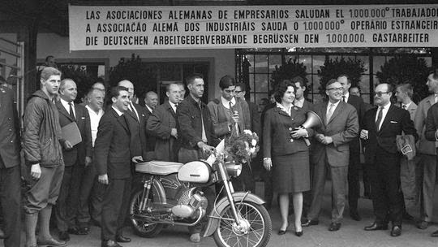
Teh pendulum: wanted – unwanted - managed
Until late 1960s – workers welcome
1970-s (crises) –late 1990s – exlcuded
Priority for own and EU citizens.
Work permit for t.c.n: the exception
Since early 2000 – selective welcome –”managed migration” –global competition for skills
Notes:
Chalmers –Davies –Monti, p.526

Slide 33
Avenues of regular migration into the EU
Value based
„humanitarian”
Utilitarian
„mercantilist”
Research, studies, training, voluntary service, pupil exchange
Family unification
Seasonal workers
No general EU rule on immigration of „normal workers” and self-employed – national competence
Highly skilled and competitive (Blue card)
Intra company transferees

Slide 34
family
COUNCIL DIRECTIVE 2003/86/EC of 22 September 2003
on the right to family reunification
Regular migrant’s family (entitled to unification):
  spouse
  the minor, unmarried (common) child of the sponsor (migrant) and of his/her spouse, including children adopted
  minor, unmarried child of either of them, if they have custody and the child is dependent on them
Optional (states may allow)
parents, if dependent on the migrant
adult unmaries child, if unable
to provide for herself/himself
Partners if in lon-term stable and/or
registered partnership
Researchers: same definition, less conditions
Refugees: optionally broader, and less conditions for the first 3 months
To what extent is the concept of family culturally determined? Or is it simple reductionist political convenience?

Slide 35
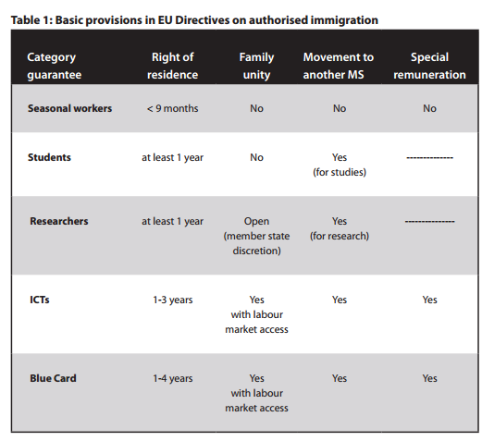
Summarising the basic rights
Source: Georgia Mavrodi
COMMON EU POLICIES ON AUTHORISED IMMIGRATION PAST, PRESENT AND FUTURE
LSE IDEAS Strategic Update 15.2
http://cadmus.eui.eu/bitstream/handle/1814/36115/Common-EU-Policies-on-Authorised-Immigration%20%281%29.pdf?sequence=2

Slide 36
Third country nationals, without the right to stay
„Illegal migration”

Slide 37
The overall approach to entry and stay without permit
Political discourse EU law in force
The engine behind entry/stay without permission is either the unbearable situation in the country of origin (economy, climate, persecution) or the willingess of the employer to exploit the irregular worker, or both
EU law: dual face
Visa, border regime, detention before removal: following political preferences
Employer’s sanctions, preferring voluntary departure, protectiong victims of trafficking - the migrant is victim
applying the legally protected values of a democratic society respecting the dignity of all

Slide 38
The Return directive
DIRECTIVE 2008/115/EC on common standards and procedures in Member States for returning illegally staying third-country nationals
Personal scope
Obligatory: third-country nationals staying illegally on the territory of a Member State
Optional:
  - those refused at the border or intercepted on land, sea or air
  - subject to return as a criminal law sanction
Limits: MS must respect rights of persons entitled to free movement under community law and the principle of non-refoulement
+ „due account of” best interest of the child, family life, state of health of the person
Member States may retain more favourable provisions
Notes:
DIRECTIVE 2008/115/EC OF THE EUROPEAN PARLIAMENT AND OF THE COUNCIL
of 16 December 2008 on common standards and procedures in Member States for returning illegally staying third-country nationals

Slide 39
Return directive, 2008
Member states must issue the return decision to any illegal stayer (exceptions exist, like right to reside in other MS or humanitarian reasons)
Preferred return: voluntary return within 7-30 days
Exceptions:
risk of absconding,
manifestly unfounded or fraudulent application for stay permit
or if the person concerned poses a risk to public policy, public security or national security,
States must take all necessary measures to enforce the return decision if the third country national does not depart voluntarily or if the exception to voluntary departure is applicable
Compulsory entry ban (max five years) if no voluntary return within time
Proportionate coercive measure against resisting persons
Detention: max 18 months (if danger of absconding or hampering preparation of return or process of removal )
Strong critique (ECRE, UNHCR, NGO-s)
Notes:
Art 6 2. Third-country nationals staying illegally on the territory of a Member State and holding a valid residence permit or other authorisation offering a right to stay issued by another Member State shall be required to go to the territory of that other Member State immediately.
4. for compassionate, humanitarian or other reasons to a third-country national staying illegally on their territory. In that event no return decision shall be issued. Where a return decision has already been issued, it shall be withdrawn or suspended
5. the subject of a pending procedure for renewing his or her residence permit or other authorisation offering a right to stay, that Member State shall consider refraining from issuing a return decision

Slide 40
Employers’ sanction
Directive 2009/52/EC
providing for minimum standards on sanctions and measures against employers of illegally staying third-country nationals
„illegally staying third-country national” = who does not fulfil, or no longer fulfils, the conditions for stay or residence in that Member State
Obligations of the employer:
- see the valid residence permit of the tcn;
- keep a copy or record of it
- notify the competent authority of start of employment
Effective, proportionate and dissuasive sanctions must be imposed on the employer:
  Financial sanctions which shall increase in amount according to the number of illegally employed
  Payments of the costs of return of illegally employed third-country nationals
  Paying the difference between the remuneration of the illegally employed and the legally employed to the illegally employed
  An amount equal to any taxes and social security contributions that the employer would have paid
If done, can not be sanctioned
Notes:
Az Európai Parlament és a Tanács 2009/52/EK irányelve ( 2009. június 18. ) az illegálisan tartózkodó harmadik országbeli állampolgárokat foglalkoztató munkáltatókkal szembeni szankciókra és intézkedésekre vonatkozó minimumszabályokról
A fizetés-különbséget az illegális foglalkoztatott akkor is követelheti, ha közben hazatoloncolták
Min. 3 hónapos munkaviszont feltételeznek.

Slide 41
Employers’ sanctions
Further sanctions
  Exclusion from public aid or subsidy
  Exclusion from participation in
  a public contract
  Recovery of recent (max 12 months) public benefits, aid, or subsidies
  Temporary or permanent closure of the establishments that have been used to commit the infringement
  Temporary or permanent withdrawal of a licence to conduct the business activity in question
Criminal sanctions in „severe” cases
    The infringement continues or is persistently repeated;
    Simultaneous employment of a significant number of illegally staying third-country nationals;
    The infringement is accompanied by particularly exploitative working conditions;
    The employed person is victim of trafficking
    The employed is a minor
Transposition date: 20 July 2011.
For a maximum
of 5 years

Slide 42
Victims of trafficiking
Smuggling ≠ Trafficking
DIRECTIVE 2011/36/EU …on preventing and combating trafficking in human beings and protecting its victims…
The definition of trafficking:
„The recruitment, transportation, transfer, harbouring or reception of persons, including the exchange or transfer of control over those persons, by means of the threat or use of force or other forms of coercion, of abduction, of fraud, of deception, of the abuse of power or of a position of vulnerability or of the giving or receiving of payments or benefits to achieve the consent of a person having control over another person, for the purpose of exploitation
Trafficked persons are victims, entitled to different source of protection (impunity, special care, victim’s protection)
According to Council Directive 2004/81/EC residence permit and assistance to those who co-operate with the authorities

Slide 43
International protection
(aylum seeekers, refugees, beneficiaries of subsidiary protection, asylum, solidarity within the Eu, cooperation with third states)

Slide 44
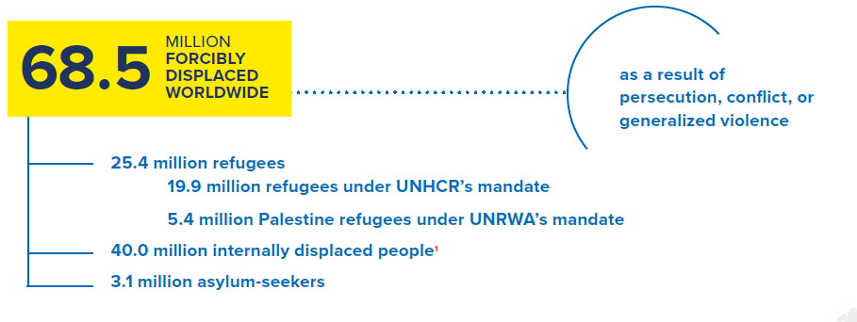
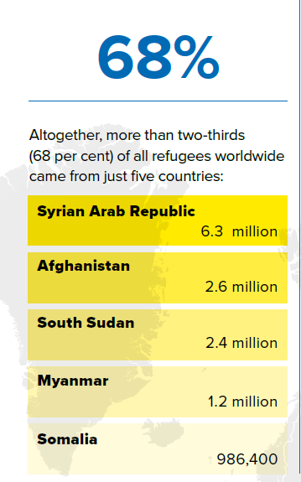
Global figures, end of 2017, UNHCR data
52% of the refugees are minors
4,4 million internationally displaced in 2017
667,400 refugees returned home
in 2017
102,800 refugees were admitted to resettlement
Source: UNHCR: Global Trends. Forced displacement in 2017. Geneva, 2018, various pages
http://www.unhcr.org/5b27be547.pdf (20180703)

Slide 45
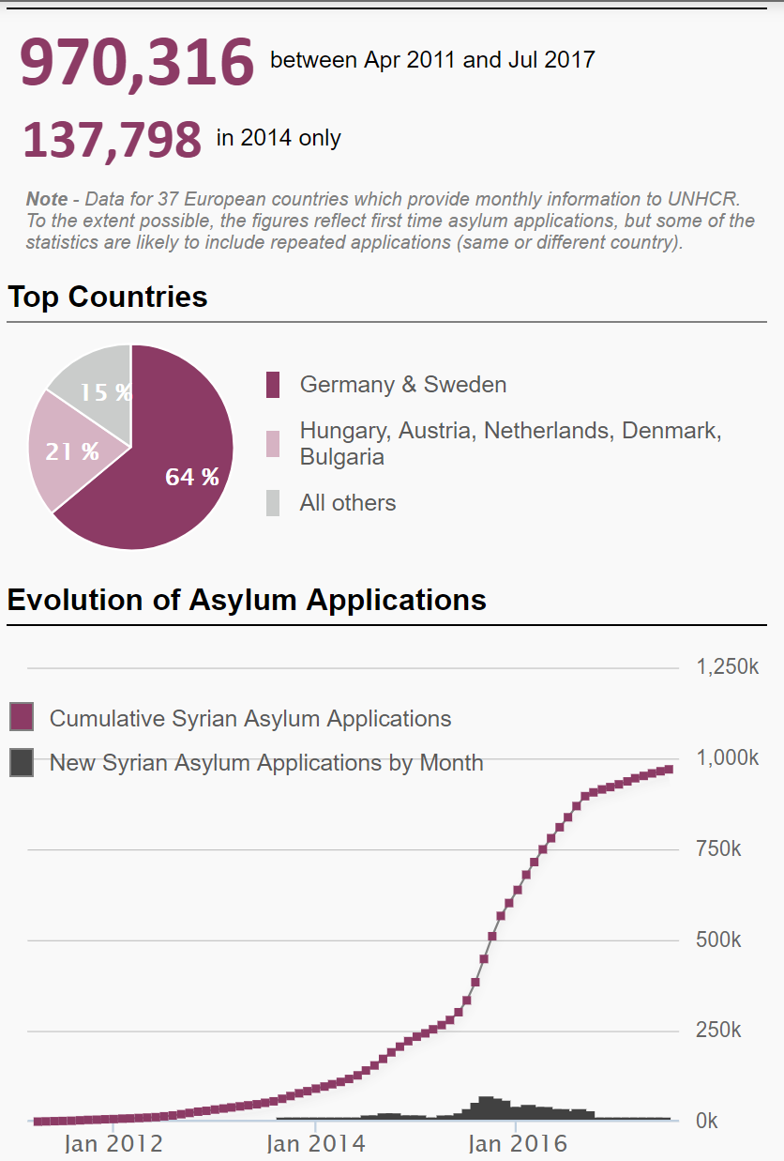
Syria! May, 2018
5,645,914
Registered Syrian refugees (abroad)
As of 10 May 2018
Egypt: 128,507
Iraq: 248,382
Jordan: 661,859
Lebanon: 986,942
Turkey: 3,586,679
Source: http://data.unhcr.org/syrianrefugees/country.php?id=224 (20180514) author’s assemblage

Slide 46
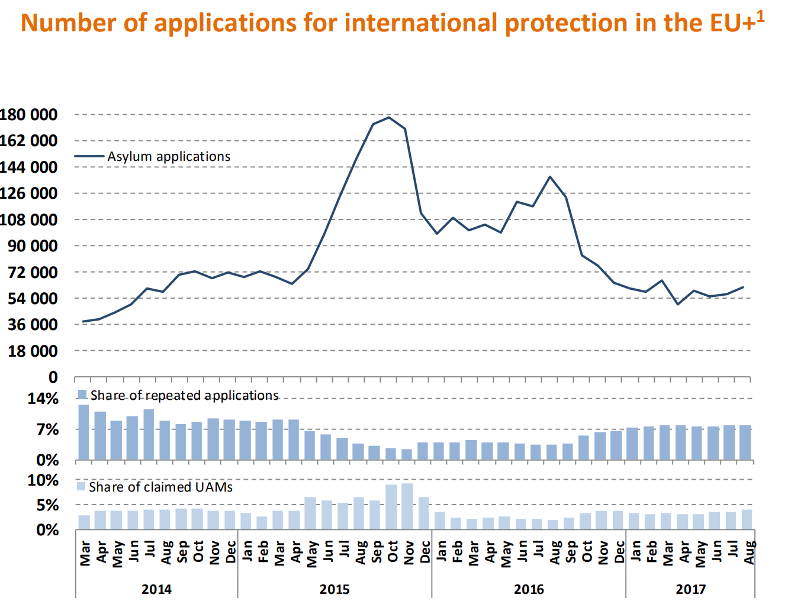
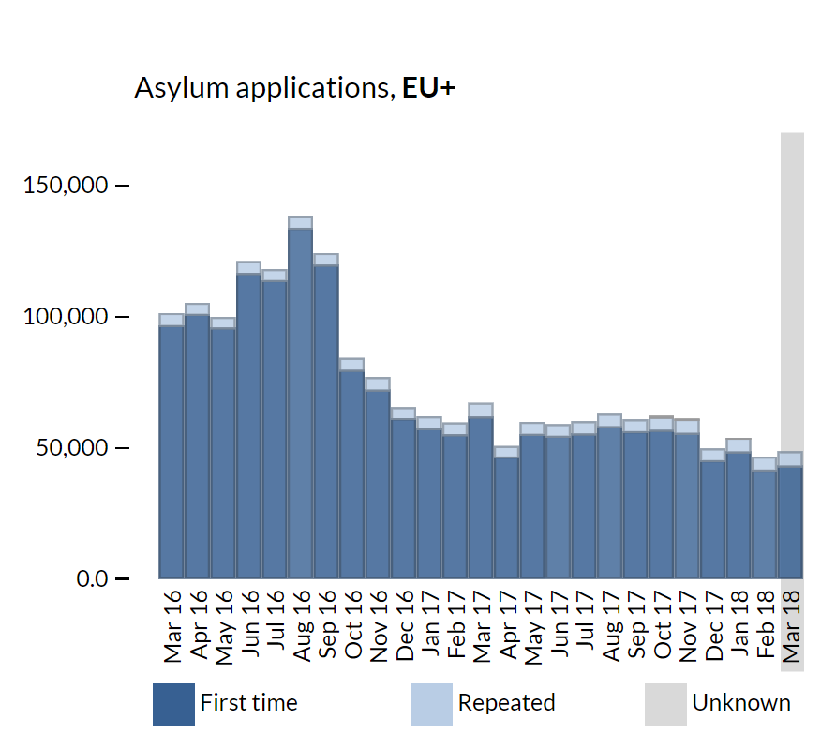
Individual applications in the EU+
Source: EASO, Latest Asylum Trends, 2017, August, p. 1. and 2018 March
https://www.easo.europa.eu/latest-asylum-trends (20180514)

Slide 47
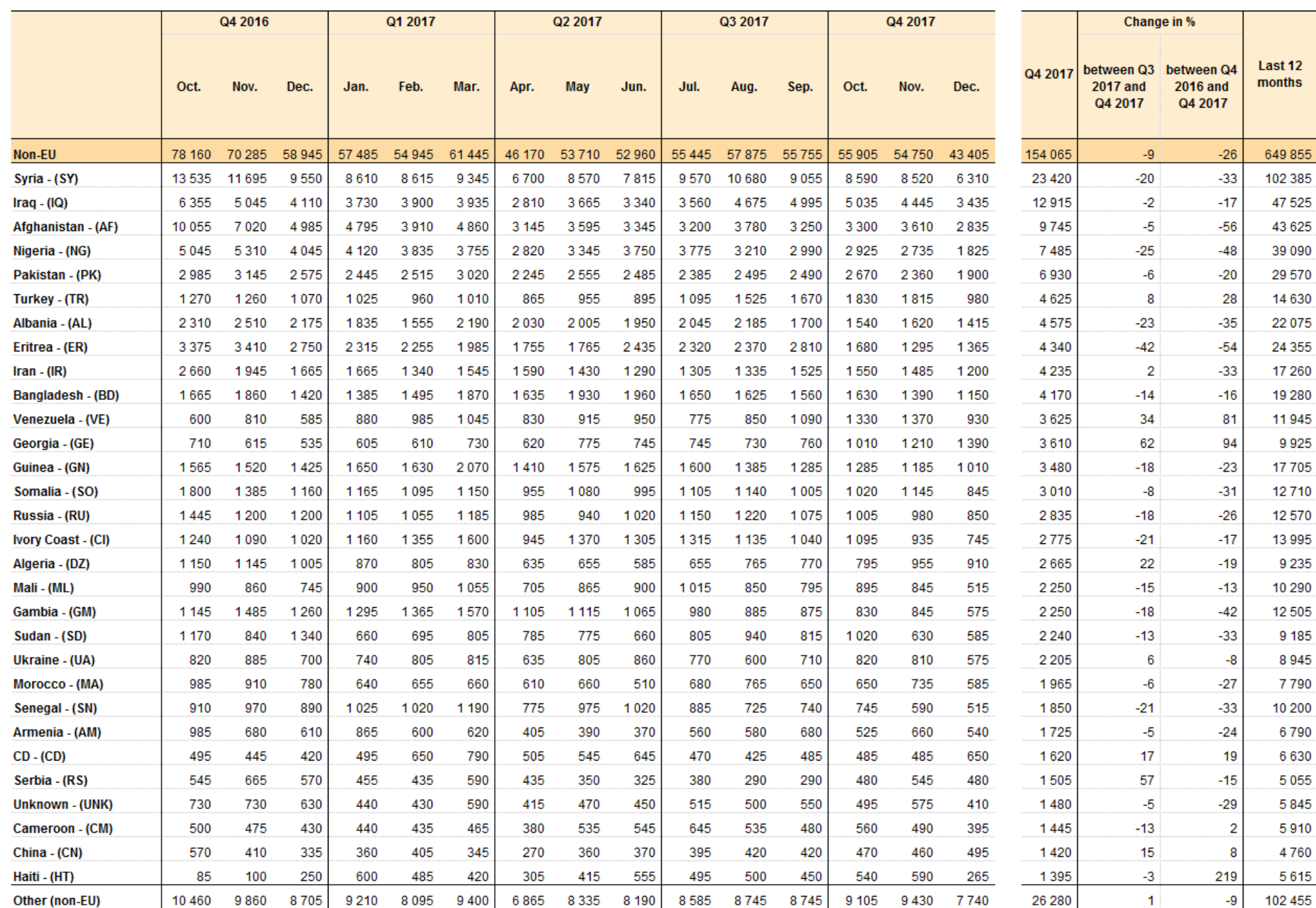
Countries of origin 2016-2017 in the EU
Source: Eurostat Asylum Quarterly Reports , 19 March 2018
/index.php/Asylum_quarterly_report (20180514)

Slide 48
DEFINITIONS

Slide 49
European Union: subregional law
„Convention refugee”
„Political refugee”
Beneficiary of subsidiary protection
Victims of civil war or threatened with inhuman or degrading treatment or punishment or death penalty
Beneficiary of temporary protection
„Mass influx” from conflict, endemic violence or systemic violations of human rights
Notes:
EU Temporary Protection Directive
(Council Directive 2001/55/EC OJ L 212/14)
Article 2
For the purposes of this Directive:
‘temporary protection’ means a procedure of exceptional character to provide, in the event of a mass influx or imminent mass influx of displaced persons from third countries who are unable to return to their country of origin, immediate and temporary protection to such persons, in particular if there is also a risk that the asylum system will be unable to process this influx without adverse effects for its efficient operation, in the interests of the persons concerned and other persons requesting protection;
...
(c) ‘displaced persons’ means third-country nationals or stateless persons who have had to leave their country or region of origin, or have been evacuated, in particular in response to an appeal by international organisations, and are unable to return in safe and durable conditions because of the situation prevailing in that country, who may fall within the scope of Article 1A of the Geneva Convention or other international or national instruments giving international protection, in particular:
(i) persons who have fled areas of armed conflict or endemic violence;
(ii) persons at serious risk of, or who have been the victims of, systematic or generalised violations of their human rights
______________________________________________________
EU Qualification Directive
2004/2011
Art 2 2004:(e) 2011: (f)
„person eligible for subsidiary protection” [means someone], „who does not qualify as a refugee but in respect of whom substantial grounds have been shown for believing that the person concerned, if returned to his or her country of origin, or in the case of a stateless person, to his or her country of former habitual residence, would face a real risk of suffering serious harm as defined in Article 15, .....is unable, or, owing to such risk, unwilling to avail himself or herself of the protection of that country;
Art 15 (in both)
Serious harm consists of:
(a) death penalty or execution; or
(b) torture or inhuman or degrading treatment or punishment of an applicant in the country of origin; or
(c) serious and individual threat to a civilian's life or person by reason of indiscriminate violence in situations of international or internal armed conflict”

Slide 50
Definitions
Geneva Convention relating to the status of refugees – 1951
Article 1. Definition of the term “refugee”
A. For the purposes of the present Convention, the term “refugee” shall apply to any person who:
(1) Has been considered a refugee ...[according to the interwar arrangements and the IRO constitution]
(2) As a result of events occurring before 1 January 1951 and owing to well-founded fear of being persecuted for reasons of race, religion, nationality, membership of a particular social group or political opinion, is outside the country of his nationality and is unable, or owing to such fear, is unwilling to avail himself of the protection of that country; or who, not having a nationality and being outside the country of his former habitual residence as a result of such events, is unable or, owing to such fear, is unwilling to return to it.
Notes:
CHAPTER I: General Provisions
B. (1) For the purposes of this Convention, the words “events occurring
before 1 January 1951” in article 1, section A, shall be understood to
mean either
(a) “events occurring in Europe before 1 January 1951”; or
(b) “events occurring in Europe or elsewhere before 1 January
1951”
and each Contracting State shall make a declaration at the
time of signature, ratification or accession, specifying which of
these meanings it applies for the purpose of its obligations under
this Convention.
(2) Any Contracting State which has adopted alternative (a) may at
any time extend its obligations by adopting alternative (b) by
means of a notification addressed to the Secretary-General of the
United Nations.
Geographic reservation: Congo, Madagascar, Monaco, Turkey

Slide 51
Definitions
Convention Governing the Specific Aspects of Refugee Problems in Africa, 1969
Article 1
Definition of the term "Refugee"
1. [ Geneva definition]
2. The term "refugee" shall also apply to every person who, owing to external aggression, occupation, foreign domination or events seriously disturbing public order in either part or the whole of his country of origin or nationality, is compelled to leave his place of habitual residence in order to seek refuge in another place outside his country of origin or nationality.
Notes:
Large scale influxes
Lack of capacity for individual determination

Slide 52
Definition
Cartagena Declaration on Refugees,
Colloquium on the International Protection of Refugees in Central America, Mexico and Panama
Adopted by the Colloquium on the International Protection of Refugees in Central America, Mexico and Panama, held at Cartagena, Colombia from 19-22 November 1984.
The Colloquium adopted the following conclusions:
.....
3. To reiterate that, in view of the experience gained from the massive flows of refugees in the Central American area, it is necessary to consider enlarging the concept of a refugee, bearing in mind, as far as appropriate and in the light of the situation prevailing in the region, the precedent of the OAU Convention (article 1, paragraph 2) and the doctrine employed in the reports of the Inter-American Commission on Human Rights. Hence the definition or concept of a refugee to be recommended for use in the region is one which, in addition to containing the elements of the 1951 Convention and the 1967 Protocol, includes among refugees persons who have fled their country because their lives, safety or freedom have been threatened by generalized violence, foreign aggression, internal conflicts, massive violation of human rights or other circumstances which have seriously disturbed public order.

Slide 53
Definition
EU Temporary Protection Directive
(Council Directive 2001/55/EC OJ L 212/14)
Article 2
For the purposes of this Directive:
‘temporary protection’ means a procedure of exceptional character to provide, in the event of a mass influx or imminent mass influx of displaced persons from third countries who are unable to return to their country of origin, immediate and temporary protection to such persons, in particular if there is also a risk that the asylum system will be unable to process this influx without adverse effects for its efficient operation, in the interests of the persons concerned and other persons requesting protection;
...
(c) ‘displaced persons’ means third-country nationals or stateless persons who have had to leave their country or region of origin, or have been evacuated, in particular in response to an appeal by international organisations, and are unable to return in safe and durable conditions because of the situation prevailing in that country, who may fall within the scope of Article 1A of the Geneva Convention or other international or national instruments giving international protection, in particular:
    (i) persons who have fled areas of armed conflict or endemic violence;
    (ii) persons at serious risk of, or who have been the victims of, systematic or generalised violations of their human rights

Slide 54
Definitions – EU
Council Directive 2004/83/EC of 29 April 2004 on minimum standards for the qualification and status of third country nationals or stateless persons as refugees or as persons who otherwise need international protection and the content of the protection granted (OJ L 304/12 2004 09 30,)
EU Qualification Directive
2004/2011
Art 2 2004:(e) 2011: (f)
„person eligible for subsidiary protection” [means someone], „who does not qualify as a refugee but in respect of whom substantial grounds have been shown for believing that the person concerned, if returned to his or her country of origin, or in the case of a stateless person, to his or her country of former habitual residence, would face a real risk of suffering serious harm as defined in Article 15, .....is unable, or, owing to such risk, unwilling to avail himself or herself of the protection of that country;
Art 15 (in both)
Serious harm consists of:
(a) death penalty or execution; or
(b) torture or inhuman or degrading treatment or punishment of an applicant in the country of origin; or
(c) serious and individual threat to a civilian's life or person by reason of indiscriminate violence in situations of international or internal armed conflict”
DIRECTIVE 2011/95/EU OF THE EUROPEAN PARLIAMENT AND OF THE COUNCIL of 13 December 2011
on standards for the qualification of third-country nationals or stateless persons as beneficiaries of international protection, for a uniform status for refugees or for persons eligible for subsidiary protection, and for the content of the protection granted

Slide 55
Asylum acquis
Adopted and proposed measures
1. Regulation on Eurodac (2000) recast: 2013. Pproposal for regulation 2016 (recast 2)
2. Directive on temporary protection (2001)
3. Reception conditions directive (2003) recast: 2013 Pproposal for directive (recast 2): 2016
4. Dublin Regulation and its implementing rules (2003 DublinII) recast: 2013 (Dublin III.) Proposal for regulation (recast 2): 2016
5. Qualification (Refugee definition) directive (2004) recast: 2011. Proposal for regulation: 2016
6. Asylum procedures directive (2005) recast: 2013. Proposal for regulation: 2016
7. Establishment of an European Asylum Support Office (2010) Proposal for regulation on European Asylum Agency: 2016
8. Decision on the new Asylum Migration and Integration Fund – 2014
9. Solidarity measures, 2015-2018: resettlement and relocation (See also 2016 Dublin proposal)
Notes:
On11 May 2016, a first package of legislative proposals, containing:
• a recast of the Dublin Regulation establishing the criteria and mechanisms for determining the Member State responsible for examining an application for international protection (doc 8715/16);
• a Regulation on the European Union Agency for Asylum, replacing the EASO Regulation (doc 8742/16);
• a recast of the Regulation on the establishment of 'Eurodac' (doc 8765/16); − on 18 July 2016, a second package of legislative proposals, which contains:
• a Regulation establishing a common procedure for international protection in the EU (replacing the Asylum Procedures Directive) (doc 11317/16 + ADD 1 + ADD 2);
• a Regulation on qualification of third-country nationals or stateless persons as beneficiaries of international protection (replacing the Qualification Directive) (doc 11316/16 + ADD 1);
• a recast of the Directive for the reception conditions of applicants for international protection (doc 11318/1/16 REV 1);
• a Regulation establishing a Union Resettlement Framework (doc 11313/16)
Quoted from:Doc 12724/16

Slide 56
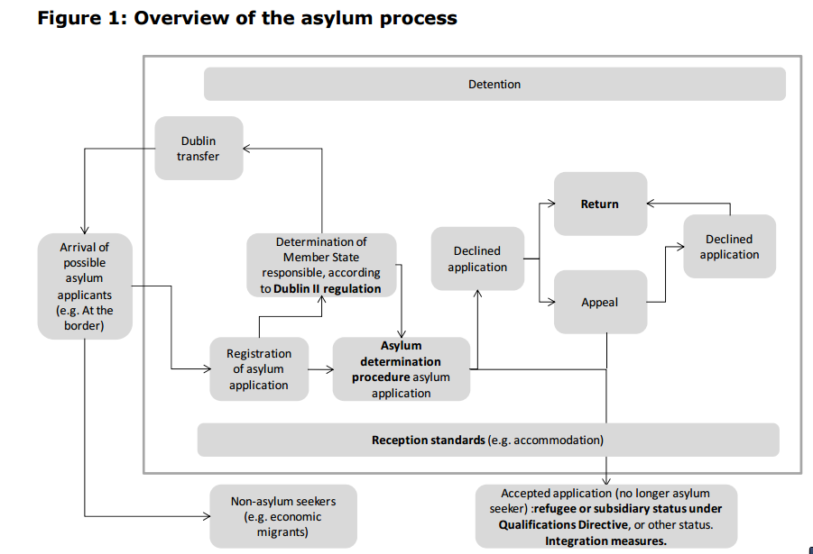
The asylum process model as in 2018
to Dublin III regulation
Source: (European Parliament:) What system of burden-sharing between Member States for the reception of asylum seekers? A study written by Dr Christina Boswell, Dr Eiko Thielemann and Richard Williams, PE 419.620,, p-34

Slide 57
Three levels of regulation
International law (1951 Geneva Convention, 1950 European Convention on Human Rights, etc. )
European Union Law (in EU member states)
National law – implementing both
_______________________________________
Control (enforcement):
UNHCR
European Court of Human Rights („Strasbourg”)
Court of Justice of the European Union („Luxembourg”)
Domestic courts

Slide 58
Key questions
Who should decide if the person is a refugee? = which is the responsible state for the asylum procedure = Dublin
Can the asylum seeker be returned to a non EU member state (instead of applying Dublin) = safe third country
What to do if the refugee found protection in a non-EU country (e.g. Turkey, Lebanon, Jordan), but after some time moves on = first country of asylum, „secondary movement”
Does the refugee have a choice as to the country of asylum? (see also answers to 2 and 3)
Can states close their borders, claiming „too many came, the country is full” = non-refoulement
Why is the temporary protection directive not applied?
Are there persons, who can be excluded („terrorists”)? = exclusion grounds and procedure
What solidarity is conceivable among EU member states? = relocation, hotspots, AMIF
What solidarity with those state who host or are transit countries for most refugees? (Statement with Turkey, Resettlement, EU Trust Fund for Syria, Emergency Trust Fund for Africa)

Slide 59
1. WHO SHOULD DECIDE WHETHER THE PERSON IS A REFUGEE? WHICH IS THE RESPONSIBLE STATE FOR THE ASYLUM PROCEDURE? =
THE DUBLIN SYSTEM

Slide 60
PURPOSE AND PHILOSOPHY OF DUBLIN
Every asylum seeker should gain access to the procedure. There must be a MS to determine the case
Only one procedure should be conducted within the Union. A decision by any MS be taken as if in the name of others = no parallel or subsequent application should take place
Notes:
See The Commission’s suggestion of 2001 (COM) 2001 447 final p.3
Goal: A unified area without internal borders - that justifies tthat only one decision be taken.
Further goals of the regulation:
Closing the gaps of the Dublin Convention
Drawing the consequence of the single visa lists
Speeding up the procedure
Increasing efficiency (the number of persons effectively transferred)

Slide 61
The philosophy of Dublin: under what conditions is taking charge by another state –without investigation of the merits in the first state fair
  Fairness preconditions
  If the substantive law (the refugee definition) is identical
  If procedural rules guarantee equal level of protection at least in terms of
    - legal remedies (appeals)
    - access to legal representation
    - reception conditions (support) during the procedure (detention, e.g.!)

Slide 62
Regulation 604/2013/EU (Dublin III) criteria 8 – 15. § (simplified)
„Coupling principles” = criteria identifying the responsible state (simplified list)
Family (narrowly defined)
Visa or residence permit
External border crossed in irregular fashion
Place of submission
Notes:
The responsible state has to be requested as soon as possible but not later than 3 months after the submission of the application. If not: loss of right to transfer
Reply: within 2 months. Silence = agreement In urgent cases: 1 month for reply
Transfer: within 6 month from acceptance to take charge or from the end of procedure in which transfer was challenged = taking charge
______________________________
In case the applicants leaves the state’s territory during the procedure of
determining the responsible state
determining whether she qualifies for status (merits)
or after a negative decision
that state has to take her back.
Reply: within 1 month (if Eurodac based request: 2 weeks)
Taking back: within 6 months from acceptance
= taking back

Slide 63
Burden shifting
NOT BURDEN SHARING !

Slide 64
Dublin
Taking charge: no application in the responsible state
Taking back: departure after application
Eurodac not decisive, but shorter deadlines
(2 instead of 3 months to request take charge or back)
No response = acceptance of responsibility

Slide 65
The lesson taught by Greece’s non-performance
Article 3 (2)
Where it is impossible to transfer an applicant to the responsible Member State „because there are substantial grounds for believing that there are systemic flaws in the asylum procedure and reception conditions for asylum applicants in that Member State resulting in risk of inhuman or degrading treatment” the determining Member State may search for another responsible state or must proceed itself.
______________________________________________________________________________
Particular pressure on a member state or systemic failure: Commission to call for a preventive action plan
Serious risk of crisis – compulsory crisis management action plan upon invitation of the Commission
Last resort: instead of Dublin resort to Art 78 (3 )of TFEU:
„In the event of one or more Member States being confronted by an emergency situation
characterised by a sudden inflow of nationals of third countries, the Council, on a proposal from the Commission, may adopt provisional measures for the benefit of the Member State(s) concerned. It shall act after consulting the European Parliament.”
Two decisions on relocation of September 2015 moving from Italy and Greece 40 + 120 thousand persons
Notes:
Further important changes in the recast:
„Family”, „relative” „dependence” defined more embracing
New or more detailed rules on
providing information to the applicant (in writing, by EU wide leaflet) (§ 4)
compulsory personal interview (§ 5)
guarantees for minors (§ 6) and (§ 8)
avoiding determination of family members’ applications in different states (§ 11)
discretionary” (humanitarian) clause expanded (bringing together dependent persons and those on whom they depend) (§ 17)
taking back (completing the case on the merits or allowing a fresh procedure without considering it a repeat application) (§ 18)
clear rules on taking back even if the person does not apply in the requesting state (§ 24)
more than 3 months absence from MSs or after effective removal = new application (§ 19)
If Eurodac hit: request must be sent within two (not three) months
Separate article on „effective remedy, in the form of an appeal or a review, in fact and in law” against a transfer decision „within reasonable time” (§ 27) MS may decide whether
the applicant has a right to stay or,
there is suspension of the transfer which is subject to „ a close and rigorous scrutiny” by a court or tribunal,
the applicant has the right to ask for the suspension. While deciding that request based on „close and rigorous scrutiny” suspension must be granted
Detailed rules of exchange on data before transfer (including info on health)

Slide 66
2. CAN THE ASLYUM SEEKER BE RETURNED TO A NON EU MEMBER STATE (INSTEAD OF APPLYING DUBLIN) = SAFE THIRD COUNTRY

Slide 67
The notion of the safe third country (§ 38 PD)
  Life and liberty are not threatened on account of the 5 Geneva Convention grounds (race, religion, political views, nationality, belonging to a particular social group) and there is no risk of torture, inhuman or degrading treatment or punishment, or threat because of indiscriminate violence in armed conflict; and
  the principle of non-refoulement is respected; and
  the prohibition of removal in breach of the right to freedom from torture and cruel, inhuman or degrading treatment and punishment as laid down in international law is respected; and
  the possibility exists to request refugee status and, if found to be a refugee, to receive protection in accordance with the Geneva Convention.
Notes:
Article 38
The concept of safe third country
1. Member States may apply the safe third country concept only where the competent authorities are satisfied that a person seeking international protection will be treated in accordance with the following principles in the third country concerned:
(a) life and liberty are not threatened on account of race, religion, nationality, membership of a particular social group or political opinion;
(b) there is no risk of serious harm as defined in Directive 2011/95/EU;
(c) the principle of non-refoulement in accordance with the Geneva Convention is respected;
(d) the prohibition of removal, in violation of the right to freedom from torture and cruel, inhuman or degrading treatment as laid down in international law, is respected; and
(e) the possibility exists to request refugee status and, if found to be a refugee, to receive protection in accordance with the Geneva Convention.
2. The application of the safe third country concept shall be subject to rules laid down in national law, including:
(a) rules requiring a connection between the applicant and the third country concerned on the basis of which it would be reasonable for that person to go to that country;
(b) rules on the methodology by which the competent authorities satisfy themselves that the safe third country concept may be applied to a particular country or to a particular applicant. Such methodology shall include case-by-case consideration of the safety of the country for a particular applicant and/or national designation of countries considered to be generally safe;
(c) rules in accordance with international law, allowing an individual examination of whether the third country concerned is safe for a particular applicant which, as a minimum, shall permit the applicant to challenge the application of the safe third country concept on the grounds that the third country is not safe in his or her particular circumstances. The applicant shall also be allowed to challenge the existence of a connection between him or her and the third country in accordance with point (a).
3. When implementing a decision solely based on this Article, Member States shall:
(a) inform the applicant accordingly; and
(b) provide him or her with a document informing the authorities of the third country, in the language of that country, that the application has not been examined in substance.
4. Where the third country does not permit the applicant to enter its territory, Member States shall ensure that access to a procedure is given in accordance with the basic principles and guarantees described in Chapter II.
5. Member States shall inform the Commission periodically of the countries to which this concept

Slide 68
The notion of the safe third country
  meaningful link between applicant and the safe third country.
  investigation if a particular country is safe for the particular asylum seeker
  a right of the asylum seeker to challenge the safety at least when torture and inhuman or degrading treatment or punishment is threatening the asylum seeker
  _________________________________________________
  If inadmissible because there is a safe third country:
  - inform the asylum seeker accordingly,
  - provide the asylum seeker with document informing the safe third country that the application has not been examined in substance

Slide 69
3. WHAT TO DO IF THE REFUGEE FOUND PROTECTION IN A NON-EU COUNTRY (E.G. TURKEY, LEBANON, JORDAN), BUT AFTER SOME TIME MOVES ON = FIRST COUNTRY OF ASYLUM, „SECONDARY MOVEMENT”

Slide 70
First Country of asylum
The application is inadmissible (no examination of the merits) if there is a first country of asylum (§ 35 PD).
Definition
If the asylum seeker has been recognised in that country as a refugee
and he/she can still avail himself/herself of that protection, or
he/she enjoys otherwise sufficient protection in that country, including benefiting from the principle of non-refoulement,
provided
that he/she will be re-admitted to that country.
_________________________
Applicant has a right to challenge inadmissibility on the basis of country of first asylum.
_________________________
Turkey, Lebanon, Jordan?
Notes:
Article 35
The concept of first country of asylum
A country can be considered to be a first country of asylum for a particular applicant if:
(a) he or she has been recognised in that country as a refugee and he or she can still avail himself/herself of that protection; or
(b) he or she otherwise enjoys sufficient protection in that country, including benefiting from the principle of non- refoulement,
provided that he or she will be readmitted to that country.
In applying the concept of first country of asylum to the particular circumstances of an applicant, Member States may take into account Article 38(1). The applicant shall be allowed to challenge the application of the first country of asylum concept to his or her particular circumstances.
__________________________________--
Otherwise sifficient protection: e.g Syrian Aremnians in Armenia (either had nationality or can apply and get instantly)

Slide 71
4. DOES THE REFUGEE HAVE A CHOICE AS TO THE COUNTRY OF ASYLUM?
(SEE ALSO ANSWERS TO QUESTIONS 2 AND 3)

Slide 72
The choice of the refugee
Family, friends, acquaintances (own diaspora)
Language
Past time spent
Labour market, right to establish a venture (self-employment)
Reception conditions
Integration assistance
Vicinity / distance to country of persecution (fast return / distance from danger, less competition with other refugees)
___________________________________________________
The more the refugee chooses the less social assistance (s)he will need.

Slide 73
5. CAN STATES CLOSE THEIR BORDERS, CLAIMING „TOO MANY CAME, THE COUNTRY IS FULL” = NON-REFOULEMENT

Slide 74
Non - refoulement
Narrow meaning: Geneva Convention Article 33
    „No Contracting State shall expel or return (“refouler”) a refugee in any manner whatsoever to the frontiers of territories where his life or freedom would be threatened on account of his race, religion, nationality, membership of a particular social group or political opinion.”
Exception (33 (2)): national security danger or final sentence for serious crime in country of asylum (amounting to danger to society)
Broad meaning: Art 3 of the European Convention of Human Rights:
„No one shall be subjected to torture or to inhuman or degrading
treatment or punishment.”
- ground irrelevant
- applies to any person, not just to refugees
- prohibition is absolute.
But, what if extremely large number of refugees come („mass influx”- Lebanon, Jordan, Turkey) - prevailing view: still applies

Slide 75
6. WHY IS THE TEMPORARY PROTECTION DIRECTIVE NOT APPLIED?
2001/55 EC Directive on Giving Temporary Protection in the Event of a Mass Influx of Displaced Persons and on Measures Promoting a Balance of Efforts Between Member States in Receiving Such Persons and Bearing the Consequences Thereof
2001 July 20, OJ L 212/12

Slide 76
Temporary Protection Directive
Beneficiaries = ‘displaced persons’
who
    have had to leave their country or region of origin,
    or have been evacuated,
    and are unable to return in safe and durable conditions
in particular:
  (i) persons who have fled areas of armed conflict or
  endemic violence;
  (ii) persons at serious risk of, or who have been the victims
  of, systematic or generalised violations of their human rights;

Slide 77
Temporary Protection Directive
Mass influx means arrival in the Community
of a large number of displaced persons,
who come from a specific country or geographical area
The Council decides by qualified majority the start and end of T.P.
Duration
  1 year + max two times 6 months
      = total max: 2 years
Council may end it earlier, but must not exceed two years‘
_______________________________________
Not applied until January 2016
Why?
The Member States ought to assist the obtaining of the necessary visas,
including transit visas. Formalities ought to be reduced to a minimum. Visas should be free of charge or their cost reduced to a minimum (§ 8 /3/ TPD)
The Temporary Protection Directive includes a solidarity mechanism (even if voluntary) on the relocation of refugees
Right to work, self-employment and to family unification are recognised

Slide 78
7. ARE THERE PERSONS, WHO CAN BE EXCLUDED („TERRORISTS”)? = EXCLUSION GROUNDS AND PROCEDURE

Slide 79
Exclusion of terrorists
Terrorists are unlikely to come as refugees, as they have to be photographed, give 10 fingerprints and give detailed account about their life
Before the 2015 November Paris attacks some returned to Europe with the mixed flow
Terrorists can be excluded from protection (and returned to their country of origin, unless Art. 3 of the ECHR would be violated)
  Exclusion grounds: crimes against peace, war crimes, crimes against humanity, serious non-political crimes, acts contrary to the principles and purposes of the UN.
See QD Preamble, para 31 „Acts contrary to the purposes and principles of the United Nations are … embodied in the United Nations resolutions relating to measures combating terrorism, which declare that ‘acts, methods and practices of terrorism are contrary to the purposes and principles of the United Nations…’”

Slide 80
8. WHAT SOLIDARITY IS CONCEIVABLE AMONG EU MEMBER STATES? = AMIF,EASO, RELOCATION, HOTSPOTS, the 2018 June European Council proposal

Slide 81
EASO, AMIF
European Asylum Support Office since 2010
(Regulation (EU) No 439/2010)
Training –Country of origin information – Capacity building and direct assistance to MS – Assistance to the Commission controlling implementation
To be transfored into a European Asylum Agency - moving from coordianation and assistance to authority
The Asylum and Migration and Integration Fund (
(Regulation (EU) No 516/2014)
2014-2020 (seven years) Total: 3 137 million Euros (in current prices)
Member states may use 2 752 million Euros.
Of that 360 million cover specific actions (e..g. joint processing centres, joint returns) + Union Resettlement Programme from third countries + transfer of beneficiaries of international protection from one Member State to another.
Notes:
EASO priorities 2018
Operational support, planning and evaluation
Support Italy, Greece and Cyprus, as well as other potential frontline Member States. Operational and technical support to Member States in order to assist them in implementing the new CEAS proposals. Capacity building in key EU neighbouring third countries. Participate in relocation and in the work of hotspots. Implement a pilot project on private sponsorship schemes.
Information, analysis and knowledge development
Develop a comprehensive EU COI system
Asylum support
Consolidate EASO’s Training Curriculum.
Monitor all aspects of the implementation of the CEAS
Horizontal activities
Promote civil society participation. Increase the availability of Information and communication technology systems and technical solutions in the field of asylum for the EU+

Slide 82
Responsibility and burden sharing - Concepts
Responsibility sharing - distributing affected persons
Burden sharing – contributing to the material reception conditions, with finances, equipment, services
 | Sharing of
Voluntarily | Norms (Harmo- nising laws) | Resources (Money) | People „Quota” relocation, resettlement
Compulsorily
Notes:
Thielemann, JCMS, 2018/1

Slide 83
Possible criteria of responsibility sharing/solidarity
Applied by Criterion | Commission COM (2015) 451 final Emergency relocation (120 000) COM (COM(2016) 270 final Dublin, Corrective allocation mechanism | EU Council Relocation decision | Germany Kőnigsteini key
Total GDP | Yes/Yes | Yes | No
GDP/person | No/No | (Yes) | No
Tax income | No/No | No | Yes
Population (size) | Yes/Yes | Yes | Yes
Territory | No/No | No | No
Population density | No/No | No | No
UNoployment | Yes/No | Yes | No
Number of earlier applicants | Yes/No | Yes | No
Physical proximity to country of origin (Neighbour, same region) | No/No | No | No
Cultural proximity | No/No | No | No

Slide 84
Possible criteria of responsibility sharing/solidarity
Applied by Criterion | Schmuck 1997 | Hathaway & Neve, 1997 | Schneider; Engler; Angevendt 2013
Total GDP | Yes (wealth”) | No (Yes – external supporter) | Yes (five years average – within EU average)
GDP/fperson | (Yes) | No (Yes – external supporter) | No
Tax income | No | No | No
Population (size) | No | No | Yes
Territory | No | No | Yes (Compared to EU total)
Population density | No | No | No
UNoployment | No | No | Yes
Number of earlier applicants | No | No | No
Physical proximity to country of origin (neighbour, same region) | Yes | Yes | No
Cultural proximity | No | Yes | No

Slide 85
Actual relocation decisions
Relocation: distributing among Member States those asylum seekers who are already within the EU and have a good chance of being recognised – i.e. members of groups with 75% recognition rate in the previous quarter (Syrians, Iraqis and Eritreans)
2 decisions:
COUNCIL DECISION (EU) 2015/1523 of 14 September 2015
40 000 persons 24,000 from Italy, 16,000 from Greece
COUNCIL DECISION (EU) 2015/1601 of 22 September 2015
    120 000 persons First year: 15,600 from Italy and 50,400 from Greece Second year: 54,000 either form the same two or from other Member States.
No relocation to Denmark, Ireland, UK, Greece and Italy – 23 MS take up the 40 plus 120 thousand
Difficult cases (not „in clear need”) remain in the competence of the frontline states
Relocating MS get 6000 Euros/head

Slide 86
How many – the key behind the compulsory relocation decision
a) Population - 40% weighting
b) Total GDP - 40% weighting
c) Average number of asylum applications over the 5 preceding years per million inhabitants with a cap of 30% of the population and GDP - 10% weighting (reducing the share)
d) Unemployment rate with a cap of 30% of the population and GDP - 10% weighting (reducing the share)

Slide 87
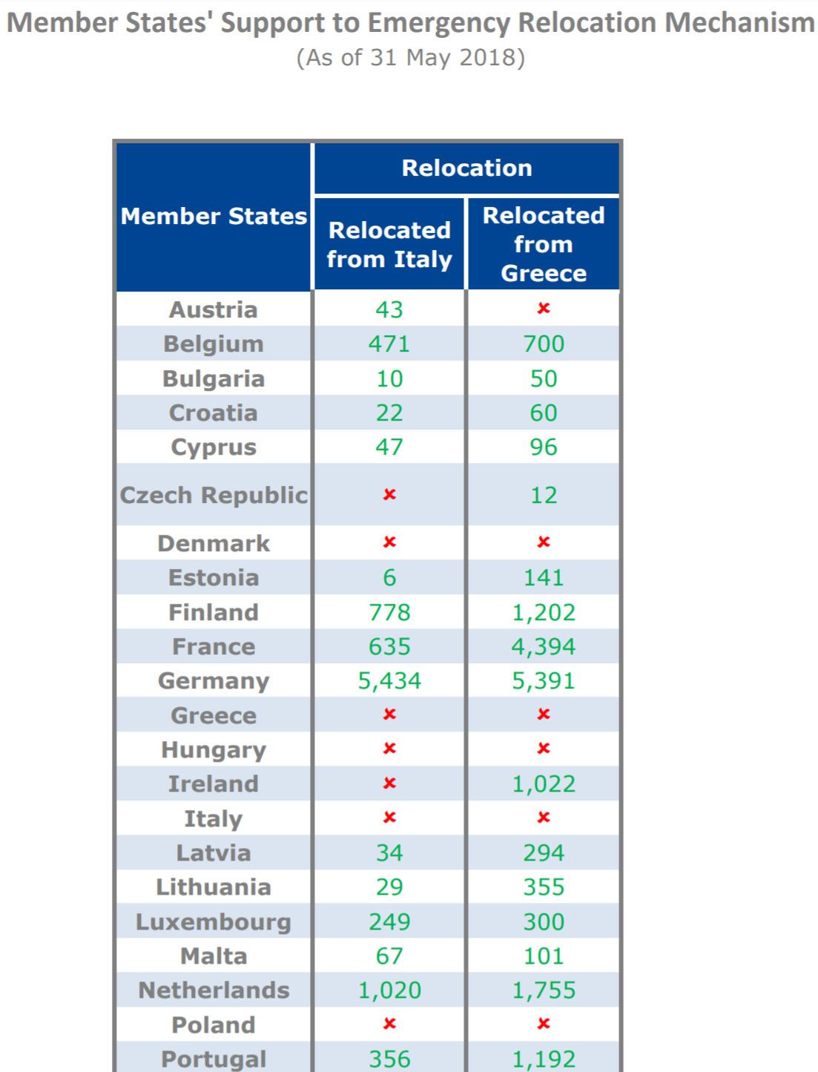
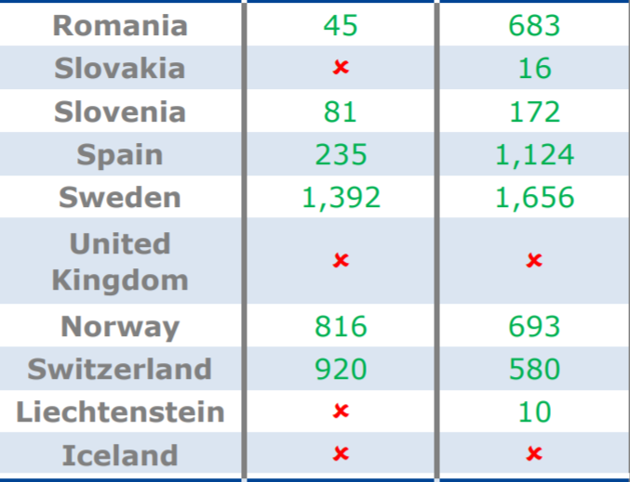
Relocation – outcome
Member States' Support to Emergency Relocation Mechanism
(As of 31 May 2018)
From Greece: 21,999
From Italy: 12,690
Total: 34,689
Source:European Commission. ttps://ec.europa.eu/home-affairs/sites/homeaffairs/files/what-we-do/policies/european-agenda-migration/press-material/docs/state_of_play_-_relocation_en.pdf (20180606)

Slide 88
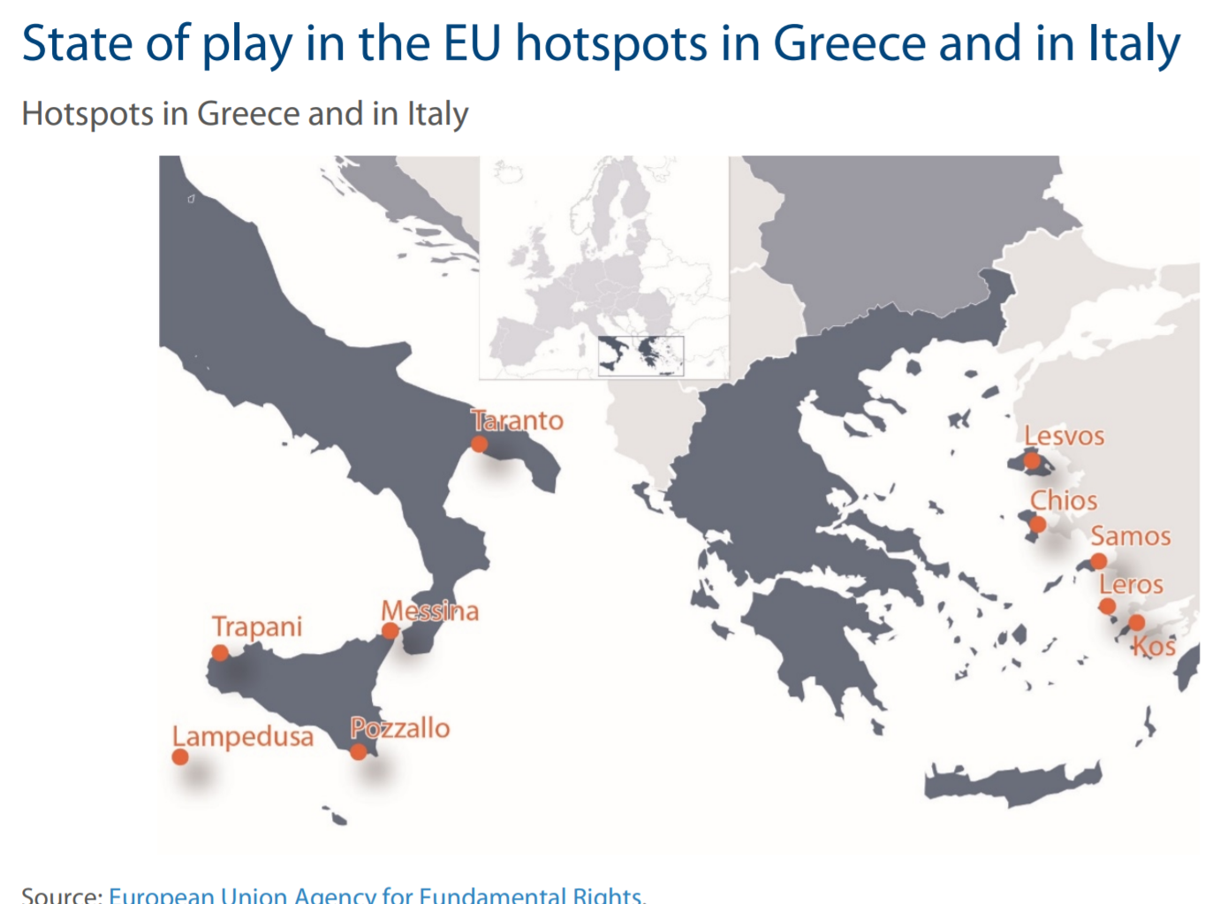
Hotspots
Hotspots = in Italy and Greece: complex sites where experts from different EU MS work together in receiving and screening the applications and organising the return of those not in need of international protection. 5 in Italy, 5 in Greece.
Overcrowded (Greece,
15 thousand for 7 thousand
capacity
Closed, inhuman
Notes:
10 Frontex fingerprinters, 2 debriefing teams and 2 screening teams, alongside a team of 3 EASO experts for information provision.

Slide 89
European Council Conclusions 25 June 2018
„To save lifes and break smuggling circles”
new approach
„based on shared or complementary actions among the Member States to the disembarkation of those who are saved in Search And Rescue operations”
not extending to those coming on land, in air, or make it to the shore/territorial waters without being rescued
In that context, the European Council calls on the Council and the Commission to swiftly explore the concept of regional disembarkation platforms, in close cooperation with relevant third countries as well as UNHCR and IOM. Such platforms should operate distinguishing individual situations, in full respect of international law and without creating a pull factor.
To explore” -?? Platform –new legal concept. Both in the EU and in Libya and elsewhere . „Distinguishing situations –may
only mean the separation of those who do not apply for refugee status or have been denied earlier. Are they closed installations (probably yes).
On EU territory, those who are saved, according to international law, should be taken charge of, on the basis of a shared effort,
Only those saved. Shared effort only within EU. Who shares, on what basis?
through the transfer in controlled centres set up in Member States, only on a voluntary basis,
„Controlled centres” closed or semi closed? Prison like? Which states will volunteer? Any standard to the centre, and the treatment within? (Certainly: Reception Conditions Directive)

Slide 90
European Council Conclusions 25 June 2018
where rapid and secure processing would allow, with full EU support, to distinguish between irregular migrants, who will be returned, and those in need of international protection,
Whole refugee status determination procedure in the centre. Court appeal? Years?
for whom the principle of solidarity would apply.
Principle of solidarity applied to refugees and nbeneficiaries of subsidiary protection. Quota? Felxible solidarity? Involving all the MSs?
All the measures in the context of these controlled centres, including relocation and resettlement, will be on a voluntary basis, without prejudice to the Dublin reform.
Resettlement – bringing in from third countries. Relocation = voluntary. Who will offer, and how many places. Without prjudice to Dublin that is compulsory and may entail a complulsory corrective mechanism

Slide 91
9. What solidarity with those state who host or are transit countries for most refugees? Or: externalisation?!
(Statement with Turkey, Resettlement, EU Trust Fund for Syria, Emergency Trust Fund for Africa)

Slide 92
Traditional multilateral and Bilateral cooperation forms in migration management and control
Cotonou Agreement (2000): 79 African, Caribbean and Pacific states and the EU. (Expiry: 2020)
Khartoum process = EU-Horn of Africa Migration Route Initiative
started in 2014, aimed at fighting irregular migration, human smuggling and trafficking
Rabat process = EU – Central and Western Africa + Tunisia and Algeria (observer) Established in 2006 – broad dialogue on migration and development https://processus-de-rabat.org/en/
Afghanistan
EU – Afghanistan declaration „Joint Way Forward”
soft law (non legally binding) document, Kabul, 2 October 2016
Libya
Italian – Libyan Memorandum of understanding of 2 February 2017
15 Return Agreements between the EU and other states (and territories
Eastern Partnership mobility agreements
Notes:
PARTNERSHIP AGREEMENT between the members of the African, Caribbean and Pacific Group of States of the one part, and the European Community and its Member States, of the other part, signed in Cotonou on 23 June 2000
http://eur-lex.europa.eu/legal-content/EN/TXT/PDF/?uri=CELEX:02000A1215(01)-20170101&from=EN
Article 13 (5) of the consolidated text:
„ each of the ACP States shall accept the return of and readmission of any of its nationals who are illegally present on the territory of a Member State of the European Union, at that Member State's request and without further formalities”
__________________
Hong Kong (2004), Macau 2004), Sri Lanka (2005), Albania (2006), Russia (2007), Ukraine (2008), Bosnia&Herzegovina (2008), Montenegro (2008), Serbia (2008), Moldova (2008), Georgia (2011), Armenia (2014) Azerbaijan (2014), Turkey (2014), Cape verde (2014

Slide 93
RESETTLEMENT FROM THIRD STATES
The ad hoc decision of 20 July 2015 of the „Representatives of the Governments of the Member States meeting within the Council” (EU Doc 11130 /1 5) = Conclusions of the on resettling through multilateral and national schemes 20 000 persons in clear need of international protection
Union Resettlement Framework – Commission Proposal of 13 July 2016 (COM (2016) 468 final
Council – in „Annual Union resettlement Plan”- sets
  Annual maximum total number
  Number of persons to be taken by each MS (based on their offers)
  Geographic priorities
Commission - in „Targeted Union resettlement schemes” – sets
  The actual number to be resettled by each state
  Details of regions, specificities of co-operation
MS choose the actual persons, who have to consent to the resettlement
EU –Turkey Statement of 18 March 2016
1 : 1 Scheme – for a Syrian taken back from greece another Syrian refugee from Turkey to be resettled to the EU
Commission Recommendation of 27.9.2017 on enhancing legal pathways for persons in need of international protection –resettlement of 50 000 persons, mainly from Africa based on voluntary pledges
Notes:
Council of the European Union Brussels, 22 July 2015 (OR. en) 11130/15 ASIM 62 RELEX 633 NOTE
ANNEX Conclusions of the Representatives of the Governments of the Member States
meeting within the Council on resettling through multilateral and national schemes 20 000 persons
in clear need of international protection

Slide 94
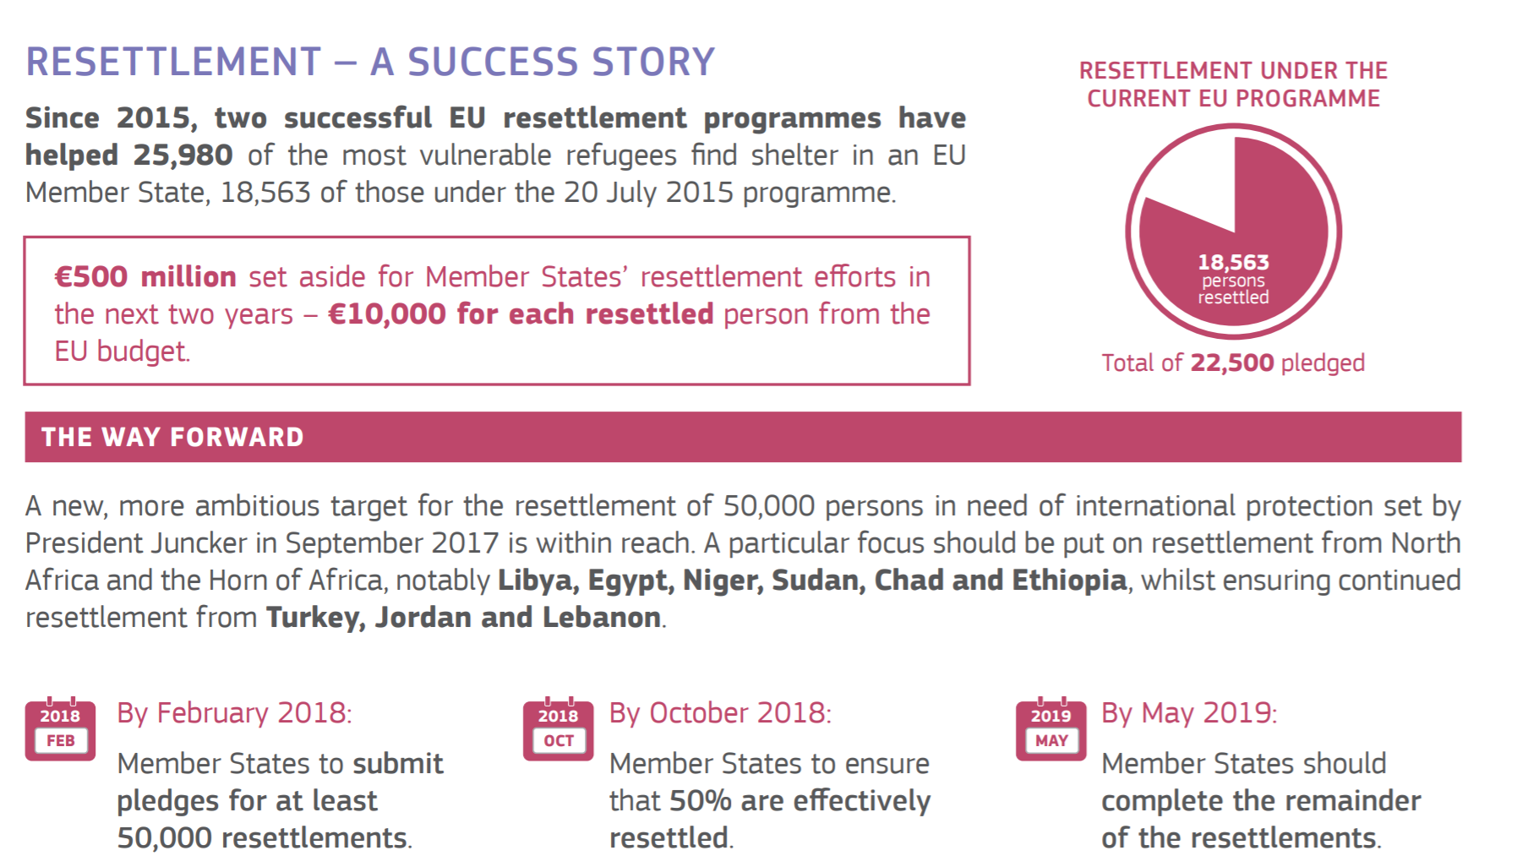
Actual resettlement and the plans
Source: RESETTLEMENT AND LEGAL MIGRATION THE COMMISSION’S CONTRIBUTION TO THE LEADERS’ AGENDA

Slide 95
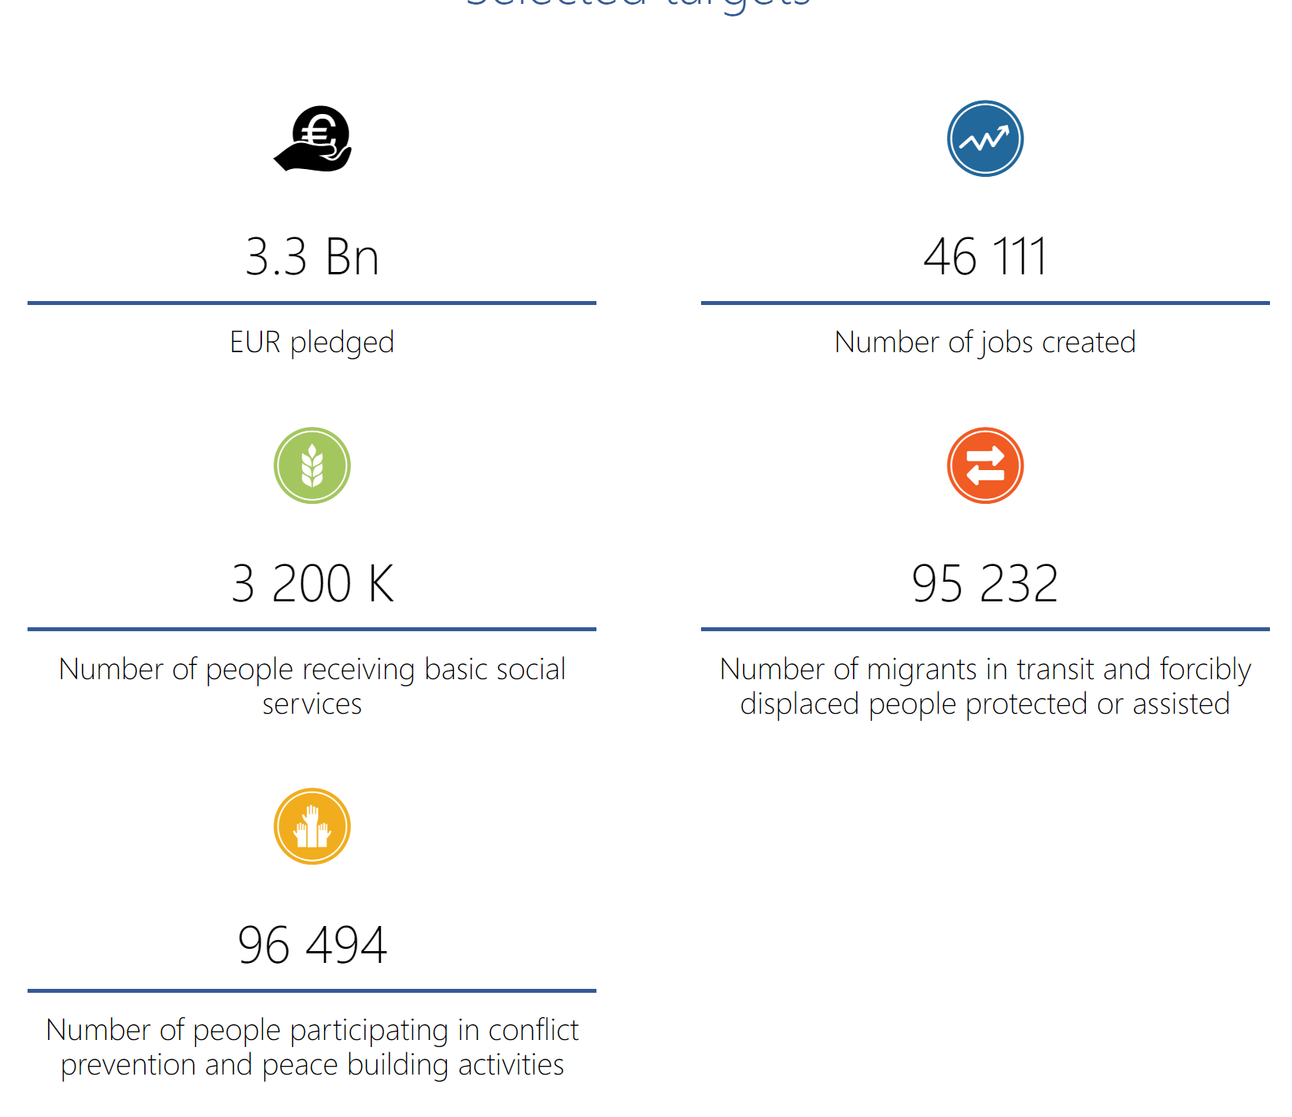
Financial assistance
Emergency Trust Fund for stability and addressing the root causes of irregular migration and displaced persons in Africa.
Goals:
foster stability in the regions;
contribute to better migration management.
  by addressing the root causes of
  destabilisation, forced displacement
  and irregular migration, by
  promoting
  economic and equal opportunities,
  security and development.
2 556 million Euros pledged
Source https://ec.europa.eu/trustfundforafrica/content/homepage_en (20180606)

Slide 96
EU Regional Trust Fund in Response to the Syrian Crisis
Countries covered: Egypt, Iraq, Jordan, Lebanon, Turkey, but also some Western Balkan states
Improving education, livelihoods and health
With contributions and pledges from 22 EU Member States and Turkey, amounting to €150 million, and contributions from various EU instruments, [1,25 billion] the Fund has reached a total volume of almost
€1,4 billion to date.
€1.213 million have already been allocated to concrete assistance programmes for refugees and host communities in the region. These programmes support basic education and child protection, training and higher education, better access to healthcare, improved water and waste-water infrastructure, as well as support to resilience, economic opportunities and social inclusion
For detals check: https://ec.europa.eu/neighbourhood-enlargement/neighbourhood/countries/syria/madad_en

Slide 97
The EU-Turkey „statement” – the deal of 18 March 2016
„[A]ny application for asylum will be processed individually by the Greek authorities in accordance with the Asylum Procedures Directive, in cooperation with UNHCR”
„All new irregular migrants crossing from Turkey into Greek islands as from 20 March 2016 will be returned to Turkey. This will take place in full accordance with EU and international law, thus excluding any kind of collective expulsion.”
„[T]emporary and extraordinary measure”
„Migrants not applying for asylum or whose application has been found unfounded or inadmissible in accordance with the said directive will be returned to Turkey”
Turkey suspended the implementation of that point in March 2017

Slide 98
The EU-Turkey „statement”
– the deal of 18 March 2016
„For every Syrian being returned to Turkey from Greek islands, another Syrian will be resettled from Turkey to the EU taking into account the UN Vulnerability Criteria”
Visa liberalisation among Schengen states for Turkey by the end of June 2016
Opening Chapter 33 in the accession negotiations
3 + 3 billion Euros for the Facility for Refugees in Turkey
Notes:
„[R]esettlement under this mechanism will take place, … honouring the commitments [of 20 July 2015], of which 18.000 places for resettlement remain. Any further need for resettlement will be carried out through a similar voluntary arrangement up to a limit of an additional 54.000 persons.” … The Commission's will propose an amendment to the relocation decision of 22 September 2015 to allow for any resettlement commitment undertaken to be offset from non-allocated places under the decision… Should the number of returns exceed the numbers provided for above, this mechanism will be discontinued.”
- A mechanism up to 72 000 resetllements. No plan for afterwards
- Purely voluntary

Slide 99
The new partnership Framework
COM(2016) 385 final 7 june 2016
The short term objectives:
save lives at sea;
increase the rate of returns to countries of origin
avoid embarking on dangerous journeys to reach Europe.
-
Long term objectives
Address the root causes of irregular migration and forced displacement
Provide reinforced EU support to third countries for capacity building and by advancing their political, social and economic situation.
Notes:
Immediate and short term operational actions include:
elaborating "compacts" with a number of priority third countries of origin and transit, such as Mali, Niger, Nigeria, Senegal, Ethiopia, but also Jordan and Lebanon;
setting up a coordination mechanism between the EU level and the Member States to deliver the compacts, with the identification of negative and positive incentives being a key part of thisprocess;-
Member states nominating European Migration Liaison Officers in order to complete the network by autumn 2016;-
mainstreaming the goals of the migration partnership in all EU policies, tools and budget programming;
ensuring that EU external policy in tackling root causes of irregular migration and forced displacement will also support the Migration Partnership.-
deploying close to €8 billion over 2016-2020, which will help deliver the compacts;
making a proposal for an External Investment Plan to mobilise up to €31 billion of investment, with the potential for this to increase to €62 billion if Member States and other partners match the EU contribution, in order to address the long term objective of tackling the root causes of migration, while contributing to the achievement of other development goals.
______________________________
An essential element underpinning the new Partnerships Framework is a coherent, credible and effective policy with regard to the return of irregular migrants, in full respect of human rights and the principle of non-refoulement. Effective return, readmission and reintegration policies for those not qualifying for protection are an essential part of combating irregular migration and will help discourage people from risking their lives.
To date, 17 readmission agreements are in force with the following partner countries: Hong Kong, Macao, Sri Lanka, Albania, Russia, Ukraine, former Yugoslav Republic of Macedonia, Bosnia & Herzegovina, Montenegro, Serbia, Moldova, Pakistan, Georgia, Armenia, Azerbaijan, Turkey, Cap Verde. In addition, a number of readmission agreements are currently under negotiation.
To ensure that third countries fulfil their obligations to readmit their nationals, the following elements
will be prioritised:
A focus on the countries of origin, which should also facilitate cooperation on readmission with countries of transit;
Coordinated and coherent EU and Member State action on readmission where the paramount priority is to achieve fast and operational returns, and not necessarily formal readmission agreements;
The facilitation of the identification of irregular migrants in view of their readmission by strengthening third countries' capacity to ensure functioning civil registries and fingerprint or biometrics digitalisation, as well as capacity building on border and migration management;
Stepping up Assisted Voluntary Return and Reintegration initiatives on the route to help countries of transit in returning third country nationals to their countries of origin whenever possible, including promoting regional cooperation among countries of origin and transit;
The acceptance by partner countries to use the EU laissez-passer for return operations.

Slide 100
Council Conclusions 25 June 2018
Migratory pressure: „a challenge not only for a single Member State, but for Europe as a whole”
Goal ”stem illegal migration on all existing and emerging routes”
Central Mediterranean (Libya): EU standing by Italy and other „frontline” states. Support for Libyan and Sahel actors, and for „humane reception conditions, voluntary humanitarian returns, cooperation with other countries of origin and transit, as well as voluntary resettlement” (NGO) vessels must not obstruct „operations of the Libyan Coastguard” and must respect laws.
Eastern Mediterranean Route reinforced cooperatioin with Turkey in exchange expectation for swift returns and prevention of new sea routes

Slide 101
Council Conclusions 25 June 2018
Western Balkans region: support to „prevent illegal migration, increase the capacities for border protection and improve return and readmission procedures.”
Western Mediterranean: Financial support to Spain and Morocco „to prevent illegal migration”
Turkey gets the second 3 billion Euros, the Trust Fund for Africa 500 million, and MS are called on to voluntary contribute.
„Africa is our neighbour”: new level of cooperation. More development funding and private investment, „increased exchanges and contacts amongst the peoples of both continents on all levels of civil society.”
Efforts to be made to increase returns

Slide 102
THANKS!
BOLDIZSÁR NAGY
E-mail: nagyb@ceu.edu
www.nagyboldizsar.hu
CEU IRES
Budapest, 1051
Nádor u. 9.

