Slide 1
EUROPE WITH NO INTERNAL BORDERS, THE SCHENGEN AREA AND EU BORDER CONTROL
Presentation of Boldizsár Nagy at the
EIPA Training
Introduction to EU law and EU policies for non-lawyers
Module 6 – The Area of Freedom, Security and Justice stream
Brussels, 13 December 2016
Slides developed in cooperation with Petra Jeney

Slide 2
THE AREA OF FREEDOM, SECURITY AND JUSTICE
THE METAMORPHOSIS OF CONCEPTS
1958 - 1993 = Up to Maastricht: intergovernmental cooperation
  Schengen Agreement (1985) and Convention implementing the Sch. A. (1990)
  The Dublin Convention on determining the state responsible for the asylum procedure (1990)
1993 – 1999 = Between Maastricht (1 November 1993) and Amsterdam (1 May 1999) = Justice and home affairs = III pillar = 9 matters of common interest as in Article K (Title IV) of the TEU (Maastricht treaty)
1999 - 2009 = From entry into force of the A.T. till entry into force of the Lisbon Treaty (1 December 2009) = Justice and home affairs = Area of freedom, security and justice =
    I pillar = Title IV. of TEC (Visas, asylum, immigration and other policies related to free movement of persons + civil law cooperation)
    +
    III pillar =Title VI. of TEU (Provisions on police and judicial cooperation in criminal matters)
2009 December 1 - = Area of freedom, security and justice reunited in Title V of the Treaty on the Functioning of the European Union = Border checks, asylum, immigration; civil law cooperation; criminal law cooperation; police cooperation = no pillar structure but CFSP is outside of the „normal” EU regime
Notes:
Freedom = freedom of movement + immigration and asylum+ non-discrimination+ data protection+ fundamental human rights+citizenship
Security = fight against organized crime (including terrorism) and drugs + police cooperation (Europol, Eurojust, External Border Agency)
Justice („Recht”) = cooperation among civil and criminal courts, approximation of procedures, mutual recognition of decisions, simplification of transborder actions (litigation in another member state)

Slide 3
The impact of the idea of Schengen and the AFSJ
The moving dilemma:
Abolition of border controls (genuine freedom of movement)
vs.
state sovereignty („security)”
Responses:
  Up to Maastricht (1993) (sovereignty)
  Maastricht-Amsterdam (sovereignty but Schengen and „matters of common interest”)
  After Amsterdam (1 May 1999): Genuine freedom with
      flanking measures
      closer cooperation, opt ins and opt outs

Slide 4
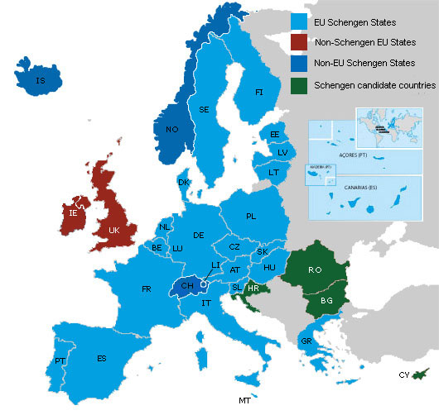
Schengen: area with no internal borders
1985: Signature of the Schengen agreement between FR, BE, NL, DE & LUX
1990 Schengen Implementing Convention
1995: abolition of the checks at the internal borders + one single external border among the 13 EU MS (except for UK IRL)
1997: incorporation of the Schengen cooperation into the EU legal framework
2001 Norway and Iceland
2007 Estonia, Hungary, Latvia, Lithuania, Malta, Poland, Slovenia, Slovakia and the Czech Republic
2008: Switzerland
2011: Liechtenstein
Prospective Members CY, BG, RO,HR
Special status UK, IRL and DK – protocols under the Treaty of Lisbon

Slide 5
Status of the United Kingdom, Ireland and Denmark
UK, Ireland
Protocol 20, on border control – may maintain, even against persons with free movement rights
Protocol 21 may opt in to any measure adopted under Title V TFEU – Arts 67 - 89 on the Area of Freedom Security and Justice
Protocol 19 on the Schengen acquis – UK, Ireland may opt out of development of Schengen (police and judicial cooperation)
Denmark
Protocol 22 Denmark only bound by the Schengen acquis as it stood in 1999 – any development of it –obligation of international legal nature

Slide 6
EU competences on visas and borders
Article 77 TFEU
The European Parliament and the Council, acting in accordance with the ordinary legislative procedure, shall adopt measures concerning:
  (a) the common policy on visas and other short-stay residence permits;
  (b) the checks to which persons crossing external borders are subject;
  (c) the conditions under which nationals of third countries shall have the freedom to travel within the Union for a short period;
  (d) any measure necessary for the gradual establishment of an integrated management system for external borders;
  (e) the absence of any controls on persons, whatever their nationality, when crossing internal borders.
The Council, acting in accordance with a special legislative procedure, may adopt provisions concerning passports, identity cards, residence permits or any other such document. The Council shall act unanimously after consulting the European Parliament.

Slide 7
Borders
Regulation (EC) No 2016/399 on a Union Code on the rules governing the movement of persons across borders - Schengen Borders Code
  common rules that govern external border checks on persons, entry requirements
  exceptional re-imposition of internal border controls
  + Regulation 656/2014 surveillance of the external sea borders in the context of operational cooperation
EUROSUR
European Border
Surveillance System
Smart borders
Entry/exit
system
Integrated border managment

Slide 8
External borders: border surveillance and control
Tasks in relation to the external border
  Border checks
  Border surveillance
Integrated border management
  1. Common rules for issuing visas + IT support;
  2. Cooperation with third countries;
  3. Common rules for border surveillance and control;
  4. In depth checks within the Schengen area.
Border control
(management)

Slide 9
External borders: border surveillance
Schengen Borders Code
Border surveillance
  means the surveillance of borders between border crossing points and the surveillance of border crossing points outside the fixed opening hours, in order to prevent persons from circumventing border checks
  to prevent unauthorised border crossings, to counter cross-border criminality and to take measures against persons who have crossed the border illegally.
Schengen catalogue – recommendations and best practices
Schengen handbook 2006/2015 - detailed instructions on the implementation of the Code

Slide 10
REGULATION (EU) 2016/1624 European Border and Coast Guard since 6 October 2016
Replaces FRONTEX
Key idea: continuum between the EU agency and the national institutions managing the border = shared responsibility
European Border and Coast Guard
The European Border Coast + national authorities of MS
Guard Agency responsible for border border management
Ireland, UK not bound,
Denmark should decide, as it is Schengen development
Iceland, Liechtenstein, Norway, Switzerland are bound

Slide 11
European Border and Coast Guard
Main fields of activity:
Monitoring External Return
and crisis border operations
prevention management
Info exchange Joint (normal) operations Coordinate returns
Migration monitoring Rapid border intervention Provide technical and info Risk analysis Migration management teams assistance
Liaison officers in MS Urgent action if the state unable
Vulnerability assessment or unwilling to act
of MS’ capacity to face risks
Rapid reaction pool: 1500 border guards according to quota (Annex I) Direct costs: agency – salary: sending country
Agency’s own equipment pool

Slide 12
REGULATION (EU) 2016/1624 European Board and Coast Guard
Situations requiring urgent action – right to intervene?
  the State did not follow the recommendations
  resulting from vulnerability assessments
  faces specific and disproportionate challenges at its
  external borders but does not request EBCG operations
  MS‘s non-compliance with the Council decision
  and failure to cooperate with the Agency may
  lead to the temporary reintroduction of border controls at the internal border
Council implementing act
-authorises EBCG to take measures
- MS has to agree to the
operational plan

Slide 13
European Border Surveillance System (Eurosur)
- Information-exchange framework designed to improve the management of Europe’s external borders
- Supports MS by increasing their situational awareness and reaction capability in combating cross-border crime, tackling irregular migration and preventing loss of migrant lives at sea
EBCG Agency creates the European situational picture and the common pre-frontier intelligence picture
Regulation No 1052/2013 of the European Parliament and the Council
of 22 October 2013
establishing the European Border Surveillance System (Eurosur)

Slide 14

Large-scale IT systems in the Area of Freedom Security and Justice
CENTRAL SIS II
technical support function
containing the SIS II database
uniform national interface NI-SIS
Agency for the operational management of large-scale IT systems in the AFSJ, established in 2011
European Commission
Management Authority
Sirene bureaux
N.SIS II
N.SIS II
N.SIS II
Visa Information system
Eurodac
Notes:
Bulgaria and Romania currently only operate the SIS only for the purpose of law enforcement cooperation. They will start using the SIS for the purpose of external border control as soon as the decision for lifting the internal border checks has entered into effect.
Cyprus and Croatia are enjoying a temporary derogation from joining the Schengen Area. They are currently carrying out preparatory activities to integrate into the SIS.
The United Kingdom operates the SIS within the context of law enforcement cooperation. Ireland is carrying out preparatory activities to integrate into the SIS for the purpose of law enforcement cooperation.

Slide 15
External borders: border checks
Schengen Borders Code
  Checks carried out at border crossing points,
  to ensure that persons, including their means of transport and the objects in their possession, may be authorised to enter the territory of the
    minimum checks - for persons enjoying the right of free movement under Union law (EU and EEA citizens and family members)
    the entry of third country nationals shall be subject to thorough checks – document, visa, sufficient means of subsistence, SIS, VIS ...
C-575/12 Air Baltic case

Slide 16
Smart borders – Entry/Exit system (EES)
EES will replace manual stamping of passports,
It will apply to all non-EU citizens who are
admitted for a short stay in the Schengen area
(maximum 90 days in any 180-day period).
The system will register the name, type of travel document and biometrics and the date and place of entry and exit.
Goal:
Enhance border crossing of bona fide travellers,
Detect over-stayers and identify undocumented persons
Reinforce internal security and the fight against terrorism and serious crime, by providing access to the data, for designated authorities and Europol to a record of travel histories of third country nationals including crime suspects
What about returning EU national terrorists?
Notes:
On 6 April 2016 the Commission presented a legislative package on Smart Borders, which included a proposal for a Regulation for the establishment of an Entry/Exit System (EES)1 and a proposal for Regulation amending the Schengen Borders Code to integrate the technical changes that resulted from the above proposal for a Regulation establishing an Entry/Exit System (EES)2 These are a revised version of the proposals presented by the Commission in February 2013 and for which the co-legislators had voiced technical, financial and operational concerns.
________________________
Policy debates were held at political level, both in the JHA Council (21 April and 13 October 2016) and in SCIFA (21 June, 13 September and 25 October 2016), to give guidance to the Working Party on some of the most sensitive issues.
15350/16 Presidency to Council note
. Discussion at technical level focused in particular on the following issues, for which the Presidency considers that a provisional agreement has been reached: – the scope of the proposal5 ;
– the optimal choice and use of biometrics identifiers to be included in the system;
– the transfer of data to third countries;
– data retention periods at EU and national level;
– the interoperability with VIS for Member States that have not yet access to this database;
– the costs at European and national level.

Slide 17
Internal borders: abolition of border control
Schengen Borders Code
  Internal borders may be crossed at any point without a border check on persons, irrespective of their nationality, being carried out
Checks within the territory
  (i) do not have border control as an objective,
  (ii) are based on general police information and experience regarding possible threats to public security and aim, in particular, to combat cross-border crime,
  (iii) are devised and executed in a manner clearly distinct from systematic checks on persons at the external borders
  (iv) are carried out on the basis of spot-checks,
Removal of obstacles to traffic at road crossing-points at internal borders
C-188/10 Melki
C-278/12 PPU Adil
Notes:
Melki – police checks within 20 kms from the border with another Schengen state, exercised irrespective of the personal behavious or individual threat are prohibited
The Schengen Borders Code, precludes „national legislation which grants to the police authorities of the Member State in question the power to check, solely within an area of 20 kilometres from the land border of that State with States party to the Convention implementing the Schengen Agreement …, the identity of any person, irrespective of his behaviour and of specific circumstances giving rise to a risk of breach of public order, in order to ascertain whether the obligations laid down by law to hold, carry and produce papers and documents are fulfilled, where that legislation does not provide the necessary framework for that power to guarantee that its practical exercise cannot have an effect equivalent to border checks”
Adil
mobile security monitoring checks in the Netherlands within 20 km-s of the border are not border checks but legitimate efforts to establish whether the person resides legally, even is no specific suspiso related to the person exists.

Slide 18
Internal border – restoration of control
Article 25. „Normal case”
For 30 days or for the foreseeable duration , exceptionally if „there is a serious threat to public policy or internal security”.
Can be extended by 30 days – max 6months
Procedure (§§ 26 – 27)
Commission must be informed 4 weeks earlier
MS must assess whether the threat justifies interference with free movement and would be reduced by reintroduction of control
Commission forms an opinion on necessity. Other MS may also express views. If dispute: consultations at least 10 days before reintroduction

Slide 19
Internal border – restoration of control
Immediate restoration (without early announcement) of border controls - Article 28 :
„Where a serious threat to public policy or internal security in a Member State requires immediate action to be taken, the Member State concerned may, on an exceptional basis, immediately reintroduce border control at internal borders, for a limited period of up to ten days ” (May be extended by 20 days, several times) Max: two months)

Slide 20
Internal border - restoration of controls
„Specific procedure where exceptional circumstances put the overall functioning of the area without internal border control at risk” New §§ 29 - 30
„In exceptional circumstances where the overall functioning of the area without internal border control is put at risk as a result of persistent serious deficiencies relating to external border control” because they constitute a „serious threat to public policy or internal security” internal border controls may be restored for 6 months It can be extended 3 times for 6 months. Max: 2 years
The Council may recommend it „as a last resort and as a measure to protect the common interests within the area without internal border control, where all other measures…are ineffective in mitigating the serious threat identified…”

Slide 21
Schengen Evaluation and Monitoring Mechanism
1994-2014 carried out by SCH States
Reform in 2013 - Regulation (EU) No 1053/2013 - Union led actions
The new mechanism is more clearly structured, including a serious follow-up mechanism
The Commission’s role has changed from observer to overall organiser and coordinator, entitled to schedule unannounced on-site visits in Member States;
Expertise of other EU institutions and bodies, such EBCG Agency, Europol, Eurojust, EASO and EDPS may be used.
The evaluation and on-site-visits may also cover the absence of border control at internal borders;
The EP is now entitled to receive the relevant information;
More public information.

Slide 22
Schengen evaluation mechanism evaluation in relation to Article 29
EBCG
Vulnerability assessment
*European Commission Website (2016), “The Schengen Rules Explained”
Notes:
Justifications provided by Member States on the reintroduction of intra Schengen border controls
How well do borders work as a response to terrorism?
The scope of the controls
The right to asylum, in light of the reintroduction of intra-Schengen border controls
Exceptional circumstances and the overall functioning of the Schengen area
Informal borders and fences

Slide 23
Extending internal border controls,
Council implementing decision 2016/1989 of 11 November 2016
HEREBY RECOMMENDS:
1. Austria, Germany, Denmark, Sweden and Norway to prolong proportionate, temporary border controls for
a maximum period of three months, starting from the day of adoption of this Implementing Decision, at the
following internal borders:
— Austria at the Austrian-Hungarian land border and Austrian-Slovenian land border,
— Germany at the German-Austrian land border;
— Denmark in the Danish ports with ferry connections to Germany and at the Danish-German land border,
— Sweden in the Swedish harbours in the Police Region South and West and at the Öresund bridge,
— Norway in the Norwegian ports with ferry connections to Denmark, Germany and Sweden.

Slide 24
Visas
Visa requirement
List of third countries subject to visa (Regulation 539/2001
Visa Reciprocity Mechanism
Visa Facilitation Agreements
Procedure
Visa Code (Regulation No 810/2009)
consulates
documents required
processing visa applications
remedies
Visa Information System
Form of visas
Uniform format visas (Regulation 1683/1995)
short stay visa,
visas with limited territorial validity
airport transit visa
Schengen visa: an authorisation/decision by a MS required with a view to:
  transit through or an intended stay in the territory of the Schengen States of a duration of no more than 90 days in any 180 days period ("short stay visa"),
  transit through the international transit areas of airports of the Schengen States ("airport transit visa")
Long term visas are subject to national procedures

Slide 25
Are visas useful and ethical?
Who must have a visa?
„The determination of those third countries whose
nationals are subject to the visa requirement, and those
exempt from it, is governed by a considered, case-by case assessment of a variety of criteria relating inter alia
to illegal immigration,
public policy and security,
and to
the European Union's external relations with third countries, consideration also being given to the implications of regional coherence and reciprocity.”
Council Regulation (EC) No 539/2001 preamle, para (5)

Slide 26
Arguments for consideration
Both „threat of illegal immigration” threat to public order and security” generalise: based on the past behaviour of a few makes everyone suspect and punished by a collective punishment: the visa obligation:
It is based on a self-fulfilling prophecy: the number of denied visas as an indication of the threat of illegal immigration
Entering a country into the visa list is the sheer generalised prejudice
(All the states of Africa, with the exception of two, on the list)

Slide 27
Arguments for consideration
2. If used as a tool in inter-state relations in order to promote other goals the visa obligation burdens the whole of the population: the civilians become hostage to a political game. If an authoritarian system is disciplined with the visa obligation the innocent population bears the brunt
Nationals of political opponents of one (or a few) member states are excluded from „the whole EU”.
3. Individuals who are known to constitute a danger may be excluded from entry even if they are visa exempt - SIS II
4 . Visa obligation prevents asylum seekers from getting to safety

Slide 28
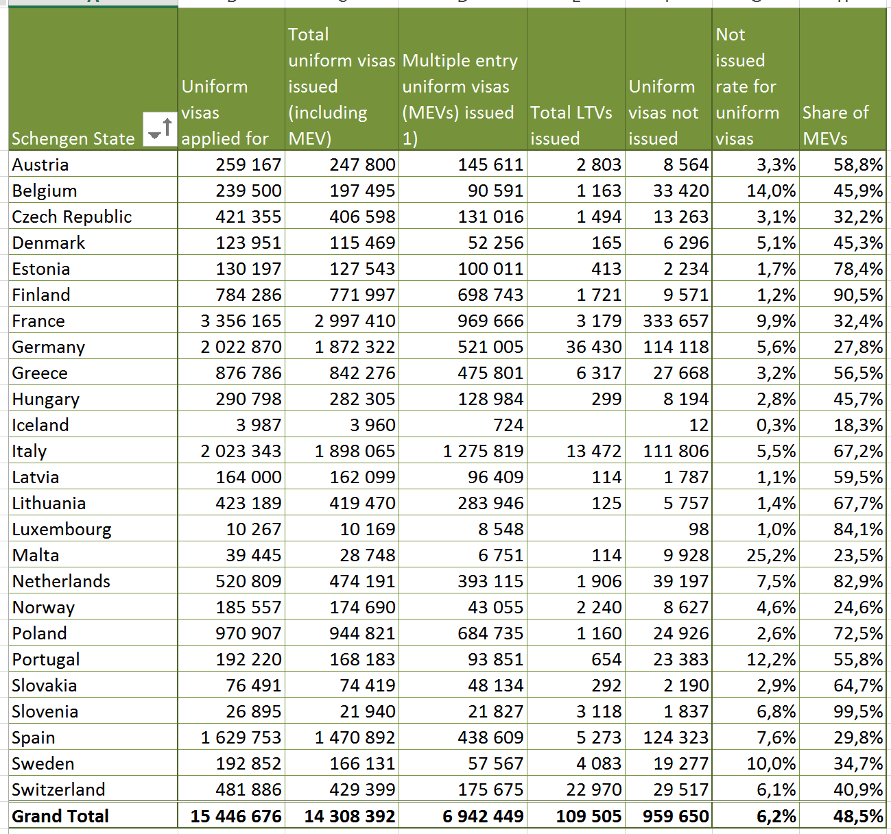
Schen-gen in context
Visa appli-cations
(at consulates) in
2015
Source:
http://ec.europa.eu/dgs/home-affairs/what-we-do/policies/borders-and-visas/visa-policy/index_en.htm
(20161211)

Slide 29
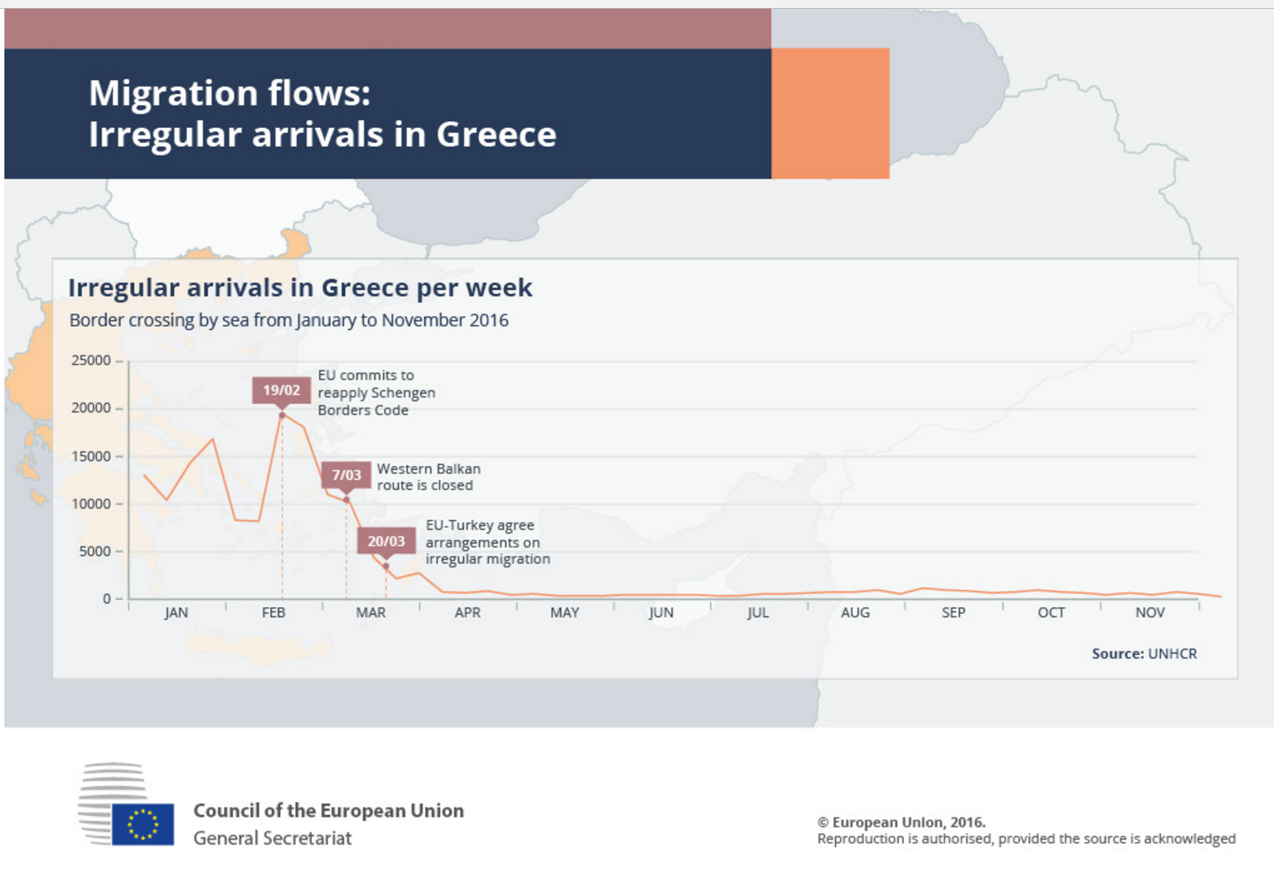
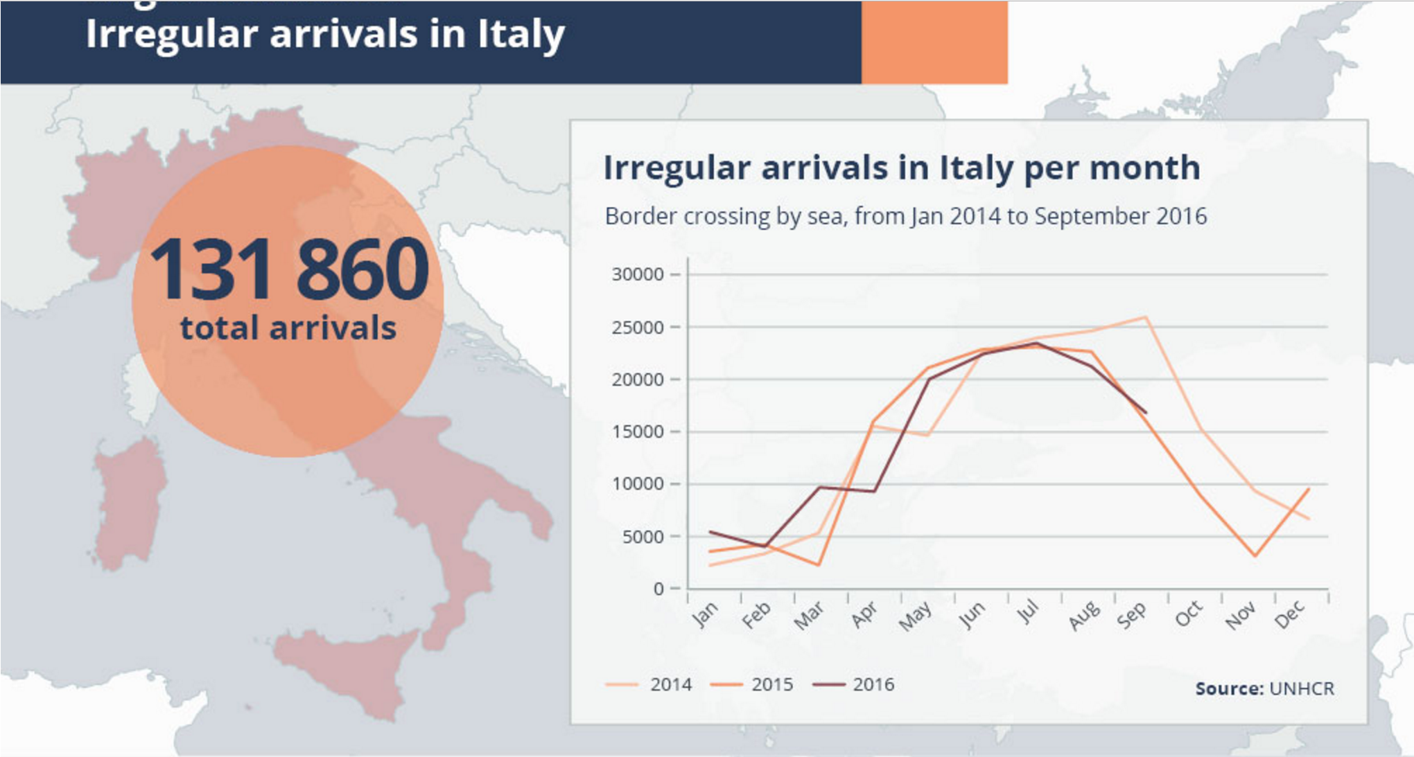
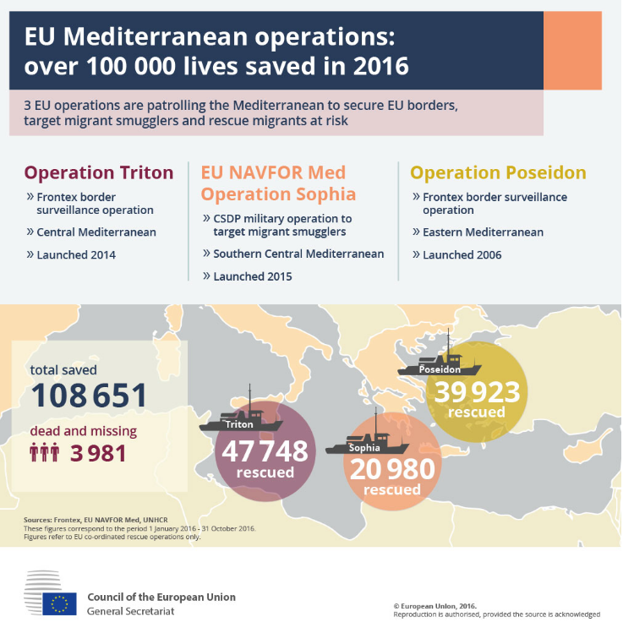
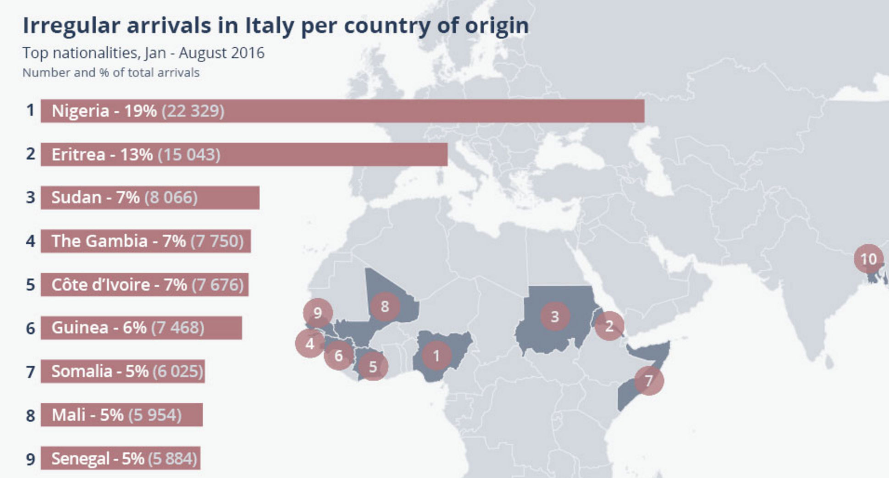
Schen-gen in context
Source Securing EU, DG Migration and Home Affairs 2016
Source: htttp://www.consilium.europa.eu/en/infographics/list/20161211)

Slide 30
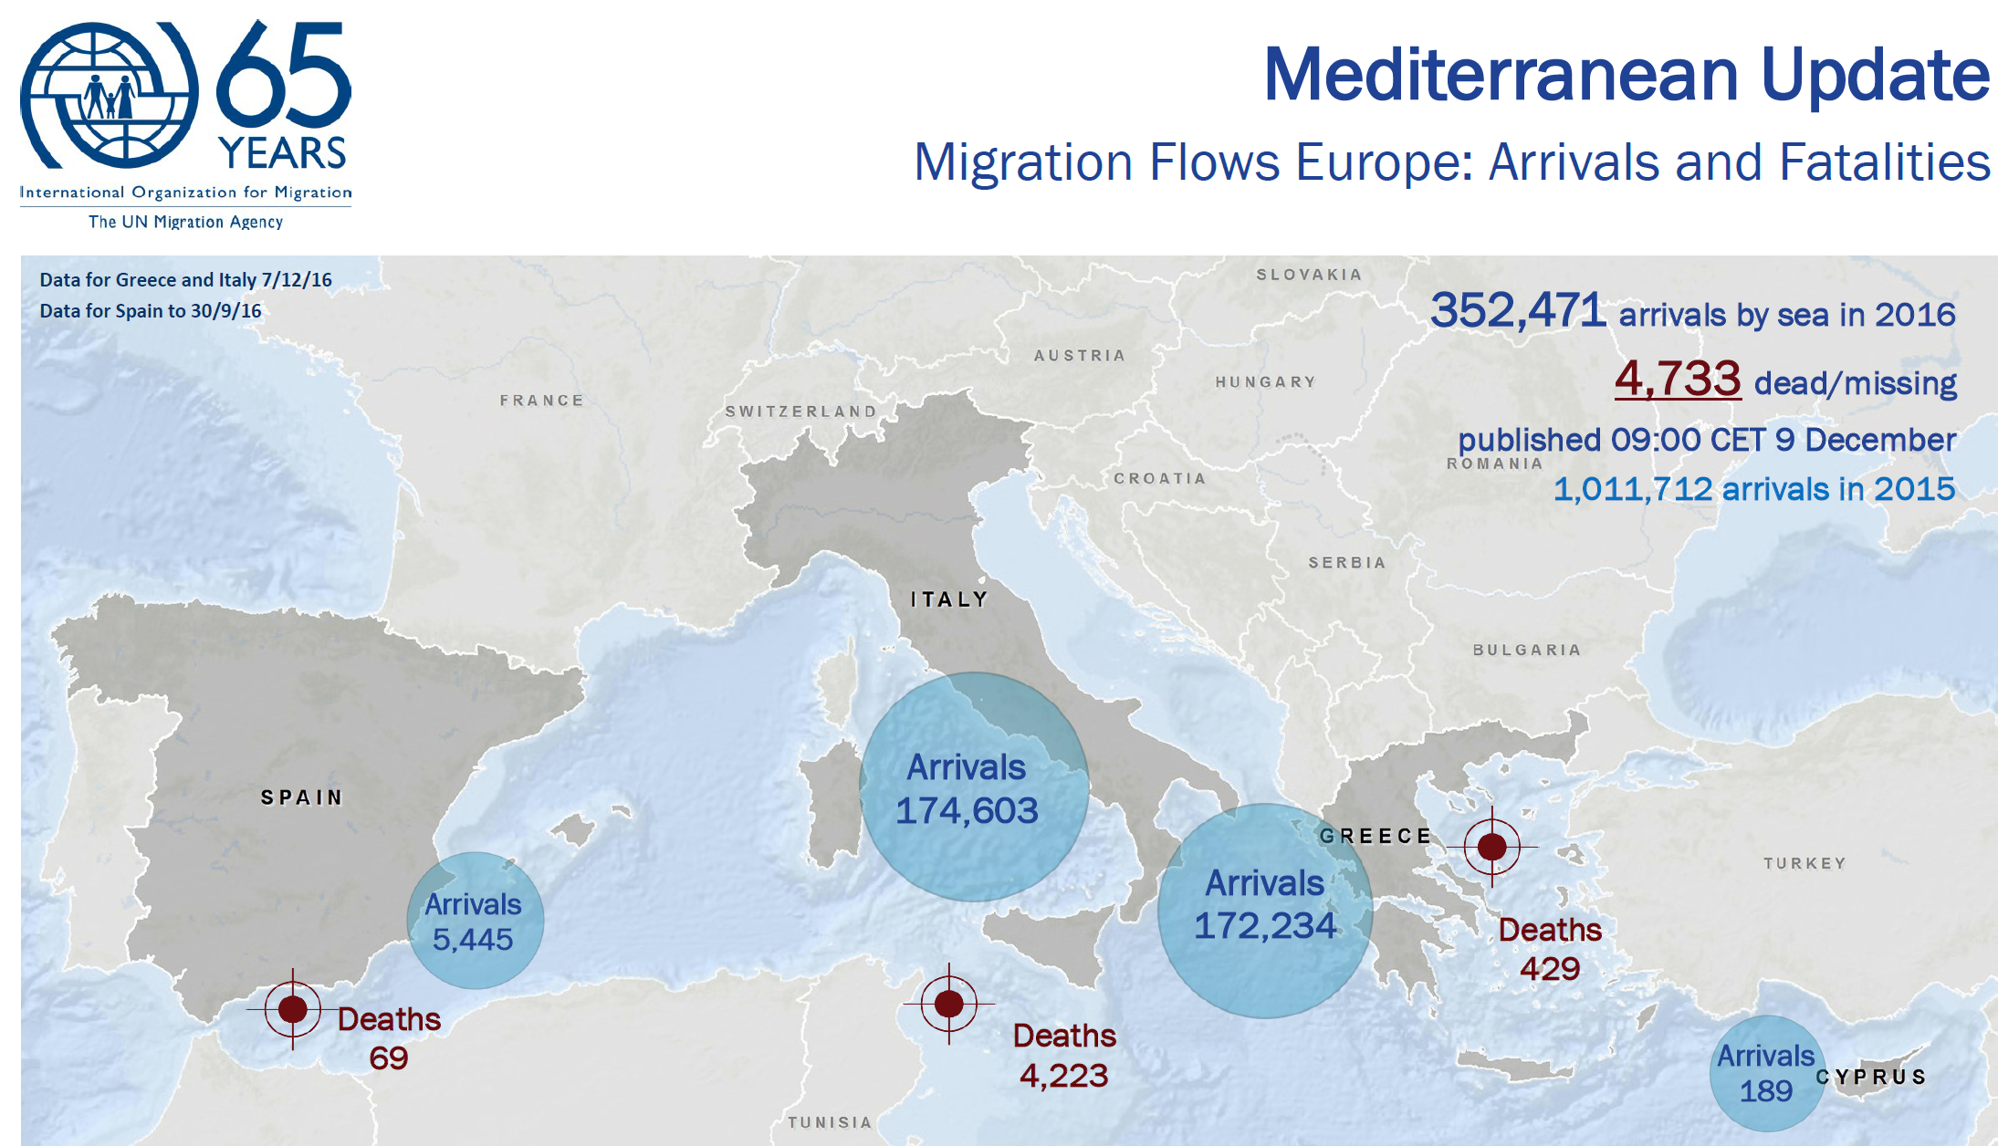
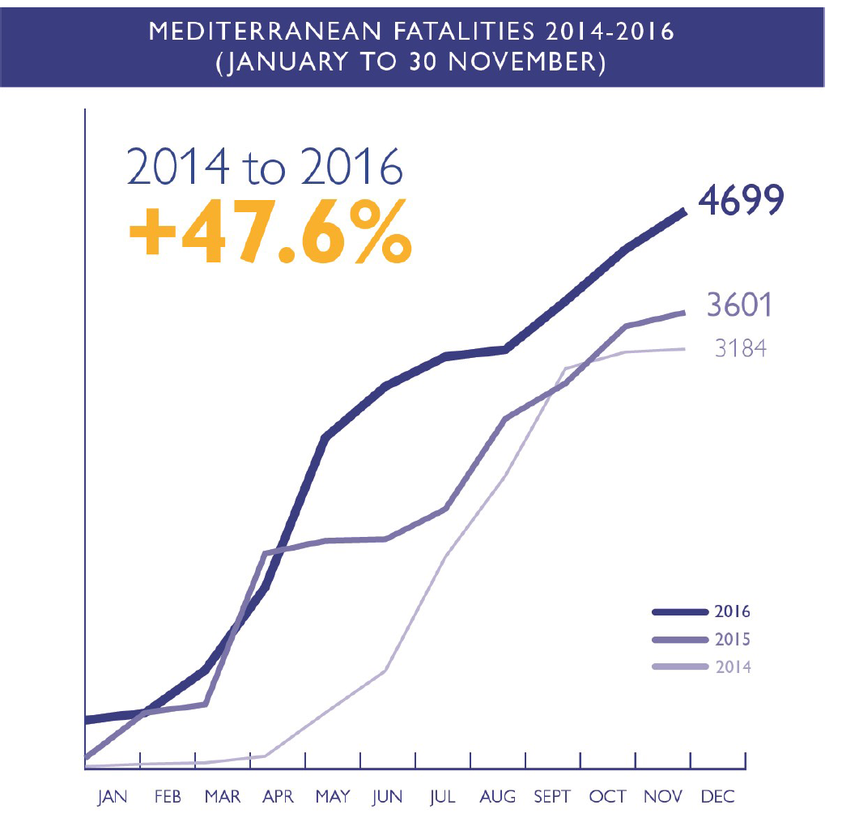
Less arrivals, more deaths at sea in 2016 than in 2015
Source: http://migration.iom.int/docs/Mediterranean_Update_09_DEC_2016.pdf (20161212)

Slide 31
Numbers do not add up
 | Arrival at sea (IOM data)+ | Detection of illegal border crossings (FRONTEX)* | Asylum applications (EASO) ¤
2015 | 1,011,712 | 1.822,337 | 1,071,971
2016 | 378,660 until December | 359,569 until July | 1,093,729 until November
Sources:
+ http://migration.iom.int/docs/Mediterranean_Update_09_DEC_2016.pdf
*Frontex: Annual Risk Analysis, 2016 http://frontex.europa.eu/assets/Publications/Risk_Analysis/Annula_Risk_Analysis_2016.pdf and FRAN Q2, 2016, p. 6 (20161212)
¤ = EASO Latest Asylum Trends, 2016 October, p. 1
Notes:
Irregular border crossing Turkey – Greece, and again Hungary or Croatia from Serbia - double counting

Slide 32
THANKS!
BOLDIZSÁR NAGY
E-mail: nagyboldi100 - at - gmail.com
www.nagyboldizsar.hu
CEU IR and Legal
Budapest, 1051
Nádor u. 9.
Tel.: +36 1 242 6313, Telefax: +36 1 430 0235

