Slide 1
ROLLING BACK THE RULE OF LAW - HUNGARIAN BORDER POLICY AND PRACTICE
Presentation by
Boldizsár Nagy at the international conference:
Borderline decisions
University of Lucerne,
9 March 2017

Slide 2
Motto No. 1
„I urge you, Secretary-General, to initiate negotiations on sharing this burden at a global level. All major stakeholders of international politics will have to take some of the migrants to their countries as part of a global quota system.”
Statement by H.E. Mr. Viktor Orbán Prime Minister of Hungary
at the High Level Side Event on “Strengthening cooperation on migration and refugee movements
in the perspective of the new development agenda” 30 September 2015 United Nations
New York at http://un.newyork.gov.hu/accessibility/download/5/02/21000/Statement_of_Viktor_Orb%C3%A1n_High-Level_Meeting_on_Migration.pdf (20170208)
Notes:
Adressed to Ban Ki-moon
From the same speech:
Excellencies, I am coming from a Christian country, therefore I would like to emphasize that the Christian approach does not tolerate any anti- Muslim policy. The Muslim faith, which we honour and respect, is not responsible for the root causes of this mass migratory movement. I invite you all to join in our efforts to avoid the spread of anti-Muslim sentiments
_____________________________
BUT: also V.O.:
„Brussels continues to seek to distribute the mass of two million who have illegally entered Europe over the past few years.”
www.miniszterelnok.hu » Prime Minister Viktor Orbán’s speech at the ceremonial swearinginof new border guards » Print
2017 January 30

Slide 3
Motto No. 2
„First of all, I find it very important that we should preserve our ethnic homogeneity. … life has confirmed that too much mixing causes trouble. …I’m convinced that if we maintain ethnic homogeneity, and if we can keep cultural diversity within certain limits of cultural homogeneity, that will enhance the value of Hungary as a place.”
Prime Minister Viktor Orbán’s speech at the Hungarian Chamber of Commerce and Industry’s ceremony to mark the start of the 2017 business year
Source: http://www.miniszterelnok.hu/prime-minister-viktor-orbans-speech-at-the-hungarian-chamber-of-commerce-and-industrys-ceremony-to-mark-the-start-of-the-2017-business-year/ (20170305)
Notes:
Viktor Orbán speaking at the he-hungarian-chamber-of-commerce-and-industrys-ceremony-to-mark-the-start-of-the-2017
First of all, I find it very important that we should preserve our ethnic homogeneity. Nowadays one can say such a thing, though a few years ago one would have been executed for such a turn of phrase. But now one can say things like that, because life has confirmed that too much mixing causes trouble. We Hungarians are naturally heterogeneous, in the sense that we are a European nation. If we just started reading the names of those present here today, they would reveal all sorts of nationalities: from Bunjevci to Swabian. But in ethnic terms these fall within certain limits, and so there is still a certain ethnic homogeneity. We are from a single civilisation. Preserving this is a key issue. Naturally, as we know from Saint Stephen of Hungary, we welcome everyone – and that is as it should be. But we must not take the risk of altering the country’s fundamental ethnic character, because rather than enhancing our position, this would degrade Hungary, and would plunge us into chaos. The Government therefore has a definite direction. This not only relates to migration, but it is a general approach on how we should perceive Hungary’s population. We also see cultural homogeneity as important. This should, of course, be seen once again as diversity within certain limits: limits which do not permit the close coexistence of civilisations which are unable to mix in a cultural sense. This is the problem of parallel societies, and we don’t want to expose Hungary to that. I’m convinced that if we maintain ethnic homogeneity, and if we can keep cultural diversity within certain limits of cultural homogeneity, that will enhance the value of Hungary as a place

Slide 4
Motto No. 3
„First they were hitting us all in the group, after they started doing it individually. … They didn't even bother to see who was older and who was younger, they just started hitting us right away. There was one man. … They grabbed him and smashed his head against the ground breaking his teeth. Blood was coming out of his ears and from his nose. His mouth was cut where the teeth broke. When they dropped us in Serbia he was done, he couldn't move. He just lied down on the ground. We carried him to the Horgos transit zone and they let him stay the night there.”
Migszol: Testimony #3 – The Helicopter.
19/2/2017 at http://www.migszol.com/border-violence/testimony-3-the-helicopter (20170305)

Slide 5
THE ORDERS OF MAGNITUDE (STATISTICS)

Slide 6
Applications and recognitions in Hungary
Year | Applicant | Recognised as refugee | Subsidiary protection | Non-refoulement
2000 | 7 801 | 197 | – | 680
2001 | 9 554 | 174 | – | 290
2002 | 6 412 | 104 | – | 1 304
2003 | 2 401 | 178 | – | 772
2004 | 1 600 | 149 | – | 177
2005 | 1 609 | 97 | – | 95
2006 | 2 117 | 99 | – | 99
2007 | 3 419 | 169 | – | 83
2008 | 3 118 | 160 | 88 | 42
2009 | 4 672 | 177 | 64 | 156
2010 | 2 104 | 83 | 132 | 58
2011 | 1 693 | 52 | 139 | 14
2012 | 2 157 | 87 | 328 | 47
2013 | 18 900 | 198 | 217 | 4
2014 | 42 777 | 240 | 236 | 7
2015 | 177 135 | 146 | 356 | 6
2000–2015 Total | 287 469 | 2 310 | 1 560 | 3 834
Source: Hungarian Statistical office http://www.ksh.hu/docs/hun/xstadat/xstadat_eves/i_wnvn003.html (20160929

Slide 7
Arrivals, countries of origin, Hungary, 2016
Citizenship | 2016
Afghan | 11 052
Syrian | 4 979
Pakistani | 3 873
Iraqi | 3 452
Iranian | 1 286
Moroccan | 1 033
Algerian | 710
Turkish | 425
Somali | 331
Bangladeshi | 279
Kosovar | 135
other | 1 877
Total | 29 432
Source:
Immigration and Asylum Office: Booklet on Statistics
http://www.bmbah.hu/index.php?option=com_k2&view=item&layout=item&id=492&Itemid=1259&lang=en 20170305)

Slide 8
Hungarian Decisions 2015-2016
 | 2015 | 2016
Total number of applicants | 177 135 | 29 432
Refugee Status | 146 | 154
Subsidiary Protection | 356 | 271
Non-refoulement | 6 | 7
Termination of procedure | 152 260 | 49 479
Rejection | 2 917 | 4 675
Pending Cases (on December 31 of present year) | 36 694 | 3 413
8 125 persons not accounted for!
Source:
Immigration and Asylum Office:: Booklet on Statistics
http://www.bmbah.hu/index.php?option=com_k2&view=item&layout=item&id=492&Itemid=1259&lang=en 20170305)

Slide 9
THE THEORETICAL FRAME

Slide 10
Conceptual frame: Securitisation, Majority identitarian populism, and Crimmigration
Securitization
Securitization refers to a set of speech acts and practices which posit a phenomenon or process as threatening the well-being of the society and calls for extraordinary reaction on behalf of the securitizing agent, most frequently entailing the demand to set aside the normal functioning of the legal system and its guarantees, as ‘extraordinary challenges require exceptional responses’.
Notes:
„Refugees were presented as a threat in the government’s discourse on different levels: as abstract threat (embodiment of different cultures), as potential threat (they bring ‘diseases … which haven’t been present for decades’) and as actual, tangible threat (aggressive crowd attacking the country’s border). In the analysis we presented in the previous two chapters we have shown how the securitization frame of explaining events related to refugees dominated the coverage of certain media – most importantly, the public broadcaster M1. But our analysis also revealed that this discourse affected all news media, since their reporting on government officials and authorities, quoting them and broadcasting their remarks, meant that the government’s rhetoric was aired in all media outlets.”
Gábor Bernáth – Vera Messing: Infiltration of political meaningproduction: security threat or humanitarian crisis? The coverage of the refugee ‘crisis’ in the Austrian and Hungarian media in early autumn 2015
CEU, Budapest December 2016 https://www.ceu.edu/sites/default/files/attachment/article/17101/infiltrationofpoliticalmeaningfinalizedweb.pdf
_____Huysmans, 2000_____________________________________
„Migration is identified as being one of the main factors weakening national tradition and societal homogeneity. It is reified as an internal and external danger for the national community or western civilization. This discourse excludes migrants from the normal fabric of society, not just as aliens but as aliens who are dangerous to the reproduction of the social fabric. The discourse frames the key question about the future of the political community as one of a choice for or against migration. The discourse reproduces the political myth that a homogenous national community or western civilization existed in the past and can be re-established today through the exclusion of migrants who are identified as cultural aliens.”
J. Huysmans, The European Union and the Securitization of Migration, 38 J. OF COMMON MKT STUDIES No. 5, p 758, (2000).

Slide 11
Conceptual frame: Securitisation, Majority identitarian populism, and Crimmigration
Majority identitarian populism
“Majority identitarian populists claim to speak for what they see as the (current) majority group”. The populist actor distances herself/himself from an elite, which may be presented as conspiring against the people. Politicians may be presented as being complicit „in mass immigration or European integration or both (depending on the nature of the Other)”*
* Quotes from: G. Lazaridis & A. M. Konsta, Identitarian Populism: Securitization of Migration and the Far Right in Times of Economic Crisis in Greece and the UK, in THE SECURITISATION OF MIGRATION IN THE EU: DEBATES SINCE 9/11 (G. Lazaridis & W. Khursheed eds., 2015) p. 186

Slide 12
Conceptual frame: Securitisation, Majority identitarian populism, and Crimmigration
Crimmigration
Immigration is no longer seen as a purely a civil or administrative law matter. Ever more criminal law measures are applied to migrants solely because they circumvented immigration rules and border controls. These kinds of criminal sanctions have no element of rehabilitation, of preparing the “criminal” for participation in the society the rules of which she may have violated. Instead criminalization of immigration related acts solely serves the purpose of deterrence and retribution.

Slide 13
NON-ACCESS PRACTICES AND EXCEPTIONAL MEASURES IN A SECURITISING CONTEXT

Slide 14
NON-ACCESS PRACTICES AND EXCEPTIONAL MEASURES IN A SECURITISING CONTEXT - OVERVIEW
NON-ACCESS TO THE TERRITORY
Building a fence (two fences)
The relocation of control beyond Hungary and inside Hungary
Punishment of the irregular crossing
The fiction of not having entered Hungary while in the transit zone
NON-ACCESS TO THE PROCEDURE
Safe third country and safe country of origin rules
EXCEPTIONAL MEASURES
Transit zones, border procedure
Crisis situation in mass influx and the the planned detention of every asylum-seeker

Slide 15
NON-ACCESS TO THE TERRITORY

Slide 16
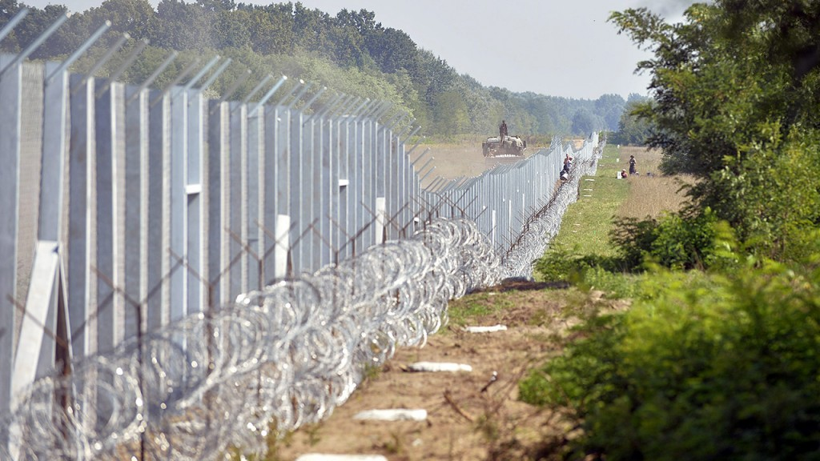
The fences
The first fence
A barbed wire dual fence at the Serbian-Hungarian border called a “temporary security border closure” completed on 15 September 2015 and its continuation at the Hungarian-Croatian border, completed on 16 October 2016
Source: http://24.hu/kozelet/2015/09/28/torvenytelen-orban-keritese/ (20170305)

Slide 17
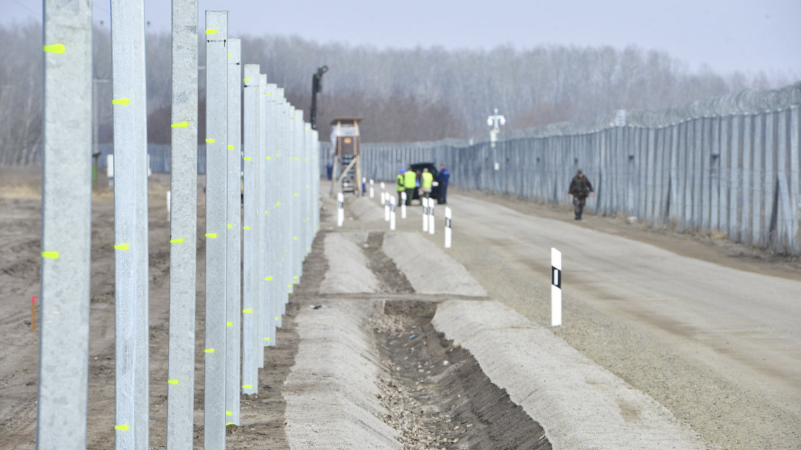
Fences
The second (parallel) fence
Started on 27 February 2017 a second line of fence, a few meters from the first, equipped with electronic devices to register any attempt to cross and alarm the law enforcement agents. (Video and night vision devices, touch sensors)
Source: Ásotthalomnál már épül az okoskerítés (The clever fence being built at Ásotthalom) Délmagyar, 27 February 2017 at http://www.delmagyar.hu/szeged_hirek/asotthalomnal_mar_epul_az_okoskerites/2509001/

Slide 18
The relocation of control beyond Hungary - externalisation
Repeated calls by the government to stop asylum seekers and other migrants before they reach the EU-s external borders. Suggestions to establish reception centres in Libya or Egypt.
V. Orbán, PM: „The European Union should set up a ‚giant refugee city’ on the Libyan coast and process asylum claims there from refugees arriving from other African countries, Hungarian Prime Minister Viktor Orban said on Saturday [24 September 2016]” - speaking in Vienna after a summit of European and Balkans countries on the refugee crisis, Reuters reported.
http://www.reuters.com/article/us-europe-migrants-hungary-libya-idUSKCN11U0GZ (20170305)
See also the „German-French note” of 17 february 2017
Notes:
"A crisis-resistant Common European Asylum System (CEAS)” The French – German note, 2017 february 17
1. The new CEAS, currently being negotiated in Council, must be crisisresistant.
…. Our citizens expect us to learn the lessons from the crisis of 2015/2016.
2. The most essential lesson from the 2015/2016 crisis is: a mass influx can only be stemmed or prevented in close cooperation with neighbouring countries of the EU. Europe cannot ensure the protection of its external borders (in particular sea borders) exclusively by its own means. …The agreement is based on three interacting elements: 1) return of asylum seekers (without an assessment on the merits) in order to discourage illegal, smuggler-driven migration; 2) opening of legal, humanitarian pathways for persons in need of protection; 3) improving living conditions for refugees in the partner
country by using EU financial means. …
3. In its current shape, the CEAS does not sufficiently offer possibilities to conclude agreements …This is mainly due to the high requirements hich must be met in order to implement returns of asylum seekers (without an assessment on the merits). … art. 38 of the EU Asylum Procedures Directive…
4. If one asks how far the CEAS reform proposals tabled in summer 2016 are suitable to strengthen the system's crisis-resistance, the answer is sobering. Art. 45 of the draft EU Asylum Procedures Regulation in conjunction with its recital no. 37. These provisions might even be interpreted in such a way that, … a right to family reunification must be provided for refugees in the third country, at least in principle. Furthermore, the draft provisions stipulate a tightening of the so-called "genuine link" criterion… According to this definition, …Turkey would be a safe third country for Syrians - but not (no longer), for example, for Afghans. … the tabled draft provisions would not significantly broaden Europe's migration policy options in the case of a crisis.
5. … Time is short. At heart is the question of a specific crisis mechanism in European asylum law that would - only - spring into action if in view of a mass influx, the Council, at the request of the Commission or an affected Member State, so decided by qualified majority. The key element of such a crisis mechanism would be the stipulation that, in case of a crisis, a State may also be considered as a safe third country if it respects the non-refoulement principle and - potentially on the basis of respective guarantees taken by the EU - it provides to returned or transferred asylum seekers safe and humane living conditions, at least meeting the standards of art. 3 of the European Convention on Human Rights (ECHR). It would suffice if these requirements were fulfilled only in those regions where asylum seekers would be transferred to. The prohibition of mass expulsion as stipulated in the ECHR would remain binding. …With EU support, the possibility of status determinations, perhaps conducted by UNHCR, would have to be given in the safe third country. For persons in need of protection, resettlements to Europe or to other States would have to be offered.
6. Affected Member States could be permitted to assemble all asylum systems in arrival zones on their own territory for the purpose of speedy admissibility assessments. Other Member States could be obliged to provide an affected Member State with up to 1,000 asylum officers (through EASO) and up to 150 judges. Judicial protection against inadmissibility … (no suspensive effect of an appeal). It should be examined whether decisions by (national) public authorities on the admissibility of an asylum application as well as on appeals against such decisions could be categorised as acts of European legal nature. Such a step (while raising very complicated questions of European law) could significantly facilitate the deployment of public officials and judges from other Member States in practice.
7. …. Neither the provisions of the current CEAS nor the draft provisions tabled are required by the European Charter of Fundamental Rights; they clearly exceed it. 8. The new CEAS will remain in force for many years. ... Thus the system must be designed in a flexible way, and it must be capable of coping with any eventuality, also by way of opening clauses if necessary. This is not about building a "fortress Europe". It is about combatting illegal immigration, which has already cost the lives of thousands, … ."

Slide 19
The relocation of control – expanding the border internally Spreading it first to an 8 km wide zone then to the whole country
The „8 km rule” in force since 6 July 2016
If an “illegally present” third country national is apprehended “within an 8 kilometre strip from the border line or border sign of the external border” of the EU,
then this person may be forcefully escorted to the fence and pushed through using the doors available in the fence
with a view towards making this person submit their application for protection from outside, by approaching the transit zone from the external side—i.e. from the Serbian green border.
No return decision or expulsion order adopted, no procedure according to the return directive (DIRECTIVE 2008/115/EC) applied, no judicial control over the use of coercion.
The „other side of the fence” is still Hungarian jurisdiction for a few meters. Re-entering Serbia through the green border is illegal according to Serbian law
Notes:
Act no. XCIV of 2016, entry into force on July 6, 2016 amending the Asylum Act.
Border procedure
„(1) If the foreigner submits his/her application
a) before entering the territory of Hungary, or
b) following his/her escort through the gate of the facility established for the protection of the order of the state border as defined by the Act on the State Border following his/her apprehension within an 8 kilometre area of the border line or border sign of the external border as defined by Article 2 (2) of Regulation (EU) 2016/399 on a Union Code on the rules governing the movement of persons across borders
in the transit zone, the provisions of this Chapter shall apply with the derogations specified in this Section.”

Slide 20
Push backs to beyond the fence (Blocked entry)
„[B]etween 5 July and 31 December 2016, 19,219 migrants were denied access (prevented from entering or escorted back to the border) at the Hungarian-Serbian border”
Pushed Back at the Door: Denial of Access o Asylum in Eastern EU Member States [Report, covering: Bulgaria, the Czech Republic, Hungary, Poland, Slovenia] Hungarian Helsinki Committee, 2017, pp. 12 - 13

Slide 21
Punishment of irregular crossing of the fence
A maximum of three years imprisonment threatens all who cross the fence illegally (Article 352 A of the penal Code).
The damaging of the fence is a separate crime with a maximum penalty of five years imprisonment. (Article 352 B)
Crossing the international border at sections where no fence has been erected—e.g. the Hungarian-Romanian border — remains a minor offence.

Slide 22
The fiction of not having entered Hungary
Asylum Act, § 71/A
„If the foreigner submits his/her application
before entering the territory of Hungary, [or after being escorted through the gate to the external side of the border] in the transit zone” then
he/she is not entitled to stay on the territory of Hungary (and to a temporary residence permit). (§ 71/A (2))
„After the expiry of 4 weeks from filing the application, the alien police authority shall authorise entry [into Hungary] on the basis of the law” (§ 71/A (4))
No guarantees related to detention apply, neither are most of the reception conditions provided.

Slide 23
The fiction of not having entered Hungary
____________________________________________
Amuur v France (App. No. 17/1995/523/609 (June 25, 1996),
„Despite its name, the international zone does not have extraterritorial status.” (§ 52);
„holding the applicants in the transit zone of Paris-Orly Airport was equivalent in practice, in view of the restrictions suffered, to a deprivation of liberty” (§ 49)
„The mere fact that it is possible for asylum-seekers to leave voluntarily the country where they wish to take refuge cannot exclude a restriction on liberty, the right to leave any country … Furthermore, this possibility becomes theoretical if no other country offering protection … is inclined or prepared to take them in” (§ 48)

Slide 24
NON-ACCESS TO THE PROCEDURE

Slide 25
Lists of safe third countries and safe countries of origin
Government Decree 191/2015 (21 July 2015)
Safe third countries and safe countries of origin. Two identical lists:
Member States (sic!) and candidate states of the European Union, including Turkey (Turkey since March 2016 – still on the list after the coup-attempt)
Member States of the European Economic Area
Those States of the United States of America that do not apply the death penalty,
Switzerland, Bosnia and Herzegovina, Kosovo, Canada, Australia, New-Zealand.
/Japan and many others not mentioned!/

Slide 26
Serbia – not a safe third country
„ In any event, UNHCR maintains the position taken in its observations on the Serbian asylum system in August 2012 that asylum-seekers should not be returned to Serbia.”
UNHCR: Hungary as a country of asylum, May 2016, p. 25
NGOs share the view (Hungarian Helsinki Committee, ProAsyl)
Practically all irregularly arriving asylum seekers come through Serbia, and presently their application is declared inadmissible on safe third country grounds.

Slide 27
THE STATE OF EXCEPTION

Slide 28
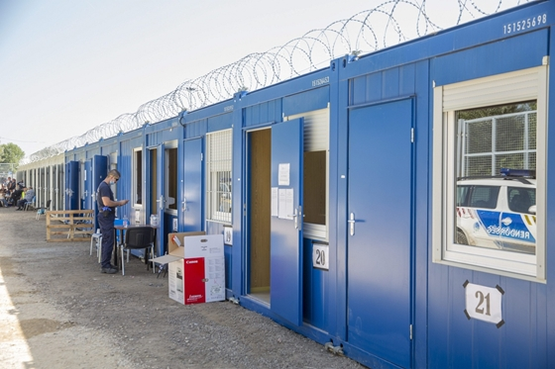
Transit zones
Since September 15, 2015 – the completion of the fence
The “transit zones” are parts of the fence.
They consist of a series of containers which host public officials responsible for refugee status determination procedures.
Police who record the flight route,
Refugee officer deciding on admissibility of the claim
Judge — or a court clerk— in a “court hearing room,” or through internet communication to adjudicate appeals on admissibility.

Slide 29
Border procedures in March 2017
From 15 September 2015
A new border procedure was introduced, only applicable in the transit zone.
Detention + extremely fast procedure + no real access to legal assistance + dramatically reducing legal remedies.
Fiction of not having entered Hungary.
The procedure in February 2017 only extends to the admissibility phase. Once admissible (no safe third country), or belonging to a vulnerable group the applicant is allowed to enter the country and the normal reception conditions must be provided,
Decision on admissibility within 8 days. Time for appeal: 7 days. „Court” review: within 8 days
Not linked to crisis situation, only to arrival from the south

Slide 30
The planned border/crisis procedure
A new procedure introduced under the heading „Procedural rules applicable in case of a crisis situation caused by mass immigration” (Planned § 80/J of the Asylum Act /Act no. LXXX of 2007/)
Personal scope: all asylum seekers (except if detained or regularly in Hungary)
Material scope: merits (not only admissibility)
Procedure:
Escorting back to the transit zone from the whole territory of Hungary (not only from the 8 km stripe)
Appeal: 3 days (No appeal if denies fingerprint or leaves the zone)
Court hearing may be done by clerk, over electronic device
No time limit for completion of the two stage procedure (administrative, court review), albeit detention during the whole procedure, including appeal (Border procedure is limited to 4 weeks)

Slide 31
The relocation of control – expanding the border internally Spreading it to the whole country (Bill No T/13976 of 20 February 2017)
Crisis situation caused by mass influx
Preconditions declaring the crisis situation
Flow data: Arrivals on average in excess of 500 per day for a month, or 750 per day for two weeks or 800 per day for a week.
Stock data: On average the number of persons in the transit zone exceeds 1,000 per day for one month, 1,500 per day for two weeks, or 1,600 per day for one week.
Any situation „related to migration” that
„directly endangers the protection of the border of Hungary as set out in Article 2 (2) of the Schengen Borders Code,”
„directly endangers the public security, public order or public health in a 60 m wide zone of the territory of Hungary measured from the border of Hungary as set out in Article 2 (2) of the Schengen Borders Code and the border mark or in any settlement in Hungary, in particular the outbreak of unrest or the occurrence of violent acts in the reception centre or another facility used for accommodating foreigners located within or in the outskirts of the settlement concerned.”

Slide 32
The relocation of control – expanding the border internally Spreading it to the whole country (Bill No T/13976 of 20 February 2017)
Crisis situation caused by mass influx
– covering the whole territory
– application for asylum only in the transit zone (from Serbia’s side) unless
= otherwise detained
= legally staying in the territory (on other grounds)
The exceptional becomes the norm – every irregularly arriving or staying person is removed to the Serbian side of the fence, without immediate access to the authorities, i.e. with no possibility to submit an asylum application without (weeks of) delay
It is detention: „The person seeking recognition can leave the territory of the transit zone via the exit [to Serbia - BN] gate.” Planned § 80/J (5)
See the Amuur case (later)!
Notes:
Act no. XCIV of 2016, entry into force on July 6, 2016 amending the Asylum Act.
Border procedure
„(1) If the foreigner submits his/her application
a) before entering the territory of Hungary, or
b) following his/her escort through the gate of the facility established for the protection of the order of the state border as defined by the Act on the State Border following his/her apprehension within an 8 kilometre area of the border line or border sign of the external border as defined by Article 2 (2) of Regulation (EU) 2016/399 on a Union Code on the rules governing the movement of persons across borders
in the transit zone, the provisions of this Chapter shall apply with the derogations specified in this Section.”

Slide 33
The combined effect of the planned modification
The extension of the crisis situation to the whole country entitles the law enforcement agents to escort almost every asylum seeker to the transit zone at the border.
However, the bill’s authors pretend that this is not a border procedure and no detention is practiced in the transit zone (The justification originally openly spoke of detention but was replaced a week later „due to a technical error”).
In effect this is an accelerated border procedure with no access to genuine and effective legal remedy and entailing unlimited detention without court control
UNHCR Statement, 7 March 2017
„In practice, it means that every asylum-seeker, including children, will be detained in shipping containers surrounded by high razor wire fence at the border for extended periods of time.
This new law violates Hungary’s obligations under international and EU laws, and will have a terrible physical and psychological impact on women, children and men who have already greatly suffered.”

Slide 34
Report of the UN HRC Special Rapporteur on the human rights of migrants, François Crépeau, 2 April 2012
„The Special Rapporteur would like to emphasize that there is no empirical evidence that detention deters irregular migration or discourages persons from seeking asylum. Despite increasingly tough detention policies being introduced over the past 20 years in countries around the world, the number of irregular arrivals has not decreased. This may be due, inter alia, to the fact that migrants possibly see detention as an inevitable part of their journey”
Para 8 of the report

Slide 35
Contempt of the law
Building the fence in violation of domestic law on the environment and on construction
Extending the crisis situation (in time and geographically) without meeting the legal conditions
Repeatedly curtailing the procedural and the material rights of the asylum seekers, in respect of effective remedies, access to reception conditions and in an increasing measure concerning their human dignity
Ignoring EU law (and international law) on preconditions of return to a (safe) third country
Constantly violating the Dublin regulation by hindering take charge and take back
Breaching the rights of minors to interpretation and translated documents in the criminal procedure
Bill of 20 February 2017
Proposal to keep minors of the age of 14 – 18 detained

Slide 36
Brutality – leaving the law behind
„As highlighted by FRA in past months, in Hungary, reports of violence, excessive use of force and humiliating practices increased significantly after … July 2016. … Reported practices include the use of unleashed dogs, the use of a pepper spry, beatings, yelling at people, and, most recently, taking away warm clothing and making people kneel. Civil society representatives noted that in most cases the authorities deny the occurrence of such incidents and are unwilling to investigate them.” (Footnotes omitted – BN)
FRA: Current migration situation in the EU: Torture, trauma and its possible impact on drug use Vienna, February 2017, p. 8.
http://fra.europa.eu/en/publication/2017/february-monthly-migration-focus-torture
_____________________________________
Testimonies at http://www.migszol.com/border-violence (20170305)

Slide 37
INTERPRETATION

Slide 38
What does Hungary do instead of protecting the refugees?
1.
IT IS IN DENIAL
6.
BREACHES EU AND DOMESTIC LAW
2.
DETERS
5.
FREE RIDES Denies solidarity
3.
OBSTRUCTS
4.
PUNISHES

Slide 39
explanation?
Structural problems beyond the control of Hungary
CEAS in force did not deliver appropriate answers
EU member states (starting with Greece) and other (Western Balkan) states renounced their duties to act as states controlling movement across their territories
Idiosyncratic Hungarian causes
The modus operandi of FIDESZ as the ruling party
Create an „enemy of the nation” and then defeat it
(Banks, utility companies, large food supermarkets, migrants, NGOs with a
political agenda)

Slide 40
explanation?
The personality of the Prime Minister from arch liberal (early nineties) to centrist conservative (late nineties) to ethno-nationalist radical and illiberal right wing politician (since 2010s).
The political program of building an illiberal state (diminished respect for human rights, distorted ethno-nationalist communitarian ideology)
The ambition to develop a feudal-socialist system built on personal allegiance (feudal element), concentration of state power and decision-making at the peak and redistribution of resources through the central administration, depriving municipalities from self governing powers (socialist element)

Slide 41
REMEDY?
Notes:
Issue
What is the responsibility of the „principle of responsibility” to solidarity/fair sharing of responsibility?
Finding
Solidarity and fair sharing of responsibility in Art 80 TFEU make room for more than an allocation of tasks, they enable fairness and assistance beyond legally assigned obligations. Dublin is neither an expression of solidarity nor of fair sharing
Issue
What forms of solidarity are applicable (beyond AMIF and the different Funds)
Finding
Relocation of asylum seekers and resettlement as ad hoc tools. Their definition as provided by the EU acquis. The fusion of the two when applying the EU-Turkey statement.

Slide 42
REMEDIAL ACTIONS
INTERNATIONAL
ECtHR judgments;
UNHCR pressure – lower standing in the UN (E.g. no re-election to Human Rights Council)
Allies distancing themselves
EU
Article 7 EU
Rule of Law Procedure
LIBE hearing
Infringement procedures
Conditionality (Renzi)
DOMESTIC
Intensive NGO criticism
Some of the major churches being critical
EU-oriented politicians in FIDESZ dissatisfied
Danger: the whole EU moving to similar direction – Valetta declaration, efforts to externalise protection
Notes:
1. UNHCR deeply concerned by Hungary plans to detain all asylum seekers
UNHCR is deeply concerned at a new law which has been voted this morning at the Hungarian Parliament and which foresees the mandatory detention of all asylum seekers, including many children, for the entire length of the asylum procedure.
In practice, it means that every asylum-seeker, including children, will be detained in shipping containers surrounded by high razor wire fence at the border for extended periods of time.
This new law violates Hungary’s obligations under international and EU laws, and will have a terrible physical and psychological impact on women, children and men who have already greatly suffered.
We already expressed serious concern about the physical barriers Hungary has already erected, together with legislative and policy obstacles, making it nearly impossible for asylum-seekers to enter the country, apply for asylum and receive international protection.
Under International and EU laws, the detention of refugees and asylum-seekers can only be justified on a limited number of grounds, and only where it is necessary, reasonable and proportionate. This requires authorities to consider whether there are less coercive or intrusive measures to achieve these goals, based on an assessment of the individual’s particular circumstances. Alternatives to detention should always to be considered first. Failure to do so could render detention arbitrary.
Children should never be detained under any conditions as detention is never in a child’s best interest.

Slide 43
Thanks!
Boldizsár Nagy
Central European University
Nagyb at ceu.hu
www.nagyboldizsar.hu

