Slide 1
MIGRATION POLICY IN A EUROPEAN CONTEXT Hungary in a nutshell
Presented by Boldizsár Nagy,
SPP 2015

Slide 2
History
Hungary, mainly source country
1848, 1919-20, pre- second World War period, 1948, 1956, continuous trickle 1957 – 1989
Dramatic turn: 1988 – 89: people fleeing Ceaușescu’s dictatorship in Romania
1991-95 Balkan war refugees
1998: first real asylum law, abolition of the geographic limitation
2004 Accession to the EU (before it: harmonisation with the then EU law)
2007 adoption of the presently applicable asylum law (with later amendments)
2013: introduction of the „asylum detention”
2013- 2015 major surge in asylum seekers’ numbers

Slide 3
Hungarian statistics
 | 2011 | 2012 | 2013 | 2014 | 2015 1 January – 10 May
Application, total | 1.693 | 2.157 | 18.900 | 42.777 | 42.298
3 Main countries of origin | Afghanistan (649) Kosovo (211) Serbia (27) | Afghanistan (880) Pakistan (327) Kosovo (226) | Kosovo (6.067) Pakistan (3.052) Afghanistan (2.279) | Kosovo (21.453) Afghanistan (8.796) Syria (6.587) | Kosovo (23.845) Afghanistan (7.511) Syria (4.802)
Some form of protection | 191 | 415 | 415 | 512 | 99
Refugee | 52 | 87 | 198 | 260 | 25
Subsidiary protection | 139 | 328 | 217 | 252 | 74
Rejection | 740 | 751 | 4.185 | 4.553
Termination | 623 | 1110 | 11.339 | 23.406
Source: own collection based on OIN Yearly booklets and UNHCR data

Slide 4
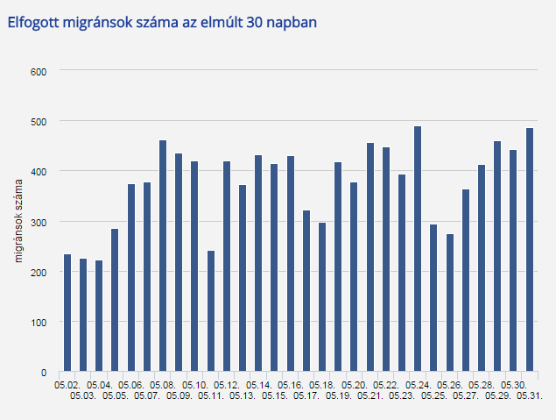
Fresh data irregular Migrants intercepted in May 2015
Source: http://www.police.hu/hirek-es-informaciok/hatarinfo/elfogott-migransok-szama 20150601)

Slide 5
The Hungarian Refugee and Beneficiary of Subsidiary Protection Status determination Procedure
Application
Preliminary
examination
Detailed examination (of the merits)
Judicial review
8 Days
Judicial review
30 days
60 + 30 days
45 working days
Administrative procedure
Judicial procedure

Slide 6
Critical issues
Absconding
Safe third country (Serbia)
Detention
Conditions during the procedure
Dublin returns to Hungary
Limited appeal
(Lack of real) integration

Slide 7
THANKS!
BOLDIZSÁR NAGY E-mail: nagyb@ceu.edu www.nagyboldizsar.hu CEU IRES Budapest, 1051 Nádor u. 9. Tel.: +36 1 242 6313

