Slide 1
THE MOVEMENT OF THIRD COUNTRY NATIONALS IN THE EU LAW AND PRACTICE
Presentation by
Boldizsár Nagy
at the GCSP, 23 January 2013

Slide 2
The scheme of the talk
Setting the stage: Interception at high seas, limits to return under the Dublin regulation
Theoretical introduction
- From freedom of movement for workers to the freedom of movement of the citizens (of the EU)
- The new meaning of security
The system of the acquis and categories of the affected persons
The movement of third country nationals across the borders and within the EU
Regular migration
Illegal (undocumented) migration
Asylum seekers, refugees

Slide 3
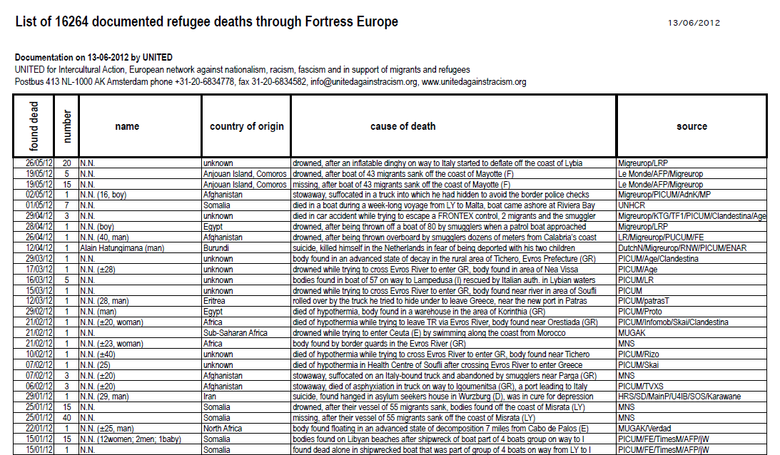
The Berlin Wall 1961 – 1989 and the frontier around Europe
During the Wall's existence there were around 5,000 successful escapes into West Berlin. Varying reports claim that either 192 or 239 people were killed trying to cross and many more injured. http://en.wikipedia.org/wiki/Berlin_Wall visited 25 February 2006
Source: http://www.unitedagainstracism.org/pdfs/listofdeaths.pdf visited 13 September 2012
Notes:
The NGO „UNITED for Intercultural Action, European network against nationalism, racism, fascism and in support of migrants and refugees” as of March 2007 lists 8855 documented asylum seeker and refugee deaths among those who wanted to reach safety and remain within.

Slide 4
Hirsi Jamaa and others v. Italy Appl. No. 27765/09 European Court of Human Rights Grand Chamber judgment of 23 February 2012

Slide 5
Hirsi Jamaa and others v. Italy Appl. No. 27765/09 Grand Chamber judgment of 23 February 2012
Facts
Eleven Somali nationals and thirteen Eritrean nationals left Libya aboard vessels with the aim of reaching the Italian coast.
On 6 May 2009, when the vessels were 35 nautical miles south of Lampedusa (Agrigento) they were intercepted by ships from the Italian Revenue Police and were transferred onto Italian military ships and returned to Tripoli. The applicants alleged that during that voyage the Italian authorities did not inform them of their real destination and took no steps to identify them.
On arrival in the Port of Tripoli, following a ten-hour voyage, the migrants were forced to leave the Italian ships.
This was the consequence of the entry into force on 4 February 2009 of bilateral agreements concluded with Libya,
Between 6 and 10 May 2009, more than 471 irregular migrants had been intercepted on the high seas and transferred to Libya

Slide 6
Hirsi Jamaa and others v. Italy Appl. No. 27765/09 Grand Chamber judgment of 23 February 2012
Legal issues
Did Italy exercise its jurisdiction? Were the returned persons exposed to the danger of inhuman, degrading treatment or torture in Libya or in Somalia and Eritrea?
Jurisdiction
Applicants’ claim
Boarding the Italian vessels put them under the exclusive jurisdiction of Italy. According to Italian law vessels flying the flag of Italy fall within Italian jurisdiction
The government’s claim
Italy denied that it had exercised “absolute and exclusive control” over the applicants.
The operation was a „rescue on the high seas of persons in distress”.
The Court: In exceptional circumstances states are responsible (exercise jurisdiction) outside their territory,
- if they have full and effective control over a place
- if their agents exercise „control and authority over an individual”
+ The Italian ship qualifies as Italian territory
Notes:
The Government concluded that the instant application differed from the case of Medvedyev and Others v. France ([GC], no. 3394/03, 29 March 2010), in which the Court had affirmed that the applicants fell under French jurisdiction having regard to the full and exclusive nature of the control exercised by France over a vessel on the high seas and over its crew. (The applicants were crew-members of a cargo vessel registered in Cambodia. As the French authorities suspected the vessel was carrying significant quantities of narcotics for distribution in Europe, the French Navy apprehended it off the shores of Cap Verde and confined the crew to their quarters on board under French military guard. The applicants complained that they had been deprived of their liberty unlawfully, particularly as the French authorities had not had jurisdiction.)

Slide 7
Hirsi Jamaa and others v. Italy Appl. No. 27765/09 Grand Chamber judgment of 23 February 2012
Inhuman and degrading treatment or punishment or torture (Article 3) issues
Two claims of breaching art 3:
- Treatment in Libya
- Potential refoulement to Eritrea and Somalia
Treatment in Libya
Applicants (and third party interveners) : inhuman and degrading conditions in which irregular migrants, notably of Somali and Eritrean origin find themselves.
Government:
EU encouraged migration co-operation between Mediterranean countries
Libya was a safe host country (sic-BN) Although not a party to the 1951 Geneva Convention. It authorised UNHCR and IOM to operate in Tripoli UNHCR could recognise refugees in Tripoli – another proof that return to Libya did not entail danger

Slide 8
Hirsi Jamaa and others v. Italy Appl. No. 27765/09 Grand Chamber judgment of 23 February 2012
The Court
If the person to be removed faces a real risk of being subjected to inhuman or degrading treatment or punishment or torture in the receiving country then states are obliged not to expel the individual to that country
Difficulties of states forming the external border of the EU acknowledged, but that can not absolve the states of their obligations under Art 3 of the ECHR as they are absolute obligations
Libya did not comply with the rules on protecting refugees. Asylum seekers and other irregular migrants were not distinguished
The conditions in Somalia and Eritrea also raise the danger of the violation of Article 3 there.
Italy breached its human rights obligation by intercepting and returning these migrants on the high seas without investigating their fear of article 3 treatment in Lybia and in Eritrea and Somalia
Notes:
Torture, poor hygiene lack of appropriate medical care and refoulement were reported
The existence of domestic laws and international treaty obligations are not sufficient to ensure adequate protection where reliable sources have reported practices manifestly contrary to the principles of the Convention
Italy can not evade its responsibility by relying on its obligations arising out of bilateral agreements with Libya
UNHCR’s activity in Tripoli did not lead to any safety of the recognised persons
Italian authorities knew or should have known that, as irregular migrants, they would be exposed in Libya to treatment in breach of the Convention
The national authorities have to find out what expects the returnees – it is immaterial whether they have applied for asylum or not.
Neither recue at sea nor fight against illegal migration justify refoulement
The Vice president of the Commission of the EU expressly warned against refoulement in the context of operations at high sea
The fact that many were threatened with ill treatment in Libya „does not make the risk any less individual”

Slide 9
Return within Europe, under the Dublin system
CASE OF M.S.S. v. BELGIUM AND GREECE
(Application no. 30696/09)
European Court of Human RIGHTS GRAND CHAMBER JUDGMENT
STRASBOURG
21 January 2011
N. S. (C‑411/10) v Secretary of State for the Home Department (UK)
and
M. E. and others (C‑493/10) v Refugee Applications Commissioner, Minister for Justice, Equality and Law Reform, (Ireland)
COURT OF JUSTICE OF THE EUROPEAN UNION
JUDGMENT, 21 DECEMBER 2011

Slide 10
ECtHR - CJEU
Greece subjects asylum seekers to inhuman treatment and threat of return to persecution – Belgium ought to have known of the poor treatment and of the threat of no real asylum procedure – it was obliged not to return M.S.S to Greece
„if there are substantial grounds for believing that there are systemic flaws in the asylum procedure and reception conditions for asylum applicants in the Member State responsible, resulting in inhuman or degrading treatment, of asylum seekers transferred…” the transfer is prohibited
End of the mutual trust/recognition of EU Member States decisions and treatment

Slide 11
OVERVIEW - DILEMMAS

Slide 12
The impact of the idea of Schengen and the Area of Freedom, Security and Justice (AFSJ)
The fundamental dilemma:
Sovereignty (control, security) - freedom of movement, abolition of borders
Responses:
Up to Maastricht (1992) (sovereignty)
Maastricht-Amsterdam (sovereignty but Schengen and „matters of common interest”)
After Amsterdam (1 May 1999):
Genuine freedom (for EU citizens) with
flanking measures
closer cooperation, opt ins and opt outs, i.e. variable geometry
Emerging common policy on regular, illegal and forced migration of third country nationals
Lisbon Treaty (after 1 December 2009) – no substantive change in these fields

Slide 13
THE NEW PERCEPTION OF SECURITY AND THE SECURITIZATION OF THE DISCOURSE
Military security replaced (augmented) by
internal,
cultural
and welfare
security (Huysmans)
and a
security continuum
developed, perceived as comprising
border control- terrorism - international crime - migration
(Bigo)
Notes:
This sensitivity to crises, such as the tragic events of 11 September 2001 and 11 March 2004, have sometimes given rise to criticism that progress is made in an unbalanced way overemphasising security aspects.. While this is the impression that may be given by certain media reports, European integration in this area is based on a rigorous concept of the protection of fundamental rights, and the Commission has always been at pains to ensure balance between the freedom, security and justice aspects. In addition, the Union must guarantee a high level of security so that the freedoms can be exercised to the full
COM(2004) 4002 final
COMMUNICATION FROM THE COMMISSION TO THE COUNCIL AND THE
EUROPEAN PARLIAMENT
Area of Freedom, Security and Justice: Assessment of the Tampere programme and
future orientations
{SEC(2004)680 et SEC(2004)693} Brussels, 2.6.2004
The EU should offer partners "Mobility and Security" pacts that would include both the mobility aspect and the conditions required to ensure the secure environment. Key policy areas that would be covered by such pacts would include fighting illegal migration, upgrading the asylum systems to EU standards, setting up integrated border management structures aligned to the EU acquis, as well as enhancing the abilities of police and judiciary in particular in the fight against corruption and organised crime. The pacts would improve the mobility of people, while contributing to the partners’ own stability and security, as well as to the security of the EU borders. They will be tailor-made on a country-by-country-basis.
COMMUNICATION FROM THE COMMISSION TO THE EUROPEAN
PARLIAMENT AND THE COUNCIL
Eastern Partnership
Brussels, 3.12.2008
COM(2008) 823 final
„In relation to movement of persons, the EU can treat migration management and the fight against crime as twin objectives of the integrated border management strategy”
Brussels, 22.11.2010
COM(2010) 673 final
COMMUNICATION FROM THE COMMISSION TO THE EUROPEAN
PARLIAMENT AND THE COUNCIL
The EU Internal Security Strategy in Action: Five steps towards a more secure Europe

Slide 14
MIGRATION AN OVERVIEW OF THE SITES, LEVELS AND TYPES OF EU RESPONSES

Slide 15
Phases/sites of migration
Methods and helpers of migration
Country of origin
Transit state
Border
Destination country (EU MS)
Elements of the acquis as tools of enforcing the EU strategy
Presentation by Boldizsár Nagy

Slide 16
Dimensions of the analysis –main elements of the migration acquis
Methods
and helpers of migration
Transit state
Border
Destination country (EU MS)
Country of origin
Immigration rules (their impact); | Man smuggling, Fight against trafficking |  | External border Surveillance conditions of crossing; abolition of internal borders Frontex Eurosur | EU Immigration policy - workers, - service providers - researchers, - students - „blue card” – highly skilled - family unification -intra corporate transferees - seasonal workers
Co-operation with third states in the management of migration | Carrier sanctions | Transit visa | Visa; Alerts (Schengen) | Integration Fight agains racism, xenophobia and discrimination
Tackling the root causes of asylum seeking | Interception in international waters | Safe third country |  | Asylum acquis Burden and responsibility sharing
Safe country of origin | Document protection (from falsification) | Return agreements |  | Cooperation in removal/return

Slide 17
Dimensions of the analysis – overview of the junctures)
Type of migrant | The position of the migrant from the EU’s point of view | Preferred | Reservations | Pawn in the game |  | Unwanted
Regular |  | National of the EU MS or of the EEA MS or of Switzerland | New MS, Europe Agreements, Associated states (Turkey) | ACP and Maghreb countries; nationals of states with return agrements; Eastern Europe |  |  | Visa rejected
S. Peer’s category: |  | Market citizen | Worker | „Alien”
Refugee Irregular Illegal migrant |  | Resettlement „Quota refugees” „protected entry” | Asylum seeker ariving directly from the territory of persecution | Asylum seeker arriving through third countries | Intercepted outside the EU; Arriving from safe country of origin; Rejected claimant
 |  |  |  | Regularisation Victims of trafficking |  | Those to be removed or already removed
Presentation by Boldizsár Nagy

Slide 18
THE CONTEXT

Slide 19
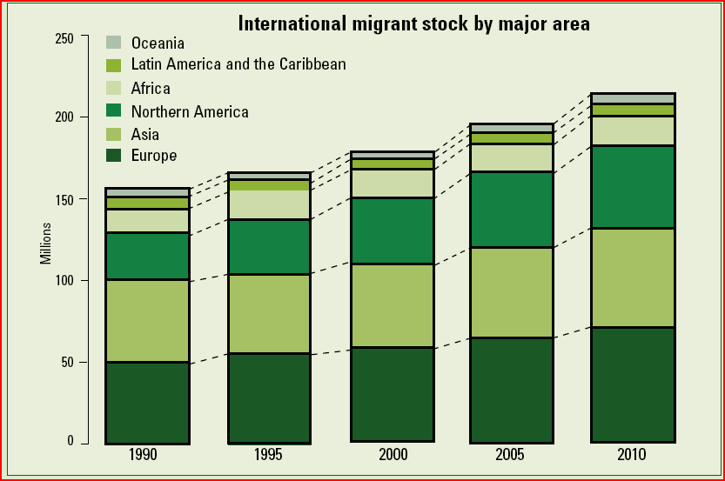
% of migrants in global population
Approx.
1990: 2,9
2000: 2,9
2010: 3,2
http://www.un.org/esa/population/publications/2009Migration_Chart/ittmig_wallchart09.pdf
United Nations • Department of Economic and Social Affairs • Population Division
Notes International Migration 2009 www.unmigration.org www.unpopulation.org
Global population
 | 1950 | 1960 | 1970 | 1980 | 1990 | 2000 | 2010 | 2020 | 2030 | 2040 | 2050
World | 2 519 470 | 3 023 812 | 3 696 588 | 4 442 295 | 5 279 519 | 6 085 572 | 6 842 923 | 7 577 889 | 8 199 104 | 8 701 319 | 9 075 903
Source: Population, Resources, Environment and Development:The 2005 Revision
http://unstats.un.org/pop/dVariables/DRetrieval.aspx Visited: 15 January 2009

Slide 20
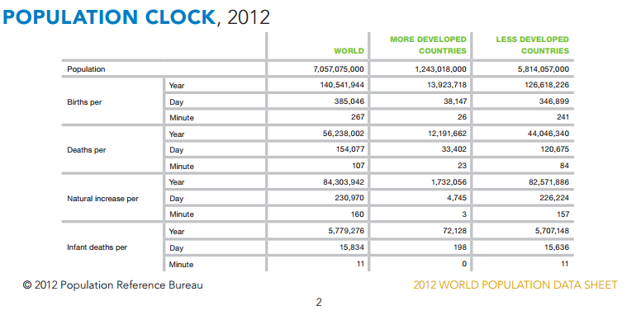
The source of the migratory pressure

Slide 21
AGEING
 | 60 years or older
 | Number |  |  | As a percentatage of the whole population |  |  | 80 years or older among the 60 or older
 | (thousand) |  |  | (percentage |  |  | percentage)
Country or region | 2012 | 2050 |  | 2012 | 2050 |  | 2012 | 2050
 | (1) | (2) |  | (3) | (4) |  | (5) | (6)
Global | 809 743 | 2 031 337 |  | 11 | 22 |  | 14 | 20
More developed regions | 279 287 | 418 326 |  | 22 | 32 |  | 20 | 29
Less developed regions^{b} | 530 455 | 1 613 011 |  | 9 | 20 |  | 11 | 17
Least developed regions | 46 389 | 181 568 |  | 5 | 11 |  | 8 | 10
EUROPE | 166 397 | 241 828 |  | 22 | 34 |  | 20 | 28
Forrás: UN Department of Economic and Social Affairs Population Division http://www.un.org/esa/population/publications/2012PopAgeingDev_Chart/2012AgeingWallchart.html
Worldwide in 1950-ben 12 working age persons were there for each 65 years or older person , in 2010 9.- By 2050 it will go down to 4.
http://www.prb.org/Publications/Datasheets/2010/2010wpds.aspx

Slide 22
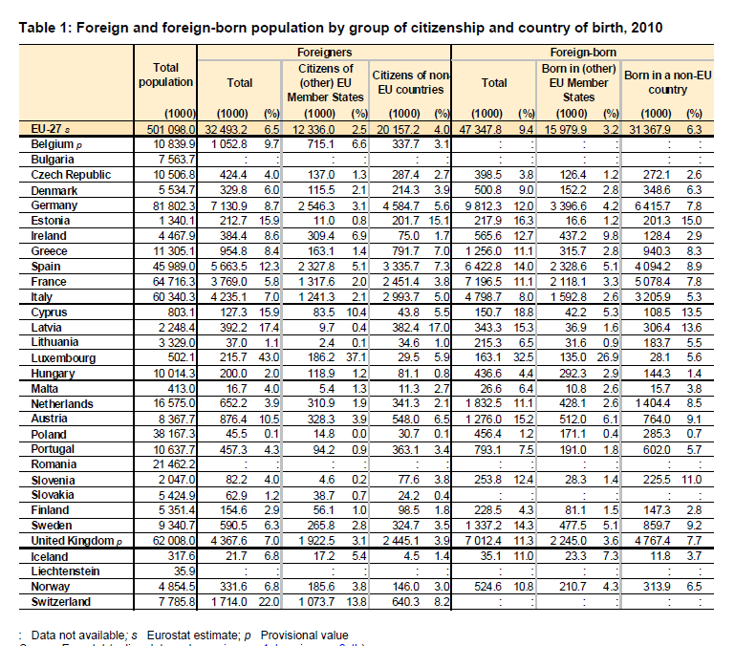
Foreign and foreign born persons in the EU 2010 Source: Eurostat Statistics in focus Author: Katya VASILEVA 34/2011 p. 2
Third country nationals:
20,2 million
EU nationals in other EU MS: 12,3 million
Out of
501 million total
Notes:
Gloabla figures: Third Annual Report on Immigration and Asylum, COM (2012) 250 final

Slide 23
EU and EEA net migration assumptions by Eurostat
 | 2010 | 2015 | 2020 | 2025 | 2030
European Union (27 countries) | 1 043 064 | 1 215 012 | 1 332 508 | 1 300 737 | 1 295 190
Belgium | 61 252 | 53 719 | 46 189 | 44 420 | 42 641
Bulgaria | -9 934 | -10 875 | -14 618 | -9 511 | -3 290
Czech Republic | 30 454 | 32 139 | 29 011 | 25 102 | 25 584
Denmark | 12 257 | 11 619 | 11 388 | 11 408 | 11 971
Germany (including former GDR from 1991) | 41 049 | 89 317 | 114 576 | 129 785 | 132 961
Estonia | -543 | -600 | -1 032 | -644 | -314
Ireland | -21 520 | -389 | 22 498 | 21 625 | 20 764
Greece | 26 171 | 32 573 | 37 051 | 36 425 | 35 779
Spain | 79 081 | 170 633 | 267 445 | 257 156 | 253 960
France | 71 890 | 83 871 | 92 741 | 89 115 | 86 967
Italy | 360 685 | 352 375 | 344 070 | 334 836 | 338 651
Cyprus | 2 227 | 4 085 | 5 958 | 5 731 | 5 501
Latvia | -3 390 | -1 669 | -507 | 261 | 423
Lithuania | -13 013 | -8 833 | -5 101 | -2 828 | -1 051
Luxembourg | 6 327 | 5 011 | 3 705 | 3 553 | 3 416
Hungary | 22 542 | 26 233 | 27 311 | 23 038 | 22 139
Malta | -1 171 | -283 | 487 | 488 | 366
Netherlands | 35 533 | 20 582 | 9 257 | 11 126 | 11 758
Austria | 19 103 | 26 986 | 35 158 | 36 061 | 35 635
Poland | 11 732 | 20 477 | 13 006 | 4 438 | 3 205
Portugal | 18 514 | 27 695 | 36 829 | 37 605 | 37 239
Romania | -206 | 7 491 | 8 362 | 4 627 | 3 216
Slovenia | 10 952 | 8 739 | 6 316 | 5 618 | 5 654
Slovakia | 10 573 | 10 835 | 9 900 | 8 324 | 8 170
Finland | 14 765 | 13 846 | 11 358 | 10 334 | 9 717
Sweden | 59 875 | 44 015 | 28 160 | 27 073 | 25 992
United Kingdom | 197 859 | 195 420 | 192 990 | 185 571 | 178 136
European Free Trade Association | 104 276 | 80 305 | 56 435 | 54 804 | 53 714
Iceland | -4 076 | -1 633 | 889 | 852 | 821
Liechtenstein | 149 | 99 | 66 | 71 | 68
Norway | 36 930 | 27 151 | 17 381 | 16 716 | 16 051
Switzerland | 71 273 | 54 688 | 38 099 | 37 165 | 36 774
Forrás: Eurostat: Assumptions [proj_10c2150a] extracted on 3 December 2012

Slide 24
The Global Approach to Migration and Mobility
COM(2011) 743 final, 18. November 2011
Short term and long term migration combined (visa regime included)
Four pillars:
(1) organising and facilitating legal migration and mobility;
(2) preventing and reducing irregular migration and trafficking in human beings;
(3) promoting international protection and enhancing the external dimension of asylum policy;
(4) maximising the development impact of migration and mobility.

Slide 25
Three interim conclusions
Europe needs more immigrants
Irregular migration has to be tamed (but its main source is not clandestine entry)
Europe ought to retain its readiness to offer protection to those who justifiably seek it.
_________________________________________________________________________
„Good governance of migration and mobility of third countries nationals can create value on a daily basis for the development of millions of people, increase the EU’s competitiveness and enrich European societies. This makes the Global Approach a core strategic interest of the EU and its Member States. With an increasingly global labour market for the highly skilled, there is already strong competition for talent.”
Communication on Global Approach to Migration and Mobility, 2011, p. 5.

Slide 26
POLICIES ON BORDER CHECKS, ASYLUM AND IMMIGRATION - THIRD COUNTRY NATIONALS

Slide 27
TFEU , TITLE V AREA OF FREEDOM, SECURITY AND JUSTICE CHAPTER 2 POLICIES ON BORDER CHECKS, ASYLUM AND IMMIGRATION
Borders, entry, short stay
Article 77 TFEU (ex Article 62 TEC)
Policies
„1. The Union shall develop a policy with a view to:
(a) ensuring the absence of any controls on persons, whatever their nationality, when crossing internal borders;
(b) carrying out checks on persons and efficient monitoring of the crossing of external borders;
the gradual introduction of an integrated management system for external borders.”
Measures
( to be adopted with ordinary legislative procedure)
the common policy on visas and other short-stay residence permits;
border checks on persons
third country nationals’ freedom to travel within the Union for a short period;
gradual establishment of an integrated management system for external borders;
the absence of any controls on persons, when crossing internal borders.
Expanding EU citizens’ rights
The Council - after consulting the European Parliament - may unanimously adopt provisions concerning passports, identity cards, residence permits or any other such if the Treaties have not granted specific powers
Notes:
Before Lisbon:
Article 61
In order to establish progressively an area of freedom, security and justice, the Council shall adopt:
(a) within a period of five years after the entry into force of the Treaty of Amsterdam, measures aimed at ensuring the free movement of persons in accordance with Article 14, in conjunction with directly related flanking measures with respect to external border controls, asylum and immigration, …
Article 62
The Council, acting in accordance with the procedure referred to in Article 67.., shall, within
a period of five years after the entry into force of the Treaty of Amsterdam, adopt:
1. measures with a view to ensuring, .. the absence of any controls on persons, be they citizens of the Union or nationals of third countries, when crossing internal borders;
2. measures on the crossing of the external borders of the Member States which shall establish:
(a) standards and procedures to be followed by Member States in carrying out checks on
persons at such borders,
(b) rules on visas for intended stays of no more than three months…

Slide 28
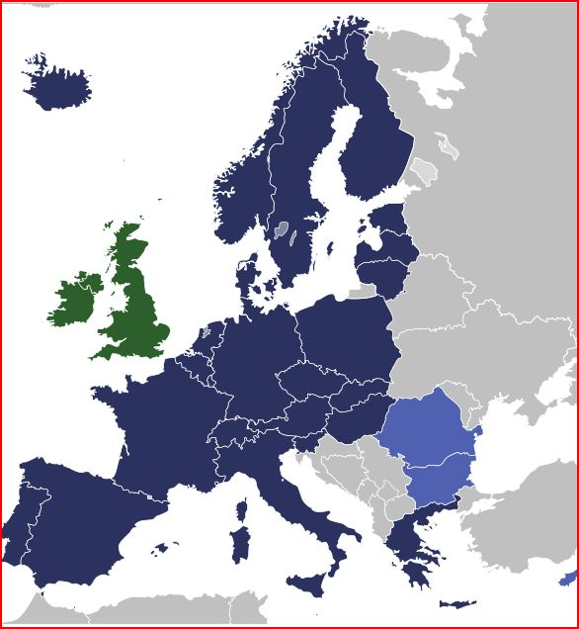
SCHENGEN AFTER SWITZERLAND’S AND LIECHTENSTEIN’S ACCESSION
Notes:
The Schengen access control model consists of the following four tiers:
Measures at consulates,
cooperation with neighbouring countries,
border control,
and control measures within the Schengen area, including return.
COM (2008) 68 final (on EUROSUR), p.2, fn. 6
________________________
14 June 1985: Belgium, Germany, France, Luxembourg and the Netherlands sign the Schengen Agreement.
19 June 1990: the original founders of the Schengen cooperation sign the Convention implementing the Schengen Agreement (Schengen Convention).
26 March 1995: abolition of border control between Belgium, Germany, France, Luxembourg, the Netherlands, Spain and Portugal.
26 October 1997: start of gradual abolition of border control with Italy (completed on 31 March 1998).
1 December 1997: start of gradual abolition of border control with Austria (completed on 31 March 1998).
1 March 2000: abolition of border control with Greece (completed on 26 March 2000).
25 March 2001: abolition of border control with Norway, Iceland, Sweden, Denmark and Finland.
21 December 2007: abolition of control of land and sea borders with the Czech Republic, Estonia, Hungary, Latvia, Lithuania, Malta, Poland, Slovakia and Slovenia (border checks on intra-Schengen flights at airports abolished on 30 March 2008).
12 December 2008: abolition of border control at land borders with Switzerland (border checks on intra-Schengen flights at airports being abolished
19 December 2011 Liechtenstein abolished internal border controls

Slide 29
EXTERNAL BORDERS (AND INTERNAL BORDERS)

Slide 30
External borders
Fragmentation
UK, Ireland and Denmark do not participate in the work done under Title V of the TFEU. But Denmark is party to the Schengen acquis as it stood on 1 May 1999. Norway Iceland, Switzerland and Liechtenstein are virtual parties: they also guard the external borders. (Switzerland: airports)
Unequal pressure on different border sections (Greece, Italy, Spain – Sweden, e.g.)
Task: equal security for all participating states based on mutual confidence and an integrated border management ensuring a uniform and high level of control and surveillance along the land, sea and air borders.

Slide 31
External and internal border: Border management, conditions of crossing the external border, flanking measures
External border control: surveillance and checks
Terrorism, human-smuggling: the weakest link determines the strength of the whole system.
Guarding the external border: still national task
Integrated management of the border
Increased practical cooperation and Frontex
„Schengen border code” – 562/2006/EC regulation, 15 March 2006
Schengen-evaluation – Comm. proposal for new regime
SISone4all - temporary solution - SIS II in great delay
The external boders of the EU are crossedy yearly by more than
700 million persons
More than 11 million visas are issued per year
Notes:
„the plan for management of the external borders of the EU Member States, has now been completed. The
legislative framework has been consolidated. The Schengen Borders Code entered into force in 2006. Simplified rules for local border traffic have been introduced. An operational dimension has been added with the establishment of the FRONTEX Agency. The concepts of burden-sharing and solidarity have been given real meaning by the European Border Fund which, for the first time, allocates substantial financial resources to these policy areas. „
Preparing the next steps in border management in the European Union COM (2008) 69
There are 1 636 designated points of entry to the Union, and in 2006 the number of people crossing was about 900 million. Source COM(2009) 262 final
Integrated border management – Council conlusions 2006, 4-5 december:
„Integrated border management is a concept consisting of the following dimensions:
• Border control (checks and surveillance) as defined in the Schengen Borders Code,
including relevant risk analysis and crime intelligence
• Detection and investigation of cross border crime in coordination with all competent law
enforcement authorities
• The four-tier access control model (measures in third countries, cooperation with
neighbouring countries, border control, control measures within the area of free
movement, including return)
• Inter-agency cooperation for border management (border guards, customs, police, national
security and other relevant authorities) and international cooperation
• Coordination and coherence of the activities of Member States and Institutions and other
bodies of the Community and the Union.”
_________________________
„around 11 million visas were granted by the Member States issuing Schengen visas in 2009” Communication on GAMM November 2011, p. 3
„Every year some 700 mllion external border crossings are made via land, sea and air borders”
Communication: „Smart borders –options and the way ahead” COM (2011) 680 final, p. 2

Slide 32
Schengen Border Code
REGULATION (EC) No 562/2006 OF THE EUROPEAN PARLIAMENT AND OF THE COUNCIL of 15 March 2006
establishing a Community Code on the rules governing the movement of persons across borders (Schengen Borders Code)
Internal border: the common land borders, including river and lake borders, of the Member States+airports used for internal flights+ regular ferry ports
External border – what is not internal (land + airport + ferry port)
Personal scope: third country nationals not enjoying the Community right of free movement (but: not to refugees and asylum seekers!)
Application start: 13 Oct 2006.
Entry conditions (max 3 months) : travel document + visa (except: if holding a valid residence permit)+sufficient means of subsistence+ no SIS alert+ not considered to be a threat to public policy, internal security, public health or the international relations of any of the Member States
Exceptions: if residence permit (for transit), border visa, humanitarian admission
Notes:
3 ‘internal flight’ means any flight exclusively to or from the territories of the Member States and not landing in the territory of a third country;
4. ‘regular ferry connection’ means any ferry connection between the same two or more ports situated in the territory of the Member States, not calling at any ports outside the territory of the Member States and consisting of the transport of passengers and vehicles according to a published timetable;
5. persons enjoying the Community right of free movement’ means:
(a) Union citizens within the meaning of Article 17(1) of the Treaty, and third-country nationals who are members of the family of a Union citizen exercising his or her right to free movement to whom Directive 2004/38/EC … on the right of citizens of the Union and their family members to move and reside freely within the territory of the Member States (1) applies;
(b) third-country nationals and their family members, whatever their nationality, who, under agreements between the Community and its Member States, on the one hand, and those third countries, on the other hand, enjoy rights of free movement equivalent to those of Union citizens;
Thorough checks on TCN light (identity) on persons enjoying Community right of free movement

Slide 33
Schengen Border Code
Border surveillance
Purposes:
prevent unauthorised border crossings,
counter cross-border criminality
take measures against persons who have crossed the border illegally (Return)
„ surveillance shall be carried out in such a way as to prevent
and discourage persons from circumventing the checks at border
crossing points.” (Art 12.)
Tool: „ efficient, high and uniform level of control” by deploying „appropriate staff and resources in sufficient numbers”, (Art 14.)
- No specific standard, but „EU Schengen catalogue of best practices” + Commission proposal for Schengen evaluation mechanism, Brussels, 16.11.2010 COM(2010) 624 final
Notes:
Article 12
Border surveillance
1. The main purpose of border surveillance shall be to prevent unauthorised border crossings, to counter cross-border criminality and to take measures against persons who have crossed the border illegally.
2. The border guards shall use stationary or mobile units to carry out border surveillance. That surveillance shall be carried out in such a way as to prevent and discourage persons from circumventing the checks at border crossing points.
3. Surveillance between border crossing points shall be carried out by border guards whose numbers and methods shall be adapted to existing or foreseen risks and threats. It shall involve frequent and sudden changes to surveillance periods, so that unauthorised border crossings are always at risk of being detected.
4. Surveillance shall be carried out by stationary or mobile units which perform their duties by patrolling or stationing themselves at places known or perceived to be sensitive, the aim of such surveillance being to apprehend individuals crossing the border illegally. Surveillance may also be carried out by technical means, including electronic means.
____________________
the integrated border management comprises elements of border control, the four-tier access control model (measures in third countries, cooperation
with neighbouring countries, border control and control measures within the
area of free movement, including return-BN addition) , interagency co-operation and coordination at the national and transnational level.
Frontex, general report 2009 (2010), p. 7.

Slide 34
FRONTEX
COUNCIL REGULATION (EC) No 2007/2004 of 26 October 2004 establishing a European Agency for the Management of Operational Cooperation at the External Borders of the Member States of the European Union , amended by REGULATION (EU) No 1168/2011 of 25 October 2011
Main tasks
(a) coordinate operational cooperation between Member States in the management of external borders;
(b) assist Member States on training of national border guards, including common training standards;
(c) carry out risk analyses and asses the capacity of Member States to face threats and pressures;
(d) participate in the development of research;
(da) assist Member States in circumstances requiring increased technical and operational assistance at external borders
Notes:
Main tasks before amendment in 2011
Main tasks
(a) coordinate operational cooperation between Member States in the field of management of external borders;
(b) assist Member States on training of national border guards, including the establishment of common training standards;
(c) carry out risk analyses;
(d) follow up on the development of research relevant for the control and surveillance of external borders;
(e) assist Member States in circumstances requiring increased technical and operational assistance at external borders;
(f) provide Member States with the necessary support in organising joint return operations.

Slide 35
FRONTEX
(e) assist Member States facing specific and disproportionate pressures
(f) coordination or organisation of joint return operations;
(g) deploy border guards from the European Border Guard Teams;
(h) develop and operate information systems that enable swift and reliable exchanges of information regarding emerging risks at the external borders;
(i) provide the necessary assistance to the development and operation of a European border surveillance system

Slide 36
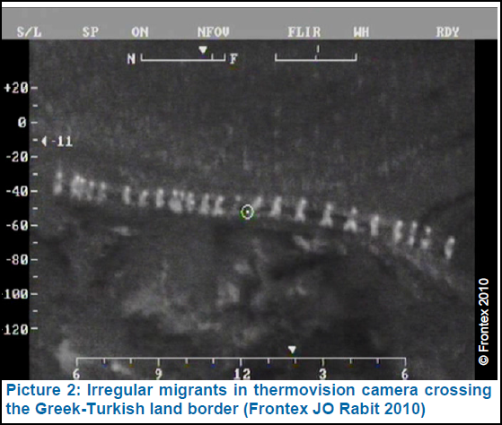
European Border Guard Teams
After 2011 amendment replacing and unifying the Frontex Joint Support Teams and Rapid Border Intervention Teams (RABITS).
Objective:
providing rapid operational assistance
for a limited period
to a requesting Member State facing urgent and exceptional pressure, especially…arrival of large number of third country nationals trying to enter…
Tool:
Participation in the check of those
crossing the external border
Land, air and water surveillance
(patrolling)
Finance
community budget
First (Rabit) deployment in Greece, 2010 November
Notes:
aim of this proposal is accordingly to establish a mechanism whereby Member States facing extreme difficulties in controlling their external borders would be able to make use of the expertise and manpower of border guards of other Member States on a temporary basis
As regards checks of persons at the external borders:
to check the travel documents
(b) to use technical devices to check the travel documents in accordance with point (a);
(c) to interview any person crossing the border in order to verify the purpose and conditions of the journey, as well as that he/she possesses sufficient means of subsistence and the required documents;
(d) to check that the person is not the object of an alert for refusal of entry in the Schengen information system (SIS);
(e) to stamp travel documents, in accordance with Article 10 of the Community Code, both at entry and exit; (f) to search means of transport and objects in the possession of the persons crossing the border, in accordance with the national law of the host Member State.
As regards surveillance of the external borders:
(a) to make use of technical means for monitoring the external border area;
(b) to participate in patrols on foot and in means of transport in the external border area of the host Member State;
(c) to prevent persons from crossing illegally the external border of the host Member State in accordance with the national law of that Member State_________________________
RABIT Operation 2010 Evaluation Report , Warsaw August 2011 http://www.frontex.europa.eu/gfx/frontex/files/publications/fer_rabit_2010_screen_v6.pdf
„RABIT Operation 2010 was a mid-term operation of four months’ duration at the Greek- Turkish land border. It started on November 2010 and ended on March 2011, followed up by the continuous Joint Operation Poseidon Land 2011 and Project Attica 2011.”
„Experts in such areas as falsedocument detection, clandestine entry, dog handling, first- and second-line border checks and stolen vehicle detection, as well as specialist interviewers, de-briefers and linguists, were made available and dispatched by 26 Member States (MSs) and Schengen Associated Countries (SACs) during the four-month deployment, representing a total of 576 officers working around 19,000 man-days during the four-month operational period.”
„ By the end of the operation there had been a 76% decrease in the number of irregular migrants apprehended compared to the daily average in October 2010. The average number of migrants apprehended per day in February was approximately 58.” (down form 245 detections per day)
4,5 million euros were spent

Slide 37
Plans for the future
European Border Surveillance System (EUROSUR) Objectives (on the southern and eastern borders)
Reduction of the number of illegal immigrants who manage to enter the EU undetected
Prevention of cross-border crime
Enhancing search and rescue capacity
Planned measures
PHASE 1: Upgrading and extending national border surveillance systems and interlinking national infrastructures in a communication network.
PHASE 2: Improve the performance of surveillance tools and sensors (e.g. satellites, unmanned aerial vehicles / UAVs, etc.), and developing a common application of surveillance tools. A common pre-frontier intelligence picture could be developed to combine intelligence information with that obtained from surveillance tools
PHASE 3: All relevant data from national surveillance, new surveillance tools, European and international reporting systems and intelligence sources should be gathered, analysed and disseminated in a structured manner, to create a common information sharing environment between the relevant national authorities.
_________________________________________________________________
Priority in the EU-s Internal Security Strategy of 2010
Proposal for a regulation: 12 December 2011 – COM 2011) 873 final
Notes:
National surveillance coordination centres be set up+ one single national surveillance system + secret, real time connections between centers + Frontex
UAVs Unmanned aviation vehicle? + satellite info

Slide 38
Plans for the future
Commission suggests „smart borders” in its Communication of 25 October 2011 COM (2011) 680 final
– Facilitating border crossings for bona fide travellers; Registered Traveller Program (RTP)
– The creation of a system to register the entry/exit of third country nationals (entry/exit system – EES)
„The Smart Borders initiative would improve the management and control of travel flows at the border by reinforcing checks while speeding up border crossings for regular travellers.”
Presentation by Boldizsár Nagy
Notes:
Preparing the next steps in border management in the European Union COM(2008) 69 final
Low-risk travellers from third countries, including those that are subject to the visa requirement and those that are not, could be offered a pre-screening process, on a voluntary basis, with a view to being granted Registered Traveller status.
When arriving at the borders of the EU Registered Travellers could benefit from a
simplified and automated border check.
It should also be noted that EU citizens and other persons enjoying the Community right of free movement could benefit from automated gates when crossing the external border
THE CREATION OF A SYSTEM TO REGISTER THE ENTRY/EXIT OF THIRD COUNTRY
NATIONALS
• The automatic registration of the time and place of entry and exit of third country
nationals, both those that require a visa and those that do not, to identify
overstayers, could be introduced at the borders.
• An alert available to national authorities could be issued once the validity of an
individual's stay in the EU has expired, and no exit data had been captured.

Slide 39
Crossing of internal borders and the restoration of border checks (Schengen Border Code)
Internal borders
Crossing internal borders
Internal borders may be crossed at any point without a border check on persons, irrespective of their nationality, being carried out. ( Art. 20.)
Restoration of checks
In case of a serious threat to public policy or internal security,
a Member State may exceptionally reintroduce border controls at its internal borders for, in principle, a limited period of no more than thirty days.
Other Member States, the Commission and the European Parliament should be informed and consultations conducted.
„ Where considerations of public policy or internal security in a Member State demand urgent action” border checks may be introduced immediately
Debate in 2011 after the Arabic Spring – proposal to re-regulate the rules on reintroduction of border controls COM (2011)560 – 16 September 2011
Notes:
Article 23
Temporary reintroduction of border control at internal borders
1. Where there is a serious threat to public policy or internal security, a Member State may exceptionally reintroduce border control at its internal borders for a limited period of no more than 30 days or for the foreseeable duration of the serious threat if its duration exceeds the period of 30 days, in accordance with the procedure laid down in Article 24 or, in urgent cases, with that laid down in Article 25. The scope and duration of the temporary reintroduction of border control at internal borders shall not exceed what is strictly necessary to respond to the serious threat. 2. If the serious threat to public policy or internal security persists beyond the period provided for in paragraph 1, the Member State may prolong border control on the same grounds as those referred to in paragraph 1 and, taking into account any new elements, for renewable periods of up to 30 days, in accordance with the procedure laid down in Article 26.
Border Code, Article 25
Procedure for cases requiring urgent action
1. Where considerations of public policy or internal security in a Member State demand urgent action to be taken, the Member
State concerned may exceptionally and immediately reintroduce border control at internal borders.
2. The Member State reintroducing border control at internal borders shall notify the other Member States and the Commission
accordingly, without delay, and shall supply the information referred to in Article 24(1) and the reasons that justify the use of
this procedure
24/1
the reasons for the proposed reintroduction, detailing the events that constitute a serious threat to public policy or internal security;
(b) the scope of the proposed reintroduction, specifying where border control is to be reintroduced;
(c) the names of the authorised crossing-points;
(d) the date and duration of the proposed reintroduction;
(e) where appropriate, the measures to be taken by the other Member States.

Slide 40
VISA

Slide 41
REGULAR MGRATION OF THIRD COUNTRY NATIONALS - VISA
What is the purpose of a visa?
Two possible lines of analysis:
Utilitarian: does it perform (achieve goal)?
Moral: does it stigmatise / collectively punish?
Factors determining whether a country is visa-free:
illegal immigration,
public policy
security,
regional coherence
reciprocity”

Slide 42
VISA
Short term – long term
Short: COUNCIL REGULATION (EC) No 539/2001 of 15 March 2001 listing the third countries whose nationals must be in possession of visas when crossing the external borders and those whose nationals are exempt from that requirement (amended four times)
Visa free: EU =27+EEA =3 + Switzerland+40 states+Macao and Hong Kong+British Nationals (overseas)
Long: national competence
The reciprocity debate
Visa facilitation: Russian Federation (1 June 2007) Moldova ,Ukraine (entry into force: 1 January 2008)
Georgia (entry into force: 1 March 2011)
Abolition of visa
Saint Kitts and Nevis: 28 May 2009,
fYRoM, Montenegro, Serbia: with effect of 19 December 2009 (for biometric passports and excluding Kosovo)
Albania, Bosnia-Herzegovina : 25 November 2010 (for biometric passports )
Brazil: 1 October 2012
Notes:
„The determination of those third countries whose nationals are subject to the visa requirement, and those exempt from it, is governed by a considered, case-bycase assessment of a variety of criteria relating inter alia to illegal immigration, public policy and security, and to the European Union's external relations with third countries, consideration also being given to the implications of regional coherence and reciprocity”
539/2001 regulation, 5th recital
Bolivia should be transferred to Annex I
Barbuda, the Bahamas, Barbados, Mauritius, Saint Kitts and Nevis, and the
Seychelles should be transferred to Annex II
COUNCIL REGULATION (EC) No 1932/2006 of 21 December 2006
Category A refers to an airport transit visa. It is required for some few nationals for passing through the international transit area of airports during a stop-over or transfer between two sections of an international flight. The requirement to have this visa is an exception to the general right to transit without a visa through an international transit area of an airport.
Category B refers to a transit visa. It is required by nationals who are not visa-free for travelling from one non-Schengen state to another non-Schengen state, in order to pass through the Schengen area. Each transit may not exceed five days.
Category C refers to a short-term stay visa. They are issued for reasons other than to immigrate. They entitle holders to carry out a continuous visit or several visits whose duration does not exceed three months in any half-year from the date of first entry.
Category D refers to national visa. They are issued by a Schengen state in accordance with its national legislation as with respect to the conditions (however, a uniform sticker is used). The national visa allows the holder to transit from a non-Schengen country to the Schengen state which issued the national visa within five days. Only after the holder has obtained a residence title after arrival in the destination country (or a different visa), he may again travel to other Schengen countries.
Category D+C visa combine the functions of the visa of both categories: They are intended to allow the holder to enter the issuing Schengen state for long-term stay in that state, but also to travel in the Schengen area like a holder of a Category C visa.
FTD and FRTD are special visa issued for road (FTD) or rail (FRTD) transit only between mainland Russian Federation and its western exclave of Kaliningrad Oblast.
1. In the examination of an application for a uniform visa, it shall be ascertained whether the applicant fulfils the entry conditions set out in Article 5(1)(a), (c), (d) and (e) of the Schengen Borders Code, and particular consideration shall be given to assessing whether the applicant presents a risk of illegal immigration or a risk to the security of the Member States and whether the applicant intends to leave the territory of the Member States before the expiry of the visa applied for.
http://www.schengenspace.com/visa_types visited 12 01 2009
_____________________________________
Agreement with Brazil (EU-Brazil) 2010 October
Estonia, Cyprus, Malta and Latvia

Slide 43
VISAS- Visa code
REGULATION (EC) No 810/2009
Scope: short stay (max. 3 months) and airport transit visas
Clarifies which Member State is responsible for processing a visa application (sole destination – longest stay/main purpose - entry point)
Defines the different phases for examination and decision taking
Lists the documents a visa applicant needs to submit and the procedures for their verification
Harmonizes the fees (Generally: 60 Euros)
Sets time limit for the procedure: 15 calendar days.
Obliges MS to give reasons and allow appeal against negative decision
Notes:
REGULATION (EC) No 810/2009 OF THE EUROPEAN PARLIAMENT AND OF THE COUNCIL of 13 July 2009 establishing a Community Code on Visas (Visa Code)__________________________
Consolidates all legal instruments and replaces the Common Consular Instructions (CCI).
Not applicable to UK, Ireland
Denmark: as if it was international law
Binding: Norway, Iceland, Switzerland Liechtenstein:___________________________________
Airport transit visa required from: AFGHANISTAN , BANGLADESH , DEMOCRATIC REPUBLIC OF THE CONGO, ERITREA , ETHIOPIA , GHANA , IRAN , IRAQ , NIGERIA PAKISTAN , SOMALIA, SRI LANKA (Annex IV)______________________________________________________________________
Visa fee exemptions
(a) children under six years; (b) school pupils, students, postgraduate students and accompanying teachers
(c) researchers from third countries travelling for the purpose of carrying out scientific research
(d) representatives of non-profit organisations aged 25 years or less participating in seminars, conferences, sports, cultural or educational events organised by non-profit organisations. _________
Applicants must appear in person when lodging an application.
Applocants shall submit a number of documents: an application form, a valid travel document, a photograph, a document indicating the purpose of the journey, proof of sufficient means to cover accommodation and subsistence, proof of travel medical insurance as well as information enabling an assessment of the applicant's intention to leave the Schengen territory before the expiry of the visa.
After the launch of VIS Member States should also collect fingerprints

Slide 44
VISA - VIS
REGULATION (EC) No 767/2008 OF THE EUROPEAN PARLIAMENT AND OF THE COUNCIL of 9 July 2008 concerning the Visa Information System (VIS) and the exchange of data between Member States on short-stay visas (VIS Regulation) (Implementing Council Decision 2004/512/EC of 8 June 2004 establishing the Visa Information System (VIS))
Objectives
the fight against fraud;
facilitate checks at external border crossing points and within the territory of the Member States;
help identify persons not entitled to enter or stay
to assist the Dublin mechanism on identifying the responsible state for refugee status determination;
to contribute to the prevention of threats to the internal security of any of the Member States
Gradual entry into operation
1 st region (Algeria, Egypt, Libya, Mauritania, Morocco and Tunisia) Start 11 October 2011
2nd region (Israel, Jordan, Lebanon and Syria) 10 May 2012
3rd region: (Afghanistan, Bahrain, Iran, Iraq, Kuwait, Oman, Qatar, Saudi Arabia, United Arab Emirates and Yemen), Start: 2 October 2012
Presentation by Boldizsár Nagy
Notes:
Each application file shall be stored in the VIS for a
maximum of five years, without prejudice to the deletion referred
to in Articles 24 and 25 and to the keeping of records referred to
in Article 34.
Dates from VIS - state of play Brusseés 3 Oct 2012 Visa 186
44

Slide 45
REGULAR MIGRATION

Slide 46
TFEU , TITLE V AREA OF FREEDOM, SECURITY AND JUSTICE CHAPTER 2 POLICIES ON BORDER CHECKS, ASYLUM AND IMMIGRATION
Article 79 TFU (ex Article 63, points 3 and 4, TEC)
Policies
develop a common immigration policy aimed the efficient management of migration flows,
fair treatment of third-country nationals residing legally in Member States,
and the prevention of, and enhanced measures to combat, illegal immigration and trafficking in human beings.
Measures
the conditions of entry and residence, and standards on the issue by Member States of long-term visas and residence permits, including those for the purpose of family reunification;
the definition of the rights of third-country nationals residing legally in a Member State, including the conditions governing freedom of movement and of residence in other Member States;
illegal immigration and unauthorised residence, including removal and repatriation of persons residing without authorisation;
combating trafficking in persons, in particular women and children.
Safeguard
„ This Article shall not affect the right of Member States to determine volumes of admission of third-country nationals coming from third countries to their territory in order to seek work, whether employed or self-employed”
Presentation by Boldizsár Nagy
Notes:
3. The Union may conclude agreements with third countries for the readmission to their countries of origin or provenance of third-country nationals who do not or who no longer fulfil the conditions for entry, presence or residence in the territory of one of the Member States.
4. The European Parliament and the Council, acting in accordance with the ordinary legislative procedure, may establish measures to provide incentives and support for the action of Member States with a view to promoting the integration of third-country nationals residing legally in their territories, excluding any harmonisation of the laws and regulations of the Member States.
5. This Article shall not affect the right of Member States to determine volumes of admission of third-country nationals coming from third countries to their territory in order to seek work, whether employed or self-employed
__________________________________________________________________________Old TEC
Article 61
In order to establish progressively an area of freedom, security and justice, the Council shall adopt:
(a) within a period of five years after the entry into force of the Treaty of Amsterdam, measures aimed at ensuring the free movement of persons in accordance with Article 14, in conjunction with directly related flanking measures with respect to external border controls, asylum and immigration, …
Article 62
The Council, acting in accordance with the procedure referred to in Article 67.., shall, within
a period of five years after the entry into force of the Treaty of Amsterdam, adopt:
1. measures with a view to ensuring, .. the absence of any controls on persons, be they citizens of the Union or nationals of third countries, when crossing internal borders;
2. measures on the crossing of the external borders of the Member States which shall establish:
(a) standards and procedures to be followed by Member States in carrying out checks on
persons at such borders,
(b) rules on visas for intended stays of no more than three months…

Slide 47
Regular migration
Immigration: still national competence (no general EC legislation on long term migration)
Partial rules:
Family unification (Council Directive 2003/86/EC of 22 September 2003)
Long term residents (Council Directive 2003/109/EC of 25 November 2003)
Students (Council Directive 2004/114/EC of 13 December 2004
Researchers (Council Directive 2005/71/EC of 12 October 2005)
Highly skilled (Council directive 2009/50/EC of 25 May 2009)
Single application procedure for a single permit for third-country nationals to reside and work (Directive 2011/98/EU of the European Parliament and of the Council of 13 December 2011 ) To be transposed by 25 December 2013
Notes:
Directive on a single application procedure for a single permit for third-country nationals to reside and work in the territory of a Member State and on a common set of rights for third-country workers legally residing in a Member State (COM(2007) 638 final, Brussels, 23.10.2007).

Slide 48
The so called blue card directive
Council directive 2009/50/EC (25 May 2009) on facilitating conditions of entry and residence in the EU of third-country citizens for the purpose of highly qualified employment
Blue card = special residence and work permit
Eligibility:
- 1 year long contract or binding job offer with a salary exceeding the 150 % of the yearly gross average wage
- degree from a higher education institution, meeting the professional requirements of the receiving state
-sickness insurance for risks normally covered for the nationals of the state
- available quota (if determined by the MS)
Benefits (rights):
Valid for 1-4 years, guarantees entry and residence
First two years: work with the original employer thereafter: freedom to move to other MS
Deadline for transposition: 19 June 2011 .
Notes:
The purpose of this proposal, presented by the Commission in October 2007, is to improve the European Union's ability to attract third-country nationals for the purpose of highly qualified employment. … it aims to facilitate the admission of these nationals by harmonising conditions of entry and residence in the European Union, to simplify admission procedures and improve the legal status of those already present on the territory of the Member States.
Third-country nationals who satisfy the conditions laid down in the Directive may acquire a Blue Card, enabling them and members of their family to enter and stay in a Member State and to leave it, and to transit through the other Member States and have access to the labour market in the sector concerned. Furthermore, they will be able to enjoy equal treatment with nationals in a vast range of areas.
The proposal also aims to facilitate the mobility of holders of the Blue Card within the Union. After a period of residence and work in the Member State concerned, they will be able to go to another Member State to engage in highly qualified employment (subject to limits fixed by the authorities of that State concerning the number of nationals who may be admitted). The procedure is the same as that relating to admission to the first Member State. (JHA Council press release 24-25 July 2008___________________
Commission summarising seasonal workers propsal: The proposal establishes a fast-track procedure for the admission of third-country seasonal workers, based on a common definition and common criteria, in particular the existence of a work contract or a binding job offer that specifies a salary equal to or above a minimum level. Seasonal workers will be issued with a residence permit allowing them to work for a specified maximum period per calendar year. Provision is also made for facilitating the re-entry of a seasonal worker in a subsequent season. In order to prevent exploitation and protect the safety and health of third-country seasonal workers, legal provisions applying to working conditions are clearly defined. Also, employers are required to provide evidence that the seasonal worker will have appropriate accommodation during his/her stay and that provision is made for facilitation of complaints. To prevent verstaying of third-country seasonal workers, a maximum duration of stay per calendar year is laid down as well a sthe explicit obligation to return after that period;

Slide 49
Regular migration
Rules in the making
Commission’s proposals:
Directive on seasonal workers COM (2010) 379 final, 13 July 2010.
(Max . 6 months in a year)
Directive on conditions of entry and residence of third-country nationals in the framework of an intra-corporate transfer COM(2010) 378 final 13 July 2010
(Managers, specialists, trainees, who have worked with the company for a year before transfer)

Slide 50
ILLEGAL MIGRATION (UNDOCUMENTED PERSONS)

Slide 51
Illegal migration
Order of magnitude
„The scale of the phenomenon is necessarily hard to quantify: estimates of the number of third-country nationals illegally staying in the EU vary between 4,5 to 8 million” (Commission proposal for a directive on sanctioning employers, COM(2007) 249 final)
Between the 1980s and 2007 at least 3,7 million persons have been regularized in France, Greece the Netherlands, Italy, Portugal and Spain.
„Frontex’s Annual Risk Analysis 2011: … the sharp decrease reported in 2009 (of around a third on 2008) stabilised in 2010; Member States and Schengen Associated Countries reported a total of 104,049 detections of illegal border crossing at the sea and land external borders, a total almost identical to the 2009 figure of 104,599. „
http://www.frontex.europa.eu/situation_at_the_external_border/art23.html visited 23 January 2012
Detections of illegal stay within Member States decreased from 412 125 in 2009 to 348 666 in 2010 (-15%), but there were large differences between particular countries.
Frontex, Annual Risk Analysis, 2011, p. 13
Notes:
3,7 millió forrása: Comm” Towards a common immigration policy, 2007 dec 5, COM (2007) final, p.5.

Slide 52
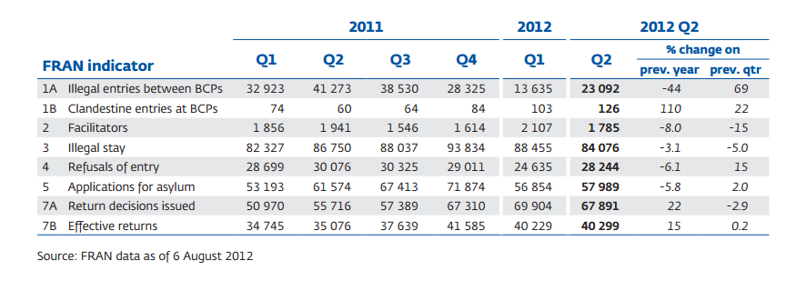
Illegal entry, stay + facilitators – Frontex data (Excluding UK, Ireland)
Source: Frontex, Fran Quarterly Issue No 2 April – June 2012, p. 10
Notes:
Source: Frontex, FRAN Quarterly
Issue 3, July-September 2010, published January 2011, p. 8

Slide 53
Council’s suggestion of 2010
Council conclusions on 29 measures for reinforcing the protection of the external borders and combating illegal immigration JUSTICE and HOME AFFAIRS Council meeting Brussels, 25 and 26 February 2010
For a review of measures see: COMMISSION STAFF WORKING DOCUMENT on the fulfilment of the 29 measures for reinforcing the protection of the external borders and combating illegal immigration adopted at the Justice and Home Affairs Council meeting, held on Brussels on 25 and 26 February 2010. Brussels, 26.11.2010 SEC(2010) 1480 final
Frontex Reinforce it and its activities
9 goals
Eurosur Develop it and enhance cooperation woth third countrties and among MS 5 goals
Fight against illegal immigration networks and trafficking in human beings
2 goals
Solidarity and the integrated management of external borders
5 goals
Cooperation with third countries
7 goals
Notes:
Frontex:
1 reinforce the capabilities of the FRONTEX Agency.
2 increase the effectiveness and efficiency of operational activities
3. ensure that resources made available in the framework of the Central Register of Available Equipment (CRATE) can be used in concrete joint operations when needed. 4 improved co-operation with third countries in joint patrolling and info echange
5 Greater role to EASO in Frontex opration
6. improve the collection, processing and systematic exchange of relevant information between FRONTEX, other EU Agencies and Member States.
7 Joint flights organized and co-financed by FRONTEX for joint return operations
8 Train border guards to a common a European cborder guards’ culture
9 Local Joint operational offices to be set up (First in Pireaus
Eurosur
10 Member States to implement the phases and steps laid down for the development of EUROSUR as soon as possible
11 Member States to establish or further develop a single national border
surveillance system and a single national Coordination Centre
12: Create a Common pre-frontier intelligence picture
13 financial and logistic support from the European Union and its Member States be
made available to the third countries
14 Commission to report on integration of satellite images into surveillance
Fight against illegal immigration networks and trafficking in human beings,
15 dismantling of these networks remains a high priorit
16 Improve the sharing of information concerning the new modus operandi of networks
Solidarity and the integrated management of external borders
17 further develop the European Patrols Network (EPN) in order to generalize bilateral joint maritime patrols, in particular between neighbouring Member States
18 Optimise the use of the European External Borders Fund –among others – by setting up a single national coordination centre (prepare for Eurosur)
19 Promote solidarity with the Member States facing particular pressures (Relocation from Malta, assistance to Greece)
20 Coordination, integration and rationalisation of the different types of checks and the need to ensure the interoperability of the systems concerned
21 further develop the networks of immigration liaison officers
Co-operationwith third countries
22 Migration policy objectives are at the centre of the political dialogue + implement return agreements
23 Intensify efforts at the level of the European Union and of the Member States to return illegally staying third-country nationals
24 Negotiate with thrid countries according to the Global Approach to Migration (holistic treatment of migration)
25 taking forward the dialogue on migration with Libya
26 achieve a readmission agreement with Turkey
27 Revise Article 13 of the Cotonou Agreement (did not happen)
28 support enhanced capacity building and infrastructures in relevant third countries
______________________________________________
29 Commission to report on the Council’s proposal

Slide 54
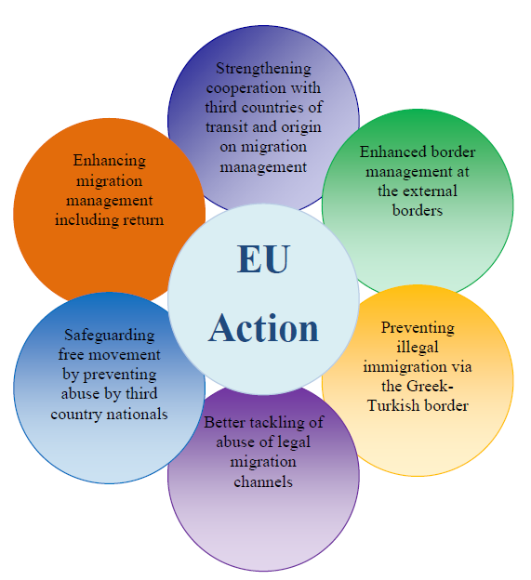
EU Action on Migratory Pressures – a Strategic Response Approved by the JHA Council on 26-27 April 2012

Slide 55
The Return directive
DIRECTIVE 2008/115/EC OF THE EUROPEAN PARLIAMENT AND OF THE COUNCIL
of 16 December 2008 on common standards and procedures in Member States for returning illegally staying third-country nationals
Personal scope
Obligatory: third-country nationals staying illegally on the territory of a Member State
Optional:
- those refused at the border or intercepted on land, sea or air
- subject to return as a criminal law sanction
Limits: MS must respect rights of persons entitled to free movement under community law and the principle of non-refoulement
+ „due account of” best interest of the child, family life, state of health of the person
Member States may retain more favourable provisions
Notes:
Bizottság javaslata: 2005 (COM(2005)0391)
Parlament elfogadja: 2008 június 18.
in accordance with fundamental rights as general principles of Community law as well as international law, including refugee protection and human rights obligations

Slide 56
Return directive, 2008
Member states must issue the return decision to any illegal stayer (exceptions exist, like right to reside in other MS or humanitarian reasons)
Preferred return: voluntary return within 7-30 days
Exceptions:
risk of absconding,
manifestly unfounded or fraudulent application for stay permit
or if the person concerned poses a risk to public policy, public security or national security,
States must take all necessary measures to enforce the return decision if the third country national does not depart voluntarily or if the exception to voluntary departure is applicable
Compulsory entry ban (max five years) if no voluntary return within time
Proportionate coercive measure against resisting persons
Detention: max 18 months (if danger of absconding or hampering preparation of return or process of removal )
Strong critique (ECRE, UNHCR, NGO-s)
Notes:
Art 6 2. Third-country nationals staying illegally on the territory of a Member State and holding a valid residence permit or other authorisation offering a right to stay issued by another Member State shall be required to go to the territory of that other Member State immediately.
4. for compassionate, humanitarian or other reasons to a third-country national staying illegally on their territory. In that event no return decision shall be issued. Where a return decision has already been issued, it shall be withdrawn or suspended
5. the subject of a pending procedure for renewing his or her residence permit or other authorisation offering a right to stay, that Member State shall consider refraining from issuing a return decision

Slide 57
Employers’ sanction
Directive 2009/52/EC of 18 June 2009
providing for minimum standards on sanctions and measures against employers of illegally staying third-country nationals
„illegally staying third-country national” = who does not fulfil, or no longer fulfils, the conditions for stay or residence in that Member State
Obligations of the employer:
- see the valid residence permit of the tcn;
- keep a copy or record of it
- notify the competent authority of start of employment
Effective, proportionate and dissuasive sanctions must be imposed on the employer:
Financial sanctions which shall increase in amount according to the number of illegally employed
Payments of the costs of return of illegally employed third-country nationals
Paying the difference between the remuneration of the illegally employed and the legally employed to the illegally employed
An amount equal to any taxes and social security contributions that the employer would have paid
If done, can not be sanctioned
Notes:
Az Európai Parlament és a Tanács 2009/52/EK irányelve ( 2009. június 18. ) az illegálisan tartózkodó harmadik országbeli állampolgárokat foglalkoztató munkáltatókkal szembeni szankciókra és intézkedésekre vonatkozó minimumszabályokról
A fizetés-különbséget az illegális foglalkoztatott akkor is követelheti, ha közben hazatoloncolták
Min. 3 hónapos munkaviszont feltételeznek.

Slide 58
Employers’ sanctions
Further sanctions
Exclusion from public aid or subsidy
Exclusion from participation in
a public contract
Recovery of recent (max 12 months) public benefits, aid, or subsidies
Temporary or permanent closure of the establishments that have been used to commit the infringement
Temporary or permanent withdrawal of a licence to conduct the business activity in question
Criminal sanctions in „severe” cases
The infringement continues or is persistently repeated;
Simultaneous employment of a significant number of illegally staying third-country nationals;
The infringement is accompanied by particularly exploitative working conditions;
The employed person is victim of trafficking
The employed is a minor
Transposition date: 20 July 2011.
For a maximum
of 5 years

Slide 59
ASYLUM (PERSONS IN NEED OF INTERNATIONAL PROTECTION)

Slide 60
The Common European Asylum System (CEAS)
Goal: Common European Asylum system
First phase: harmonized rules (minimum standards)
Second phase: uniform procedure and uniform status
(Majority decision-making only after first phase complete – from 2005 December)

Slide 61
Asylum issues
Adopted measures
1. Regulation on Eurodac (2000)
2. Directive on temporary protection (2001)
3. Reception conditions directive (2003)
4. Dublin II Regulation and its implementing rules (2003)
5. Qualification (Refugee definition) directive (2004)
6. Asylum procedures directive (2005)
7. Decision on the (third) European Refugee Fund (2007)
8. Establishment of an European Asylum Support Office. (2010)

Slide 62
Overview of the recasts
Secondary rule | Is there a recast? | State of play
European refugee Fund 2007/573/EK határozat | None | To be replaced by a new Fund on Migration and Return
Temporary Protection Directive Council Directive 2001/55/EC | None
Eurodac Council Regulation 2725/2000/EC | Yes | Text negotiated but impasse
Dublin II regulation Council Regulation 343/2003 EC | Yes | November 2012 political agreement see doc. 16332/12
Reception Conditions Directive Council Directive 2003/9/EC | Yes | September 2012. political agreement see doc. 14112/1/12 REV 1
Qualification directive Council Directive 2004/83/EK irányelv | Yes | Published as directive 2011/95/EU 20 December 2011
Procedures directive Council Directive 2005/85/EC | Yes | January 2013 still negotiating the second proposal
Notes:
Common European Asylum System = State of play Brussels, 7 December 2011 18170/11
Asylum Procedures Directive
Significant headway has been made in negotiations on the amended recast of the Asylum Procedures Directive. Compromise proposals have been discussed at the level of the Asylum Working Party. Progress has been made in particular on the question of the definition and identification of applicants in need of special procedural guarantees, the role and funding of medical examinations, grounds for accelerated procedures, the time limits applicable as regards the procedure at first instance as well as the scope of legal assistance and representation. Further discussion will be needed on key political elements of the recast such as subsequent applications, accelerated procedures and provisions concerning the right to an effective remedy.
Reception Conditions Directive
2011 Dec: Progress has been made in particular in respect of health care, tracing and the definition of family members. Discussions on material reception conditions, free legal assistance and representation, as well as the identification of persons with special reception needs have also been constructive.
2012 March: (ASILE 36) two main issues remained open; grounds for detention (Article 8) and access to labour market for asylum applicants (Article 15). The Permanent Representatives Committee acknowledged the Presidency’s compromise proposal for a list of grounds for detention. Four other issues were described to the Permanent Representatives Committee, including the definition of family members (Article 2 (c)), material reception conditions (Article 17(5)), identification of the special reception needs of vulnerable persons (Article 22) and free legal assistance and representation (Article 26). The discussions on those four topics have been constructive and progress has been achieved overall.
Dublin Regulation
Discussions on this item have continued at the Strategic Committee on Immigration, Frontiers and Asylum and at the Permanent Representatives Committee. An overwhelming majority of delegations considered that the Union’s asylum acquis should not be complemented by an emergency mechanism including a provision concerning the suspension of transfers carried out in the framework of the Dublin Regulation. The emphasis of the discussion shifted from addressing situations of crisis after they have unfolded to addressing the root causes of such crises. A majority of delegations agreed that a concise clause setting out the structure of a process for early warning, preparedness and management of asylum crises should be included in the Dublin Regulation as an alternative to the emergency mechanism. The process would serve to build mutual trust between the Member States and provide a basis for the provision of measures of solidarity. Indeed, the discussions on the process for early warning, preparedness and management of asylum crises should be accompanied by steps to reinforce solidarity between Member States in the framework of the CEAS.
Eurodac Regulation
Work on the Eurodac Regulation is on hold. The overwhelming majority of delegations maintains its support for inserting a clause in the EURODAC Regulation enabling Member States to allow their law enforcement authorities' access to the EURODAC central database under strict conditions for the purposes of fighting terrorism and organised crime.

Slide 63
EUROPEAN ASYLUM SUPPORT OFFICE

Slide 64
EASO
Commission’s proposal: (COM (2009) 66 final)
Regulation: 439/2010/EU establishing a European Asylum Support Office, OJ L 132/11, 29.5.2010
Purposes
Coordinate and strengthen practical cooperation among Member States and improve the implementation of the CEAS;
Operative support to MS subject to particular pressure on their asylum and reception systems
Scientific and technical assistance in regard to the policy and legislation of the Union

Slide 65
EASO
Priorities
First meeting of the Management Board : Malta, 25-26 November 2010
Start of operation: 19 June 2011.
For developments check: http://easomonitor.blogspot.com/
Support of training
Promotion of the implementation of CEAS (Assisting the Commission in supervising implementation)
Country of origin info
(Portal, analyses)
Capacity building
(Support of countries under particular pressure)
Notes:
Képzés: interjútechnikák, határozatok indokolása, hitelesség -európai szointen igazi szakmai közösség alakuljon ki (Comon European Asylum Curriculum)
COI: elsősorban azon országokra, amelyek kapcsán a legnagyobbak az eltérések
EASO work programme, 2012: (http://ec.europa.eu/home-affairs/policies/asylum/docs/easo/EASO_2011_00110000_EN_TRA.pdf)
According to Article 15 of the EASO Regulation, EASO has established an Asylum Intervention Pool (AIP). In 2012 EASO will possibly have around 400 experts in the AIP (this number includes experts from Denmark)
The two year Operating Plan for the deployment of Asylum Support Teams to Greece, signed on 1 April 2011, supports the implementation of the principles outlined in the Greek Action Plan and aims to increase the ability and resources for the new Asylum Service, the new Reception Service, and an overall improved and efficient asylum procedure. The ASTs are mainly organised as advising expert teams to advise the Greek government on the issues outlined in the Operating Plan. ollowing the experience with the Operation Plan in the first half of 2011, a number of amendments are prepared jointly between Greece and EASO as to adjust the support to new needs. The ollowing ASTs are foreseen in 2012 as specified in the revised Operating Plan:
- Support on First instance procedures
- EAC-training sessions
- Management support to the New Asylum Service
- Support to First Reception Centre system
A total of 10-15 MS experts will be deployed in 2012 in Greece within the framework of the Operating Plan.

Slide 66
Progress or slow motion
In asylum and (regular) migration rather slow motion
The EU is fragmented in an increasing fashion – the move to qualified majority decision making has not increased efficiency
In the field of regular migration member Sates are unwilling to give up their national preferences and specialities
Dividing lines: :
States at the external borders exposed to disproportionate pressure - more protected central (and Western) states
Liberal, human rights based approach – pragmatist realists
Changing geometry (Great Britain, Ireland, Denmark, Iceland, Norway, Switzerland, Liechtenstein) hard to identify the actual obligations of MSs
Illegal migration
Fight against illegal migration – fitting well with the securitisation spirit
- Human rights constraints!

Slide 67
Questions for discussion
Is the European culture so valuable and in need of protection?
Think of the religious wars, colonisation, fascism, communism, civil wars, ethnic clashes.
Or do we want to defend achievements of the last 68 years?
Why is migration seen as a problem?
isn`t it part and parcel of human history?
was Europe not the region with the largest number of poor emigrants seeking betterment of their life in other continents?
Is the European Union not based on the desirability of migration (freedom of movement)?
Is exclusion of asylum seekers compatible with «our ethics »?
Is the imposition of visa a collective stigma?
Should the Union have a common (integrated) border guard replacing national units?

Slide 68
THANKS!
BOLDIZSÁR NAGY E-mail: nagyboldi@ludens.elte.hu www.nagyboldizsar.hu CEU IRES Budapest, 1051 Nádor u. 9. Tel.: +36 1 242 6313, Telefax: +36 1 430 0235

