Slide 1
OBJECTIVE 12: STRENGTHEN CERTAINTY AND PREDICTABILITY IN MIGRATION PROCEDURES FOR APPROPRIATE SCREENING, ASSESSMENT AND REFERRAL UNCERTAIN TARGET, OPAQUE LANGUAGE
Presentation by
Boldizsár Nagy
at the conference,
THE GLOBAL COMPACT FOR SAFE, ORDERLY AND REGULAR MIGRATION:
PROGRESS, CHALLENGES AND THE WAY FORWARD TO A PRINCIPLED IMPLEMENTATION
Geneva Graduate Institute of International and Development Studies

Slide 2
Objective 12: the stepchild
SG in his 2021 on the GCM report does not mention
Voluntary state reports to the International Migration Review Forum of 2022 frequently ignore
Academic commentaries are practically non-existent
Here, at our conference it is the last item ;)
Why? – see the last slide!

Slide 3
The content of Objective 12, condensed
Objective 12: Strengthen certainty and predictability in migration procedures for appropriate screening, assessment and referral
Commitment: apply effective and human rights-based mechanisms for the adequate and timely screening and individual assessment of all migrants in order to direct them to appropriate referral procedures, in accordance with international law. Goal: increase legal certainty and predictability of migration procedures
Actions
Communicate requirements for entry, stay, etc. Use cost-effective technologies for the application
Train first responders, and state staff to identify, assist, and refer victims of trafficking and other persons in situation of vulnerability
Establish gender and child responsive referral mechanisms at borders and places of first rrival
Apply standardised operating procedures
Identify children. If unaccompanied or separated – refer them to services and appoint guardian.
Protect family unity Apply multi-disciplinary age assessment
If mixed movement, share relevant info on entry and stay,
+
available forms of protection
+
on return and reintegration
Notes:
OBJECTIVE 12: Strengthen certainty and predictability in migration procedures for appropriate screening, assessment and referral
28. We commit to increase legal certainty and predictability of migration procedures by developing and strengthening effective and human rights-based mechanisms for the adequate and timely screening and individual assessment of all migrants for the purpose of identifying and facilitating access to the appropriate referral procedures, in accordance with international law.
To realize this commitment, we will draw from the following actions:
a) Increase transparency and accessibility of migration procedures by communicating the requirements for entry, admission, stay, work, study or other activities, and introducing technology to simplify application procedures, in order to avoid unnecessary delays and expenses for States and migrants
b) Develop and conduct intra- and cross-regional specialized human rights and traumainformed trainings for first responders and government officials, including law enforcement authorities, border officials, consular representatives and judicial bodies, to facilitate and standardize identification and referral of, as well as appropriate assistance and counselling in a culturally-sensitive way, to victims of trafficking in persons, migrants in situations of vulnerability, including children, in particular those unaccompanied or separated, and persons affected by any form of exploitation and abuse related to smuggling of migrants under aggravating circumstances
c) Establish gender-responsive and child-sensitive referral mechanisms, including improved screening measures and individual assessments at borders and places of first arrival, by applying standardized operating procedures developed in coordination with local authorities, National Human Rights Institutions, international organizations and civil society
d) Ensure that migrant children are promptly identified at places of first arrival in countries of transit and destination, and, if unaccompanied or separated, are swiftly referred to child protection authorities and other relevant services as well as appointed a competent and impartial legal guardian, that family unity is protected, and that anyone legitimately claiming to be a child is treated as such unless otherwise determined through a multi-disciplinary, independent and child-sensitive age assessment
e) Ensure that, in the context of mixed movements, relevant information on rights and obligations under national laws and procedures, including on entry and stay requirements, available forms of protection, as well as options for return and reintegration, is appropriately, promptly and effectively communicated, and is accessible.

Slide 4
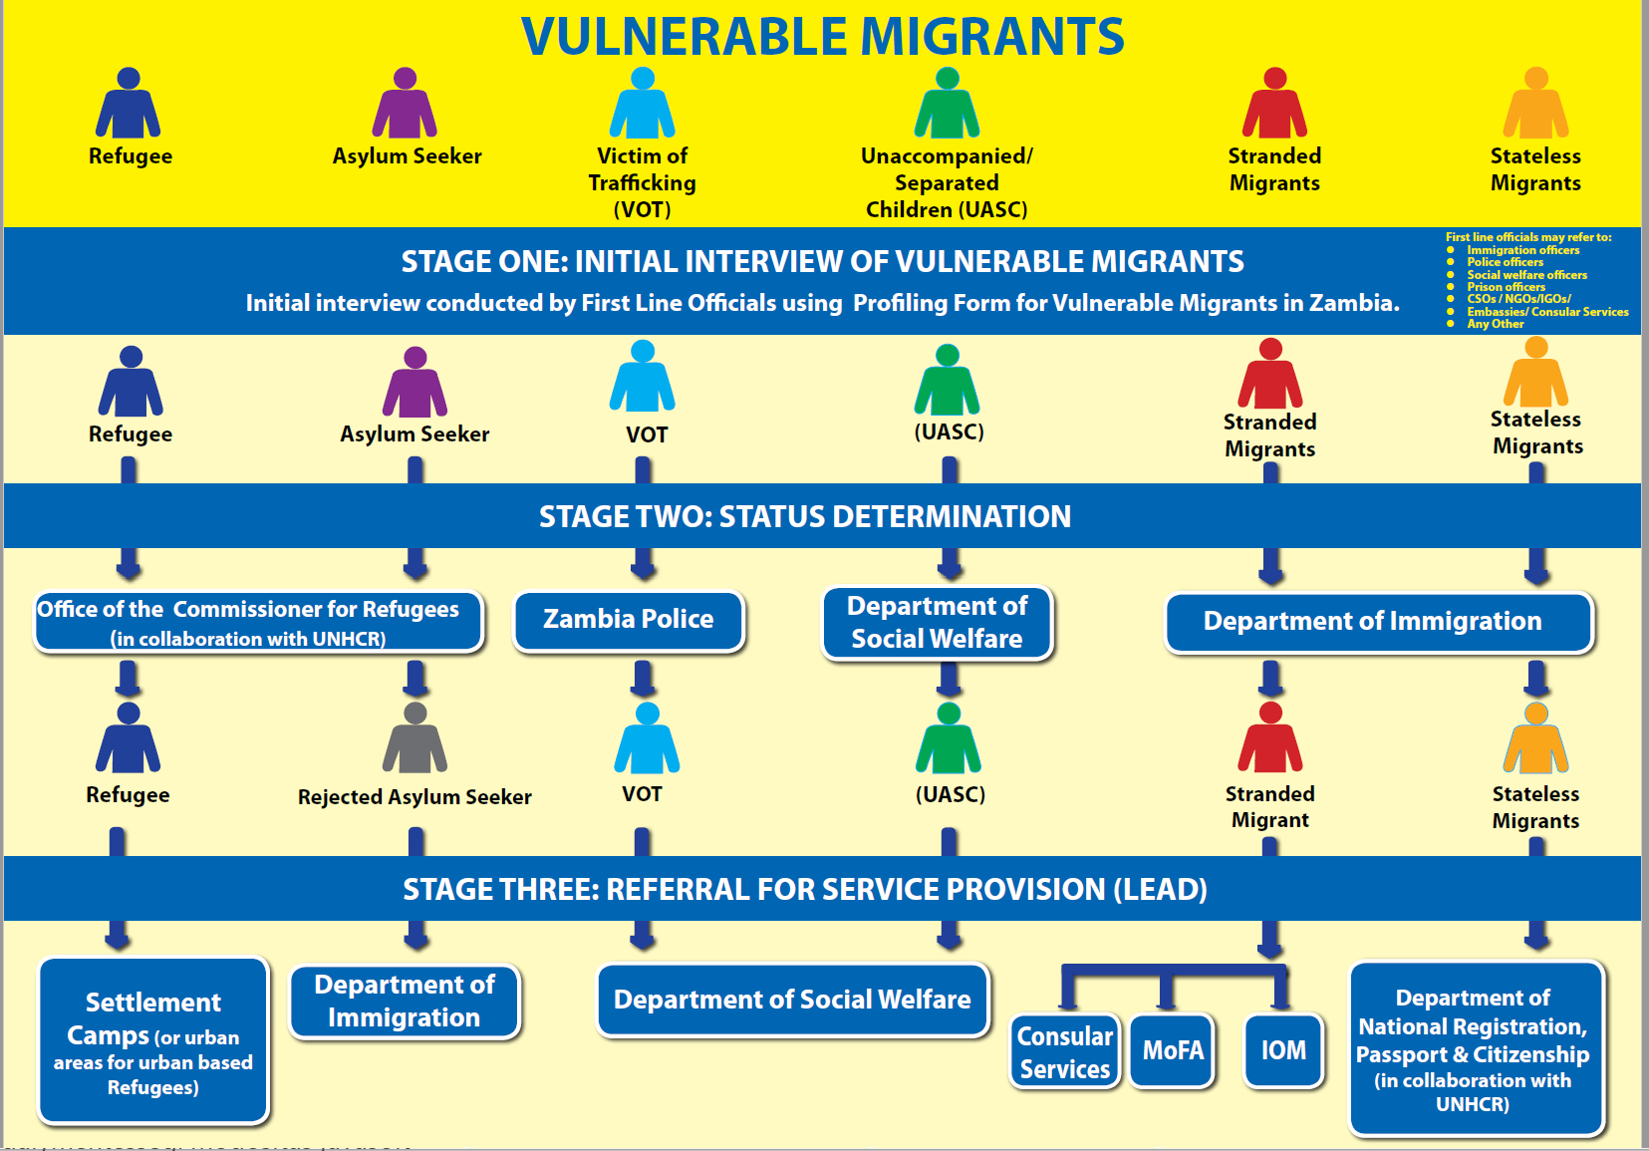
What does this mean in practice? The Zambian National Referral Mechanism
Source: om.int/sites/g/files/tmzbdl486/files/migrated_files/Country/docs/National-Referral-Mechanism-NRM-for-the-Protection-of-Vulnerable-Migrants-in-Zambia.pdf (20221120)

Slide 5
The goal
The duality of the overarching goals reflected in the objective
Overarching:
shared responsibility to
address risks and challenges for
Communities Individual migrants
Reduce the incidence Facilitate safe, orderly and impact of irregular m. and regular (SOR) m.
In Objective 12
- Adequate, effective and timely - human rights based screening of ALL migrants - international law respecting in order to control („Assess”) - individual assessment - referral of m. in vulnerable (inherent suspicion) situation, especially children
Notes:
Duality in cross cutting principles
National Sovereignty = Rule of law/due process govern migration distuingish between regular and irregular m
Human Rights
Child sensitive Whole of government approach
Screening goal: „Prüfung und Einzelbeurteilung”, les contrôles et évaluations individuelles = screening and individual assessment

Slide 6
The short but winding road of drafting
Zero draft 2018 February 5:
„Strengthen procedures and mechanisms for status determination”
We commit to develop and strengthen effective, human rights-based and protection-sensitive mechanisms and procedures for the identification and status determination of all migrants, in order to ensure adequate and timely referral, and assistance at all stages of the migration cycle, as well as to distinguish clearly between migrants and refugees.
Adopted text, 2018 July 13
Strengthen certainty and predictability in migration procedures for appropriate screening, assessment and referral
We commit to increase legal certainty and predictability of migration procedures by developing and strengthening effective and human rights-based mechanisms for the adequate and timely screening and individual assessment of all migrants for the purpose of identifying and facilitating access to the appropriate referral procedures, in accordance with international law.
Green – identical
Beige - more or less equivalent
Red, strikethrough – lost
Blue - added

Slide 7
The short and winding road of drafting
Two conceptual changes:
Elimination of all direct references to asylum seekers, refugees and asylum.
Zero Draft, action 1: „ promote effective and swift status determination, protection and referral of asylum seekers, refugees and migrants, including those displaced in the context of disasters and crisis.”
action 5: „ Ensure that information on the right to asylum or other forms of international protection are appropriately and effectively communicated…”
Elimination of reference to status determination
Zero and zero+ „ We commit to … protection-sensitive
… status determination of all migrants,…”
Draft, 2nd revision (May 2018)
„effective and protection-sensitive mechanisms …screening and individual assessment of all migrants for the purpose of … facilitating access to the appropriate determination”
Action 5: Ensure that information on …. access to the right to seek asylum or other adequate forms of protection, …are …. communicated, and accessible to all migrants, including in the context of mixed movements, in order to facilitate access to the appropriate determination and referral procedures”
The words could be eliminated, but the inherent duality in „mixed movements” - the presence of refugees awaiting identification and recognition - not!

Slide 8
The normative environment - examples
 | Hard law | Soft law / Policy document
Universal | ICCPR, 1966, Convention on the Elimination of All Forms of Discrimination against Women (1979) Convention against Torture and Other Cruel, Inhuman or Degrading Treatment or Punishment (1984) Convention on the Rights of the Child (1989) International Convention on the Protection of the Rights of All Migrant Workers and Members of Their Families (1990) [„Palermo”] Protocols to the UN Convention against Transnational Organized Crimes on trafficking and on smuggling, 2000 | New York Declaration 2016 UN Global Plan of Action to Combat Trafficking in persons, 2010 UN HCHR Recommended Principles and Guidelines on Human Rights at International Borders 2014 UN Counter-Terrorism Implementation Task Force (CTITF) Working Group on Protecting Human Rights while Countering Terrorism: Handbook on human rights and screening in border security and management
Regional | Regional Human Rights Conventions (Africa, Americas, Europe) Council of Europe, Convention on Action against Trafficking in Human Beings, 2005 EU Visa Code; EU Schengen Borders Code; EU GDPR regulation; EU Return directive; EU Screening regulation [New Pact, 2020 proposed] (when adopted) Return and readmission agrements | Group of Experts on Action against Trafficking in Human Beings (GRETA) (CoE): Guidance Note on the Entitlement of Victims of Trafficking, and Persons at Risk of Being Trafficked, to International Protection
Nati-onal | Rules on immigration procedures, asylum procedures, border controls, non-discrimination, child protection | e.g. National Referral Mechanism (NRM) for the Protection of Vulnerable Migrants in Zambia
Jurisprudence and treaty bodies’ output interpreting and applying the normative instruments, e.g. Chowdury and others v. Greece, ECtHR, Application no. 21884/15, 30 March

Slide 9
Links to other objectives („O”)
Direct link
O3 [Information] Accurate and timely info at all stages of migration – predictability and certainty
Labour market and visa info a)
Information points along the migration route –referral to child and gender responsive support and counselling c)
Child sensitive and gender responsive info for „newly arrived migrants”
Q7 [Vulnerabilities]
- uphold best interest of the child, apply gender responsive approach „including in responses to mixed movements”
Identification and assistance, protection of their HR „regardless of their migration status” b)
Unaccompanied and separated children: establish „specialized procedures for their identification, referral, care and family reunification” f)
Access to public or affordable legal assistance „in legal proceedings” g)
Involve local authorities and stakeholders in the identification, referral and assistance of migrants in situation of vulnerability k)
Remote link
O1 [Data collection ]
O5 [Enhance regular m]
- reduce visa processing time
- admit persons compelled to leave due to sudden onset natural disaster or „other precarious situation” – provide humanitarian visa
- devise planned relocation and visa options for victims of slow onset environ-mental change, including climate change
O17 [Eliminate discrimination]
O23 [International cooperation]
- Capacity building, mobilizing technical and financial resources

Slide 10
Links to other objectives
O9 [Smuggling]
- Identification of smuggled migrants, attention to special needs of women and children.
- Provide training on smuggling f)
O10 [Trafficking]
enhance the identification and protection of, and assistance to victims of trafficking, paying particular attention to women and children.
Train public officials and law enforcement officers to identify signs of trafficking in persons
Raise awareness of prospective migrants by info campaigns
O11 [Integrated, secure and coordinated border management]
Cooperate on on „proper identification, timely and efficient referral, assistance and appropriate protection of migrants in situations of vulnerability” a)
Effective border management by pre-screening of arriving persons, pre-reporting by carriers b)
Apply due process in screening, in individual assessment and interview
If unaccompanied or separated child crosses the border: promptly inform and involve the child protection authority
O13 [Detention]
Detention be a last resort, necessary, proportionate, based on individual assessment,for the shortest possible period, not a deterrent
Respect the best interest of the child /No prohibition of detention!/

Slide 11
Links to other objectives
O14 [Consular protection] Strengthen consular capacities in order to identify, protect and assist nationals abroad who are in a situation of vulnerability, including … victims of trafficking in persons, migrants subject to smuggling under aggravating circumstances; d)
Provide consular support to our nationals through advice, including on local laws and customs, … as well as through the issuance of relevant documentation, such as travel documents and consular identity documents… f)
O 21 [Return and readmission]
Uphold the prohibition of returning migrants when there is a real and foreseeable risk of death, torture and other cruel, inhuman and degrading treatment or punishment, or other irreparable harm, in accordance with our obligations under international human rights law.
Uphold procedural safeguards and individual assessment as well as legal certainty
Promote gender-responsive and child sensitive return programmes
Cooperate on identification of nationals and issuance of travel document

Slide 12
Focal points of the analysis, the good and the bad
The good
The text makes reference to culturally sensitive counselling and calls for training to recognise signs of trauma.
It focuses on persons with special needs or “migrants in situations of vulnerability”, reflecting in a compressed form ideas expressed in much more detail in the “Principles and Guidelines, supported by practical guidance, on the human rights protection of migrants in vulnerable situations” produced by the UNHCHR and the Global Group on Migration.
It aims at producing certainty and predictability in all migration procedures, based on human rights and conducted in an effective, fast, individualised and non-costly way.
It requires relevant information to be made available for all migrants, in an appropriate, timely and effective way.

Slide 13
Focal points of the analysis, the good and the bad
The bad
Asylum seekers are not treated as a separate subgroup, the key concept of the New York Declaration – mixed movement – is mostly eliminated - therefore the problem unaddressed
Irregular migrants not in a situation of vulnerability get little attention
There is no word about civil society presence at the border or in these procedures.
Objective 12 remains fully silent about access to legal representation and the preconditions of free legal aid.
No word is devoted to the interview situation, language, interpreters, or legal remedies against the outcome of the „assessment”.
Issues with profiling, data mining, trespassing privacy, use of AI in pre-screening and screening, uncontrollable information exchange within the country and between states, in general the whole arsenal of the securitizing establishment is unreflected.

Slide 14
Focal points of the analysis, the indeterminate
Indeterminacy
Legal certainty and predictability for whom?
Screening and assessment serve the state.
The migrant – whether regular or part of the mixed flow – can not better predict whether
she’ll get the visa
will be detained,
residence right/work permit will be extended next time, etc.
Screening and individual assessment of „all migrants”
- Why? What for? Is a conference attendee a migrant to be screened?
How much control has the migrant over the data gained by screening?

Slide 15
Evaluation: Janus faced, random, opaque, partly redundant
Janus faced: O12 serves two lords
The securitizing forces aimed at a The migrant whose human right Foucaldian panopticon, wishing to and situation of vulnerability see and know everything about ought to be acknowledged and everybody crossing (or attempting responded to without delay to cross) the border
Random
The actions collected under the Objective 12 are incongruent. The utilitarian rules on streamlining regular migration – for work, e.g. – are followed by protecting people in vulnerable situation and steps related to refusal. Neither the persons affected, nor the types of migration, nor the place of action unite the five actions.
Opaque
The language is obscure „screening and assessment of all migrants”; relevant information on „available forms of protection”. The underlying cause is that the genuine nature of mixed movements, that includes refugees arriving as asylum seekers is not expressly mentioned.
Partly redundant
Overlaps with Objectives 3, 7, 9-11, 13, 14, 21.

Slide 16
THANKS!
BOLDIZSÁR NAGY E-mail: nagyb at ceu.edu
CEU IR Department
Vienna

