Slide 1
ELEMENTS OF THE EU ASLYUM LAW WITH SPECIAL RELEVANCE TO SYRIAN REGUGEES
Presented by Boldizsár Nagy,
at the workshop:
Syrian refugee crisis: Response and coordination
Istanbul, 17 October 2015

Slide 2
Three levels of regulation
International law (1951 Geneva Convention, 1950 European Convention on Human Rights, etc. )
European Union Law (in EU member states)
National law – implementing both
_______________________________________
Control (enforcement):
UNHCR
European Court of Human Rights („Strasbourg”)
Court of Justice of the European Union („Luxembourg”)
Domestic courts

Slide 3
The rationale behind developing an EU acquis: Schengen

Slide 4
Schengen
Purpose:
Abolition of controls at the internal borders
Measures logically following from the lack of border controls
protecting the external borders with the same level of security including checks and surveillance
intensive co-operation in customs, police and criminal justice matters
establishing a system to determine which state is responsible for the examination of asylum applications („Dublin”)

Slide 5
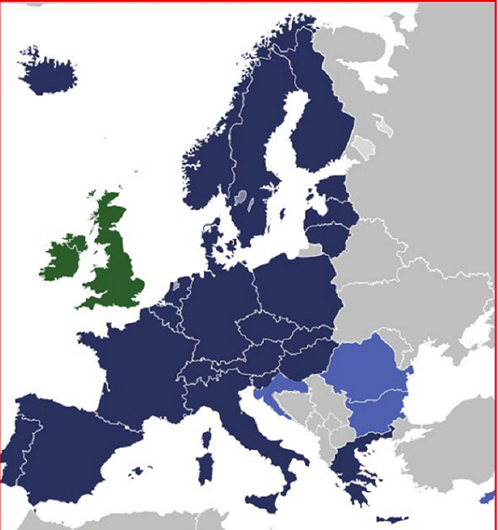
THE SCHENGEN AREA IN 2015
Notes:
The Schengen access control model consists of the following four tiers:
Measures at consulates,
cooperation with neighbouring countries,
border control,
and control measures within the Schengen area, including return.
COM (2008) 68 final (on EUROSUR), p.2, fn. 6

Slide 6
THE BASIC CONCEPTS OF EU LAW

Slide 7
Forms of decisions
Article 288 TFEU
…
A regulation shall have general application. It shall be binding in its entirety and directly applicable in all Member States.
A directive shall be binding, as to the result to be achieved, upon each Member State to which it is addressed, but shall leave to the national authorities the choice of form and methods.
A decision shall be binding in its entirety upon those to whom it is addressed.

Slide 8
Direct applicability, direct effect, primacy of eU law
Direct applicability: a regulation „automatically forms part of the (highest) provisions of a Member State’s legal order” – without transposition Laenarts – Van Nuffel (Bray, ed), Constitutional Law of the European Union, second ed. 2005, p. 764
Direct effect: if the regulation is clear and precise and leaves no margin of discretion then individuals can rely on it against the state and against each-other
Directive:
No direct applicability – needs transposition
May have direct effect if unconditional and sufficiently precise – and the state fails to transpose it on time. no direct applicability (needs transposition) but
Primacy/Supremacy of EC law: In case of conflict it has primacy even over later national acts, including statutes.
Notes:
The primacy of EC law over constitutions is debated!

Slide 9
Votes distribution – qualified majority
After 1 November 2014
1 member – 1 vote
Qualified majority = „double majority”
On a proposal from the Commission or the High Representative | On any other porposal
55% of the ministers (countries) (15) representing 65% of the population of the EU | 72 % of the ministers (20) representing 65 % of the population of the EU
Blocking minority : minimum 4 countries even if 3 represent more than 35 % of the population
The UK and Ireland may decide whether to participate in refugee-related matters, Denmark does not participate
Notes:
TEU, § 16:
4. As from 1 November 2014, a qualified majority shall be defined as at least 55 % of the members of the Council, comprising at least fifteen of them and representing Member States comprising at least 65 % of the population of the Union.
A blocking minority must include at least four Council members, failing which the qualified majority shall be deemed attained.
The other arrangements governing the qualified majority are laid down in Article 238(2) of the Treaty on the Functioning of the European Union.
5. The transitional provisions relating to the definition of the qualified majority which shall be applicable until 31 October 2014 and those which shall be applicable from 1 November 2014 to 31 March 2017 are laid down in the Protocol on transitional provisions.
____________________________
TFEU, Article 238
(ex Article 205(1) and (2), TEC)
1. Where it is required to act by a simple majority, the Council shall act by a majority of its component members.
2. By way of derogation from Article 16(4) of the Treaty on European Union, as from 1 November 2014 and subject to the provisions laid down in the Protocol on transitional provisions, where Council does not act on a proposal from the Commission or from the High Representative of the Union for Foreign Affairs and Security Policy, the qualified majority shall be defined as at least 72 % of the members of the Council, representing Member States comprising at least 65 % of the population of the Union.
3. As from 1 November 2014 and subject to the provisions laid down in the Protocol on transitional provisions, in cases where, under the Treaties, not all the members of the Council participate in voting, a qualified majority shall be defined as follows:
(a) A qualified majority shall be defined as at least 55 % of the members of the Council representing the participating Member States, comprising at least 65 % of the population of these States.
A blocking minority must include at least the minimum number of Council members representing more than 35 % of the population of the participating Member States, plus one member, failing which the qualified majority shall be deemed attained;
(b) By way of derogation from point (a), where the Council does not act on a proposal from the Commission or from the High Representative of the Union for Foreign Affairs and Security Policy, the qualified majority shall be defined as at least 72 % of the members of the Council representing the participating Member States, comprising at least 65 % of the population of these States.
4. Abstentions by Members present in person or represented shall not prevent the adoption by the Council of acts which require unanimity.

Slide 10
Asylum acquis
Adopted measures
1. Directive on temporary protection: 2001 TPD
2. Reception conditions directive (2003) recast: 2013 RD
3. Dublin III Regulation and its implementing rules (2003) recast: 2013
4. Regulation on Eurodac (2000) recast: 2013
5. Qualification (Refugee definition) directive (2004) recast: 2011 QD
6. Asylum procedures directive (2005) recast: 2013 PD
7. Establishment of an European Asylum Support Office: 2010
8. Decision on the new Asylum Migration and Integration Fund : 2014 AMIF
Notes:
Parliament to have first reading on new Asylum and Migration Fund regulation on March 12, 2014

Slide 11
Overview of the recasts
Secondary rule | Is there a recast? | State of play
European Refugee Fund 2007/573/EK határozat | New Fund | Regulation (EU) No 516/2014 of 20.5.2014 ( OJ 2014 L 150/168 ) establishing the Asylum, Migration and Integration Fund, amending Council Decision 2008/381/EC and repealing Decisions No 573/2007/EC and No 575/2007/EC of the European Parliament and of the Council and Council Decision 2007/435/EC
Temporary Protection Directive Council Directive 2001/55/EC | None
Eurodac Council Regulation 2725/2000/EC | Yes | Revised Eurodac Regulation: Reg. 603/2013: (OJ 2013 L 180/1) – deadline July 2015
Dublin II regulation Council Regulation 343/2003 EC | Yes | Revised Dublin Regulation: Reg. 604/2013: (OJ 2013 L 180/31) – applicable from 1 Jan. 2014
Reception Conditions Directive Council Directive 2003/9/EC | Yes | Revised Reception Conditions Directive 2013/33 (OJ 2013 L 180/96) – deadline July 2015
Qualification directive Council Directive 2004/83/EK irányelv | Yes | Revised Qualification Directive 2011/95/EU 20 December 2011 transformation deadline Dec. 2013
Procedures directive Council Directive 2005/85/EC | Yes | Revised Procedures Directive 2013/32 (OJ 2013 L 180/60) – transformation deadline July 2015

Slide 12
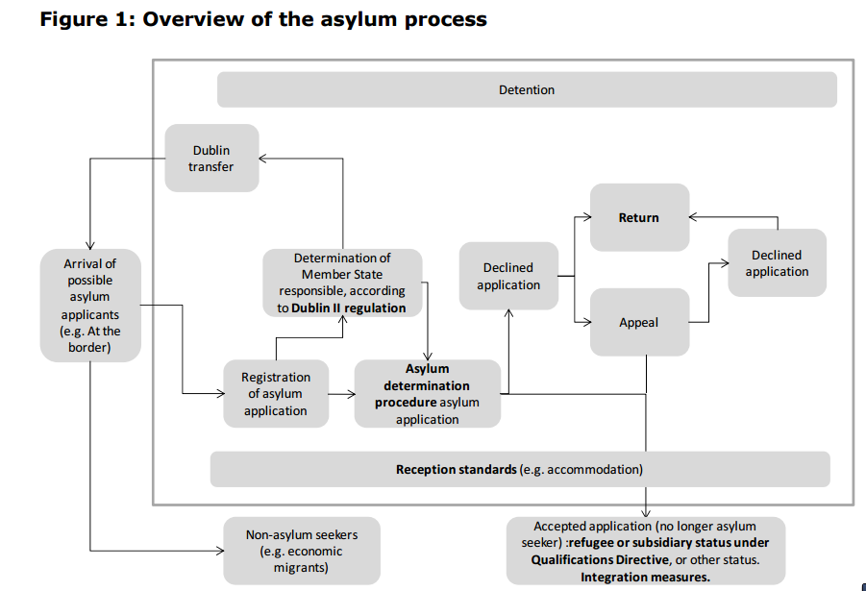
The asylum process
to Dublin III. regulation
Source: (European Parliament:) What system of burden-sharing between Member States for the reception of asylum seekers? A study written by Dr Christina Boswell, Dr Eiko Thielemann and Richard Williams, PE 419.620,, p-34, adjusted for Dublin III by B.N.

Slide 13
Key questions
Who should decide if the person is a refugee? = which is the responsible state for the asylum procedure = Dublin
Can the asylum seeker be returned to a non EU member state (instead of applying Dublin) = safe third country
What to do if the refugee found protection in a non-EU country (e.g. Turkey, Lebanon, Jordan), but after some time moves on = first country of asylum, „secondary movement”
Does the refugee have a choice as to the country of asylum? (see aso answers to 2 and 3)
Can states close their borders, claiming „too many came, the country is full” = non-refoulement
Why is the temporary protection directive not applied?
Are there persons, who can be excluded („terrorists”)? = exclusion grounds and procedure
What solidarity is conceivable among EU member states? = relocation, hotspots, AMIF
What solidarity with those state who host most refugees. (Resettlement, EU Trust Fund for Syria /”Madad Trust Fund”/), Emergency Trust Fund for Africa

Slide 14
1. WHO SHOULD DECIDE WHETHER THE PERSON IS A REFUGEE? WHICH IS THE RESPONSIBLE STATE FOR THE ASYLUM PROCEDURE? = THE DUBLIN SYSTEM

Slide 15
PURPOSE AND PHILOSOPHY OF DUBLIN
Every asylum seeker should gain access to the procedure. There must be a MS to determine the case
Only one procedure should be conducted within the Union. A decision by any MS be taken in the name of others = no parallel or subsequent application should take place
Notes:
See The Commission’s suggestion of 2001 (COM) 2001 447 final p.3
Goal: A unified area without internal borders - that justifies tthat only one decision be taken.
Further goals of the regulation:
Closing the gaps of the Dublin Convention
Drawing the consequence of the single visa lists
Speeding up the procedure
Increasing efficiency (the number of persons effectively transferred)

Slide 16
The philosophy of Dublin: under what conditions is taking charge by another state –without investigation of the merits in the first state fair
Fairness preconditions
If the substantive law (the refugee definition) is identical
If procedural rules guarantee equal level of protection at least in terms of
- legal remedies (appeals)
- access to legal representation
- reception conditions (support) during the procedure (detention, e.g.!)

Slide 17
Regulation 604/2013/EU (Dublin III) criteria 8 – 15. § (simplified)
„Coupling principles” = criteria identifying the responsible state
Family (narrowly defined)
Visa or residence permit
External border crossed in irregular fashion
Place of submission
Notes:
The responsible state has to be requested as soon as possible but not later than 3 months after the submission of the application. If not: loss of right to transfer
Reply: within 2 months. Silence = agreement In urgent cases: 1 month for reply
Transfer: within 6 month from acceptance to take charge or from the end of procedure in which transfer was challenged = taking charge
______________________________
In case the applicants leaves the state’s territory during the procedure of
determining the responsible state
determining whether she qualifies for status (merits)
or after a negative decision
that state has to take her back.
Reply: within 1 month (if Eurodac based request: 2 weeks)
Taking back: within 6 months from acceptance
= taking back

Slide 18
Burden shifting
NOT BURDEN SHARING !

Slide 19
Dublin
Taking charge: no application in the responsible state
Taking back: departure after application
Eurodac not decisive, but shorter deadlines
(2 instead of 3 months to request take back)
No response – acceptance of responsibility

Slide 20
The lesson taught by Greece’s non-performance Article 3 (2)
Where it is impossible to transfer an applicant to the responsible Member State „because there are substantial grounds for believing that there are systemic flaws in the asylum procedure and reception conditions for asylum applicants in that Member State resulting in risk of inhuman or degrading treatment” the determining Member State may search for another responsible state or must proceed itself.
______________________________________________________________________________
Particular pressure on a member state or systemic failure: Commission to call for a preventive action plan
Serious risk of crisis – compulsory crisis management action plan upon invitation of the Commission
Last resort: instead of Dublin resort to Art 78 (3 )of TFEU:
„In the event of one or more Member States being confronted by an emergency situation
characterised by a sudden inflow of nationals of third countries, the Council, on a proposal from the Commission, may adopt provisional measures for the benefit of the Member State(s) concerned. It shall act after consulting the European Parliament.”
Two decisions on relocation of September 2015 moving from Italy and Greece 40 + 120 thousand persons
Notes:
Further important changes in the recast:
„Family”, „relative” „dependence” defined more embracing
New or more detailed rules on
providing information to the applicant (in writing, by EU wide leaflet) (§ 4)
compulsory personal interview (§ 5)
guarantees for minors (§ 6) and (§ 8)
avoiding determination of family members’ applications in different states (§ 11)
discretionary” (humanitarian) clause expanded (bringing together dependent persons and those on whom they depend) (§ 17)
taking back (completing the case on the merits or allowing a fresh procedure without considering it a repeat application) (§ 18)
clear rules on taking back even if the person does not apply in the requesting state (§ 24)
more than 3 months absence from MSs or after effective removal = new application (§ 19)
If Eurodac hit: request must be sent within two (not three) months
Separate article on „effective remedy, in the form of an appeal or a review, in fact and in law” against a transfer decision „within reasonable time” (§ 27) MS may decide whether
the applicant has a right to stay or,
there is suspension of the transfer which is subject to „ a close and rigorous scrutiny” by a court or tribunal,
the applicant has the right to ask for the suspension. While deciding that request based on „close and rigorous scrutiny” suspension must be granted
Detailed rules of exchange on data before transfer (including info on health)

Slide 21
2. CAN THE ASLYUM SEEKER BE RETURNED TO A NON EU MEMBER STATE (INSTEAD OF APPLYING DUBLIN) = SAFE THIRD COUNTRY

Slide 22
The notion of the safe third country (§ 38 PD)
Life and liberty are not threatened on account of the 5 Geneva Convention grounds (race, religion, political views, nationality, belonging to a particular social group) and there is no risk of torture, inhuman or degrading treatment or punishment, or threat because of indiscriminate violence in armed conflict; and
the principle of non-refoulement is respected; and
the prohibition of removal in breach of the right to freedom from torture and cruel, inhuman or degrading treatment and punishment as laid down in international law is respected; and
the possibility exists to request refugee status and, if found to be a refugee, to receive protection in accordance with the Geneva Convention.
Notes:
Article 38
The concept of safe third country
1. Member States may apply the safe third country concept only where the competent authorities are satisfied that a person seeking international protection will be treated in accordance with the following principles in the third country concerned:
(a) life and liberty are not threatened on account of race, religion, nationality, membership of a particular social group or political opinion;
(b) there is no risk of serious harm as defined in Directive 2011/95/EU;
(c) the principle of non-refoulement in accordance with the Geneva Convention is respected;
(d) the prohibition of removal, in violation of the right to freedom from torture and cruel, inhuman or degrading treatment as laid down in international law, is respected; and
(e) the possibility exists to request refugee status and, if found to be a refugee, to receive protection in accordance with the Geneva Convention.
2. The application of the safe third country concept shall be subject to rules laid down in national law, including:
(a) rules requiring a connection between the applicant and the third country concerned on the basis of which it would be reasonable for that person to go to that country;
(b) rules on the methodology by which the competent authorities satisfy themselves that the safe third country concept may be applied to a particular country or to a particular applicant. Such methodology shall include case-by-case consideration of the safety of the country for a particular applicant and/or national designation of countries considered to be generally safe;
(c) rules in accordance with international law, allowing an individual examination of whether the third country concerned is safe for a particular applicant which, as a minimum, shall permit the applicant to challenge the application of the safe third country concept on the grounds that the third country is not safe in his or her particular circumstances. The applicant shall also be allowed to challenge the existence of a connection between him or her and the third country in accordance with point (a).
3. When implementing a decision solely based on this Article, Member States shall:
(a) inform the applicant accordingly; and
(b) provide him or her with a document informing the authorities of the third country, in the language of that country, that the application has not been examined in substance.
4. Where the third country does not permit the applicant to enter its territory, Member States shall ensure that access to a procedure is given in accordance with the basic principles and guarantees described in Chapter II.
5. Member States shall inform the Commission periodically of the countries to which this concept

Slide 23
The notion of the safe third country
meaningful link between applicant and s.t.c.
investigation if a particular country is safe for the particular asylum seeker
a right of the a.s.to challenge the safety at least when torture and inhuman or degrading treatment or punishment is threatening the a.s.
_________________________________________________
If inadmissible because of s.t.c. :
- inform a.s. accordingly,
- provide a.s. with document informing the s.t.c. that the application has not been examined in substance

Slide 24
3. WHAT TO DO IF THE REFUGEE FOUND PROTECTION IN A NON-EU COUNTRY (E.G. TURKEY, LEBANON, JORDAN), BUT AFTER SOME TIME MOVES ON = FIRST COUNTRY OF ASYLUM, „SECONDARY MOVEMENT”

Slide 25
First Country of asylum
The application is inadmissible (no examination of the merits) if there is a first country of asylum (§ 35 PD).
Definition
If the asylum seeker has been recognised in that country as a refugee
and he/she can still avail himself/herself of that protection, or
he/she enjoys otherwise sufficient protection in that country, including benefiting from the principle of non-refoulement,
provided that he/she will be re-admitted to that country.
_________________________
Applicant has a right to challenge inadmissibility on the basis of c. f.a.
_________________________
Turkey, Lebanon, Jordan?
Notes:
Article 35
The concept of first country of asylum
A country can be considered to be a first country of asylum for a particular applicant if:
(a) he or she has been recognised in that country as a refugee and he or she can still avail himself/herself of that protection; or
(b) he or she otherwise enjoys sufficient protection in that country, including benefiting from the principle of non- refoulement,
provided that he or she will be readmitted to that country.
In applying the concept of first country of asylum to the particular circumstances of an applicant, Member States may take into account Article 38(1). The applicant shall be allowed to challenge the application of the first country of asylum concept to his or her particular circumstances.

Slide 26
4. DOES THE REFUGEE HAVE A CHOICE AS TO THE COUNTRY OF ASYLUM? (SEE ALSO ANSWERS TO 2 AND 3)

Slide 27
The choice o the refugee
Family, friends, acquaintances (own diaspora
Language
Past time spent
Labour market, right to establish a venture (self-employment)
Reception conditions
Integration assistance
Vicinity / distance to country of persecution (fast return / distance from danger, less competition with other refugees)
___________________________________________________
The more the refugee chooses the less social assistance (s)he will need.

Slide 28
5. CAN STATES CLOSE THEIR BORDERS, CLAIMING „TOO MANY CAME, THE COUNTRY IS FULL” = NON-REFOULEMENT

Slide 29
Non - refoulement
Narrow meaning: Geneva Convention Article 33
„No Contracting State shall expel or return (“refouler”) a refugee in any manner whatsoever to the frontiers of territories where his life or freedom would be threatened on account of his race, religion, nationality, membership of a particular social group or political opinion.”
Exception: national security danger or final sentence for serious crime in country of asylum
Broad meaning: Art 3 of the European Convention of Human Rights: - ground irrelevant - applIes to any person, not just to refugees
- prohibition is absolute.
But, what if extremely large number of refugees come („mass influx”) - prevailing view: still applies

Slide 30
6. WHY IS THE TEMPORARY PROTECTION DIRECTIVE NOT APPLIED?
2001/55 EC Directive on Giving Temporary Protection in the Event of a Mass Influx of Displaced Persons and on Measures Promoting a Balance of Efforts Between Member States in Receiving Such Persons and Bearing the Consequences Thereof 2001 July 20, OJ L 212/12

Slide 31
Temporary Protection Directive
Beneficiaries = ‘displaced persons’
who
have had to leave their country or region of origin,
or have been evacuated,
and are unable to return in safe and durable conditions
in particular:
(i) persons who have fled areas of armed conflict or
endemic violence;
(ii) persons at serious risk of, or who have been the victims
of, systematic or generalised violations of their human rights;

Slide 32
Temporary Protection Directive
Mass influx means arrival in the Community
of a large number of displaced persons,
who come from a specific country or geographical area
The Council decides by qualified majority the start and end of T.P.
Duration
1 year + max two times 6 months
= total max: 2 years
Council may end it earlier, but must not exceed two years‘
_______________________________________
Not applied until October 2015
Why?
The Member States ought to assist the obtaining of the necessary visas,
including transit visas. Formalities ought to be reduced to a minimum. Visas should be free of charge or their cost reduced to a minimum (§ 8 /3/ TPD)
The Temporary Protection Directive includes a solidarity mechanism (even if voluntary) on the relocation of refugees
Right to work, self-employment and to family unification are recognised

Slide 33
7. ARE THERE PERONS, WHO CAN BE EXCLUDED („TERRORISTS”)? = EXCLUSION GROUNDS AND PROCEDURE

Slide 34
Exclusion of terrorists
Terrorists are unlikely to come as refugees, as they have to be photographed, give 10 fingerprints and give detailed account about their life
Terrorists can be excluded from protection (and returned, unless Art. 3 of the ECHR would be violated)
Exclusion grounds: crimes against peace, war crimes, crimes against humanity, serious non-political crimes, acts contrary to the principles and purposes of the UN.
See QD Preamble, para 31 „Acts contrary to the purposes and principles of the United Nations are … embodied in the United Nations resolutions relating to measures combating terrorism, which declare that ‘acts, methods and practices of terrorism are contrary to the purposes and principles of the United Nations…’”

Slide 35
8. WHAT SOLIDARITY IS CONCEIVABLE AMONG EU MEMBER STATES? = RELOCATION, HOTSPOTS, AMIF

Slide 36
Relocation decisions
Relocation: distributing among Member States those asylum seekers who are already within the EU and have a good chance of being recognised – i.e. members of groups with 75% recognition rate in the previous quarter (Syrians, Iraqis and Eritreans)
2 decisions:
COUNCIL DECISION (EU) 2015/1523 of 14 September 2015
40 000 persons 24,000 from Italy, 16,000 from Greece
COUNCIL DECISION (EU) 2015/1601 of 22 September 2015
120 000 persons First year: 15,600 from Italy and 50,400 from Greece Second year: 54,000 either form the same two or from other Member States.
No relocation to Denmark, Ireland, UK, Greece and Italy – 23 MS take up the 40 plus 120 thousand
Relocating MS get 6000 euros/head
In exchange: Greece, Italy must develop „roadmap”

Slide 37
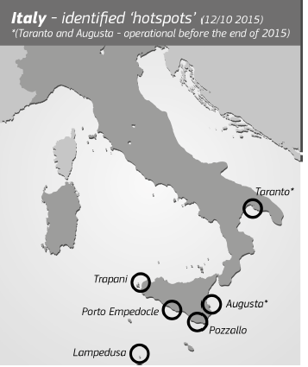
Hotspots, AMIF
Hotspots = in Italy and Greece: complex sites where experts from different EU MS work together in receiving and screening the applications and organising the return of those not in need of international protection. 6 planned
for Italy, 5 for Greece.
AMIF: Asylum, Migration and
Integration Fund 2014-2020: 2,6 billion
Euros!
To support the reception of
asylum seekers and the integration
of refugees and beneficiaries
of subsidiary protection
Source:
Brussels, 14.10.2015 COM(2015) 510 final ANNEX 5
Notes:
10 Frontex fingerprinters, 2 debriefing teams and 2 screening teams, alongside a team of 3 EASO experts for information provision.

Slide 38
9. WHAT SOLIDARITY WITH THOSE STATE WHO HOST MOST REFUGEES? RESETTLEMENT, EU TRUST FUND FOR SYRIA /”MADAD TRUST FUND”/, EMERGENCY TRUST FUND FOR AFRICA

Slide 39
Solidarity with those hosting refugees and support for other affected states
Resettlement of 22 thousand refugees from outside of the EU in the next two years finally decided on 1 October 2015.
Madad Fund to support Syrian refugee hosting countries (500 million Euros from the budget of the EU in 2015, to be matched by another 500 million donated directly by the MS)
Emergency Trust Fund for stability and addressing the root causes of irregular migration and displaced persons in Africa. „The Commission considers that national contributions should match the €1.8 billion EU funding.” COM(2015) 510 final COMMUNICATION FROM THE COMMISSION TO THE EUROPEAN PARLIAMENT, THE EUROPEAN COUNCIL AND THE COUNCIL Managing the refugee crisis: State of Play of the Implementation of the Priority Actions under the European Agenda on Migration, p. 10.)
Notes:
132 Syrians staying in neighbouring countries have already been resettled under the scheme agreed on 20 July 2015 to the Czech Republic (16), Italy (96), and Liechtenstein (20).
„
EU Trust Fund for Syria can reach at least €500 million this year;
COM(2015) 510 final COMMUNICATION FROM THE COMMISSION TO THE EUROPEAN PARLIAMENT, THE EUROPEAN COUNCIL AND THE COUNCIL Managing the refugee crisis: State of Play of the Implementation of the Priority Actions under the European Agenda on Migration

Slide 40
THANKS!
BOLDIZSÁR NAGY E-mail: nagyb@ceu.hu www.nagyboldizsar.hu CEU International Relations and Legal Departments Eötvös Lorand University, International Law Department

