Slide 1
FREE RIDING INSTEAD OF SOLIDARITY: AN ATTEMPT TO INTERPRET HUNGARY’S (ANTI)REFUGEE POLICY IN THE FRAME OF GLOBAL AND REGIONAL SUGGESTIONS FOR RESPONSIBILITY SHARING
Presentation by
Boldizsár Nagy
At the 2nd UNESCO Conference
“Refugees: Regional Approaches
to Global Challenges”
December 9, 2016
University of Zagreb
,
Notes:
1

Slide 2
THE FRAME HOW TO APPROACH SOLIDARITY RESPONSIBILITY SHARING

Slide 3
THE MATRIX OF FIELDS AND LEVELS OF ANALYS
Field / Discipline Level of analysis | Moral and Political Philosphy | Practical, Political | Legal, Justice-orinted | Social, Sociological, Psychological
State / Community | Responsibility sharing or shifting? Allocation of „burdens” | What is „in the interest of the state?” ever fewer asylum seekers? Minimum expenses? Avoidance of social tensions? | Compatibility with Geneva 51? Criteria of fairness: Procedural rights Substantive interpretation of definition Material reception conditions | Social identity construction of receiving society : why to protect refugees, (or why not) Selectivity according to country of origin
Individual / Family | Freedom of movement (choice of residence) Decresing vulnerability | Can she reach her preferred destination? Where is social integration the smoothest? | ECHR, Article 3, 8, 13 issues (Torture, inhuman degrading teatment or punishment, right to privacy and family, effective remedies) | Extended trauma Loss of trust in democracy (and its superiority over authori-tarian regimes)

Slide 4
Possible goals and venues of responsibility sharing/solidarity (or denial of them)
Goals
Venues
Addressing root-causes
Impact on routes, denial of entry, diverting arrivals
Harmonisation of rules
Allocation of persons
Financial contribution instead of receiving persons
Sharing of costs and benefits
Global
Inter-regional
Regional
Subregional
Bilateral
Intra-state (e.g. in a federation)

Slide 5
Possible criteria of responsibility sharing/solidarity
Applied by Criterion | Commission COM (2015) 450 final Crisis relocation mechanism | EU Council Relocation decision | Commission Dublin recast COM(2016) 270 final Corrective allocation mechanism | Germany Kőnigsteini key
Total GDP | Yes | Yes | Yes | No
GDP/fperson | (Yes) | (Yes) | No | No
Tax income | No | No | No | Yes
Population (size) | Yes | Yes | Yes | Yes
Territory | No | No | No | No
Population density | No | No | No | No
Unemployment | Yes | Yes | No | No
Number of earlier applicants | Yes | Yes | No | No
Physical proximity to country of origin (Neighbour, same region) | No | No | No | No
Cultural proximity | No | No | No | No

Slide 6
Possible criteria of responsibility sharing/solidarity
Applied by Criterion | Schmuck 1997 | Hathaway & Neve, 1997 | Schneider; Engler; Angevendt 2013
Total GDP | Yes (wealth”) | No (Yes – external supporter) | Yes (five years average –within EU average)
GDP/fperson | (Yes) | No (Yes – external supporter) | No
Tax income | No | No | No
Population (size) | No | No | Yes
Territory | No | No | Yes (Compared to EU total)
Population density | No | No | No
Unemployment | No | No | Yes
Number of earlier applicants | No | No | No
Physical proximity to country of origin (neighbour, same region) | Yes | Yes | No
Cultural proximity | No | Yes | No

Slide 7
HUNGARIAN ASYLUM LAW AND POLICY IN 2015–2016: SECURITIZATION INSTEAD OF PROTECTION AND LOYAL COOPERATION
Notes:
7

Slide 8
Applications and recognitions in Hungary
Year | Applicant | Recognised as refugee | Subsidiary protection | Non-refoulement
2000 | 7 801 | 197 | – | 680
2001 | 9 554 | 174 | – | 290
2002 | 6 412 | 104 | – | 1 304
2003 | 2 401 | 178 | – | 772
2004 | 1 600 | 149 | – | 177
2005 | 1 609 | 97 | – | 95
2006 | 2 117 | 99 | – | 99
2007 | 3 419 | 169 | – | 83
2008 | 3 118 | 160 | 88 | 42
2009 | 4 672 | 177 | 64 | 156
2010 | 2 104 | 83 | 132 | 58
2011 | 1 693 | 52 | 139 | 14
2012 | 2 157 | 87 | 328 | 47
2013 | 18 900 | 198 | 217 | 4
2014 | 42 777 | 240 | 236 | 7
2015 | 177 135 | 146 | 356 | 6
2000–2015 Total | 287 469 | 2 310 | 1 560 | 3 834
Source: Hungarian Statistical office http://www.ksh.hu/docs/hun/xstadat/xstadat_eves/i_wnvn003.html (20160929

Slide 9
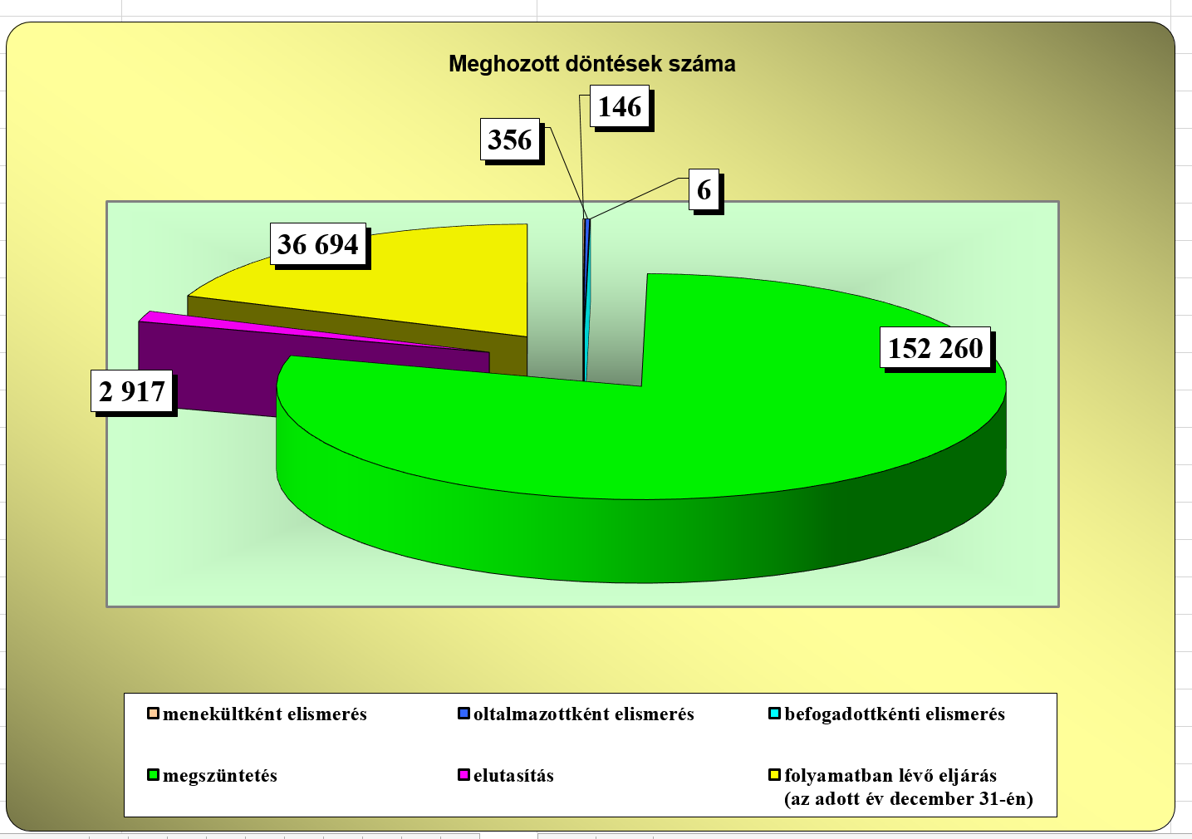
Protection is minimal
A form of protection. Ref - sp -nr
Pending
Terminated w/out substantive decision
Protection denied
Source: OIN, „Statisztikák” 2014-2015 . www.bmbah.hu (20160928)

Slide 10
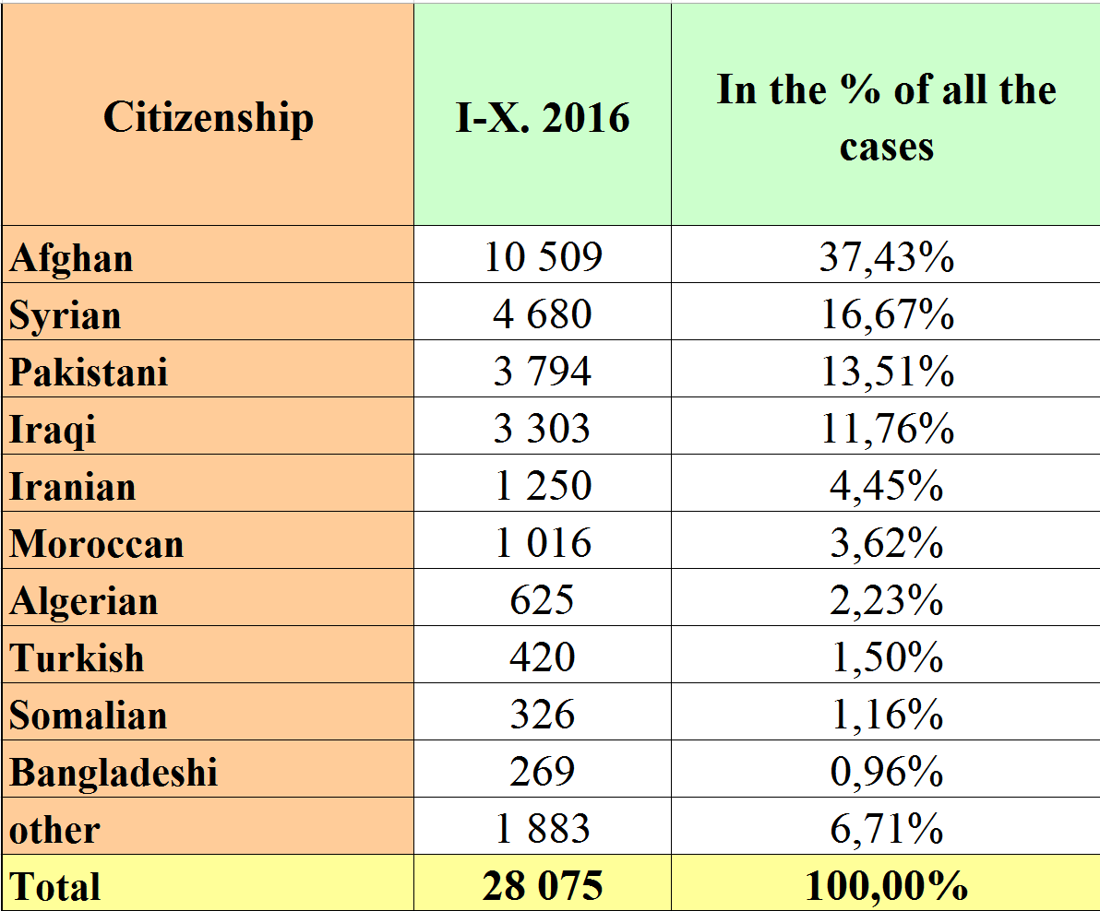
Arrivals, countries of origin
Source: OIN, Staistics I-X. 2015 - I-X. 2016 www.bmbah.hu (20161208)

Slide 11
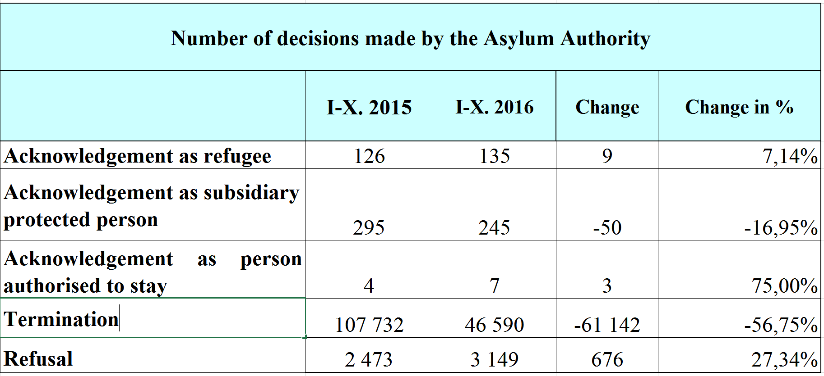
Decisions in 2016 until Nov 1
Source: OIN, Staistics I-X. 2015 - I-X. 2016 www.bmbah.hu (20161208)

Slide 12
Conxceptual frame
Securitisation
Majority identitarian populism
Crimmigration

Slide 13
What does Hungary do instead of protecting the refugees?
1.
IT IS IN DENIAL
6.
BREACHES EU AND DOMESTIC LAW
2.
DETERS
5.
FREE RIDES Denies solidarity
3.
OBSTRUCTS
4.
PUNISHES

Slide 14
Hungary: no genuine response to the increased flows with a view to protection. Instead of protection
DENIAL DETERRENCE OBSTRUCTION PUNISHMENT
Hungary does not need livelihood immigrants” title of the parliamentary debate day on 22 February 2015 _______________________ „National consultation on terrorism and immigration” (May 2015) _______________________ “Waves of illegal immigration threaten Europe with explosion…The European Union is responsible for the emergence of this situation… We have the right to defend our culture, language, values….” Parliament’s resolution 22 November 2015 | Reluctant reception and transport to reception centers in 2015 Fence at the border from 15 September 2015 _______________________ Systemic detention of asylum seekers _______________________ Non-access to basic services / inhuman treatment _______________________ Unpredictable denial / permission to move on to Austria before the closure _______________________ Crisis situation caused by mass immigration, renewed without legal ground in March 2016 | No creation of new reception and processing capacities / Closing down the largest in Debrecen _____________ „Transit zones” with 100/day capacity –decreased in March 2015 to 50 _____________ Serbia declared safe third country | Unauthorised crossing the „border closure” is a crime ___________________ Ineligible applicants are banned from the EU and detained even if removal is hopeless ___________________ Applying to people-smuggler rules to volunteers transporting refugees ___________________ Unlawful detention of applicants in the transit zone (w/out court control)
Notes:
14

Slide 15
Hungary: no genuine response to the increased flows with a view to protection. Instead of protection
FREE RIDING / LACK OF SOLIDARITY BREACHING THE LAW
Closing of the border (September and October 2015) only rerouted the flow | Building the fence in violation of environmental and nature conservation rules
Waving though approximately 233 000 persons without registration | Violating procedural guarantees in the border procedure (Including the lack of effective remedy)
Attacking the relocation decision in the CJEU in December 2015 | Violating rights of minors and access to translation in the criminal procedure
Refraining from resettlement, including under the Turkey – EU deal of March 18 | Systemic return to Serbia without obeying the EU-Serbia return agreement
Inititating a referendum against any compulsory relocation scheme | Inhuman conditions in front of the „transit zones”
After the failed referendum failed attempt to amend the Fundamental Law in order to block EU decision | Coercing persons apprehended within 8 kms from the fence with Serbia back across the fence leading to inhuman tratment
 | Denying the taking charge/taking back under Dublin
Notes:
15

Slide 16
Literature
Betts, Alexander: Comprehensive Plans of Action: Insights from CIREFCA and the Indochinese CPA UNHCR New issues in refugee research, No. 120 Geneva, 2006.
Hathaway, James A - Neve, Alexandre R : Making International refugee Law relevant Again: A proposal for Collectivized and Solution-oriented Protection Harvard Human Rights Journal, vol. 10 (1997) Spring, 115 – 211
Liguori, Anna: The extraterritorial processing of asylum claims, 2015 Working Paper Jean Monnet Centre of Excellence on Migrants’ Rights in The Mediterranean http://www.jmcemigrants.eu/category/working-papers/
Noll, Gregor. "Risky Games? A Theoretical Approach to Burden-Sharing in the Asylum Field." Journal of Refugee Studies 16.3 (2003): 236-52.
Noll, Gregor. „‘Visions of the Exceptional: Legal and Theoretical Issues Raised by Transit Processing Centres and Protection Zones’, European Journal of Migration and Law, vol. 5 (2003), pp. 303–341.
Schmuck, Peter H. „Refugee Burden Sharing: A Modest proposal” Yale Journal of International Law, Vol. 22 (1997) pp. 243 – 297
Schneider, Jan – Engler, Marcus – Angenendt, Steffen: European Refugee Policy Pathways to Fairer Burden-Sharing SachverständYesrat deutscher Stiftungen für Integration und Migration (SVR) Berlin, 2013

Slide 17
Thanks!
Boldizsár Nagy
Central European University
and Eötvös Loránd University
Budapest
nagyb@ceu.hu
www.nagyboldizsar.hu
Notes:
17

